Slide 1
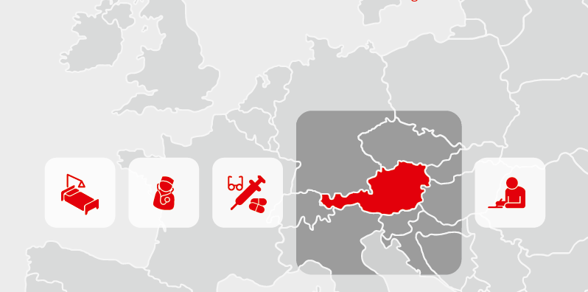
Austrian Health Care System
Jiranan Nhujak, Markus Oberhofer, Mihai-Dan Buca, Frederic Strunz, Veronika Emelianova

Slide 2
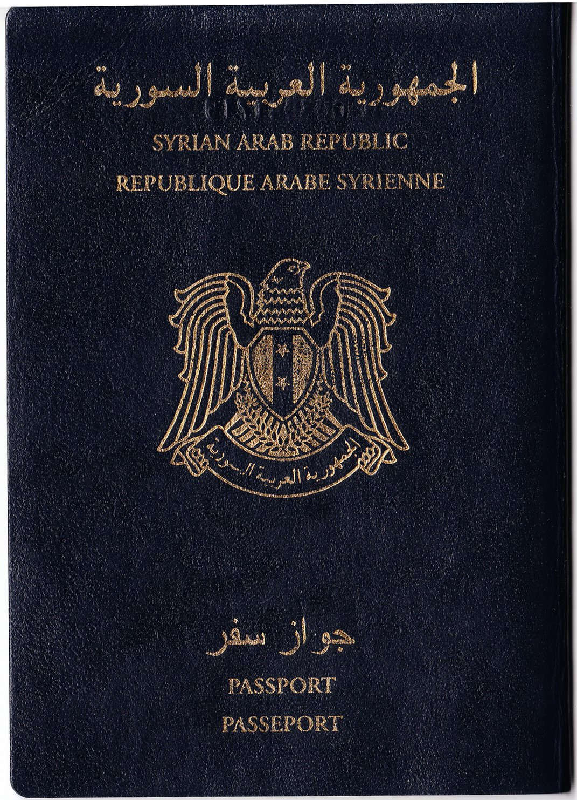
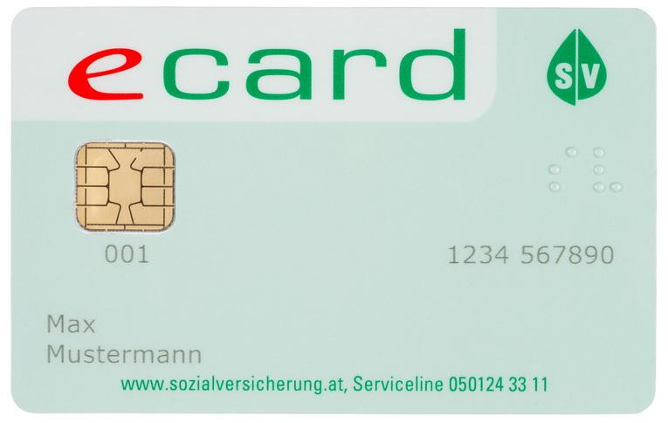
How to consume health care services
In emergency cases when you need hospital services:
Going to the Anmeldung/Leitstelle for registration.
Showing the electronic health care card or passport which should be carried at all times.

Slide 3
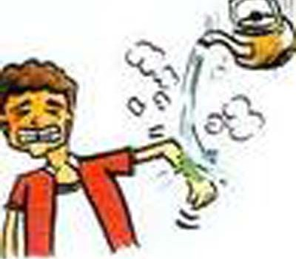
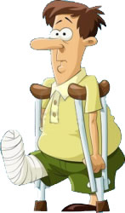
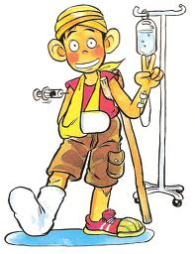
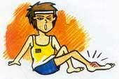
How to consume health care services
3. Doctors will call the patients by emergency priority queue.
4. After seeing the doctor, the doctor will give you a prescription in order to get the medicines you need from pharmacists. People cannot buy any intense medicines by themselves without prescript.

Slide 4
How to consume health care services
in non-emergency cases:
family doctors (General practitioners)
trained to provide primary health care
for either sex and any age
usually the first doctors to diagnose and
treat most common medical problems
prescribe medicines
order laboratory tests
Notes:
in non-emergency cases:
Family doctors (General practitioners) who is trained to provide primary health care to patients of either sex or any age can help refugees. Family doctors are usually the first doctors to diagnose and treat most medical problems. If they need to see a specialist doctor, people usually need a family doctor to refer them. Family doctors also order laboratory and other tests.

Slide 5
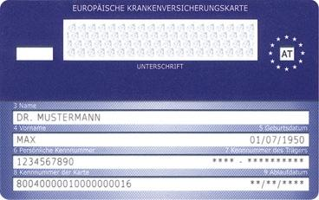
How to consume health care services
E-cards enable access to the health care system.
The E-Card is required to go to doctors, dentists or hospitals, if no other insurance is in place.
Personal information, such as name, date of birth are stored on it → kind of ID.
Through the e-card, the Austrian government processes healthcare claims electronically, which significantly simplifies the procedure of health care.

Slide 6
How to consume health care services
E-card benefits
Short response time
Short waiting time
Close and practicable medical care
Undisturbed therapy and continuous approval process

Slide 7
How to consume health care services
When people choose a family doctor, they may think about:
Is the doctor accepting new patients? Can they make appointments at a convenient time? Does the doctor answer their questions clearly? Does the doctor explain their options for treatment? Is there a medical lab where basic tests can be done? Which hospital does the doctor send patients to?

Slide 8
How to consume health care services
Pharmacies and medicines in Austria:
shops where you can buy drugs
Monday to Friday: 8am - 6pm
Saturday: 8am - 12pm
At least one pharmacy is 24/7
for more information call: 1455

Slide 9
The most important emergency numbers
112 - Common European Emergency Number
Will connect you with the responsible emergency-division
(ambulance, fire, rescue, police)
Valid all over Europe
Can be dialled free of charge from any fixed or mobile phone
Can be called even if a phone is blocked by the user or by non-payment of bills
All services are free of charge. In case of inappropriate calls and pranks, the costs of intervention can be charged to the perpetrator.
Notes:
http://europedirectleeds.org.uk/wp-content/uploads/2011/02/112-logo_in_european_flag.jpg
http://www.clipartlord.com/wp-content/uploads/2014/04/ambulance5.png

Slide 10
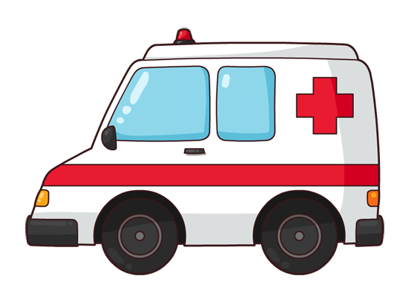
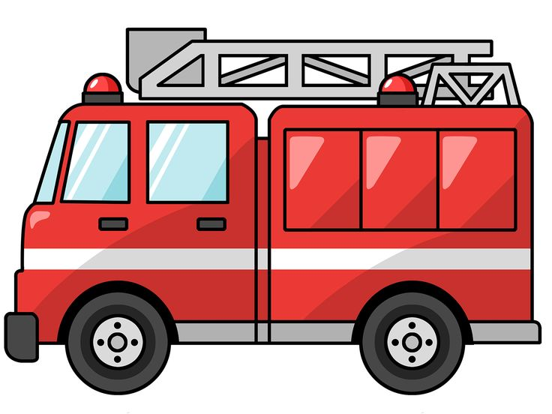
The most important emergency numbers
144
Ambulance
Responsible for all kind of medical emergencies
Heavy injuries, intoxication, heavy sickness
Reserved for people in emergency situations, in need of immediate help
133
Police
Maintaining public order and security
Road accidents, domestic burglaries, personal injury, criminal offences
122
Firefighters
Rescuer, extinguish hazardous fires that threaten property and civilian or natural populations.
Rescue people from dangerous situations:
collapsed buildings / burning buildings / crashed vehicles
All services are free of charge. In case of inappropriate calls and pranks, the costs of intervention can be charged to the perpetrator.

Slide 11
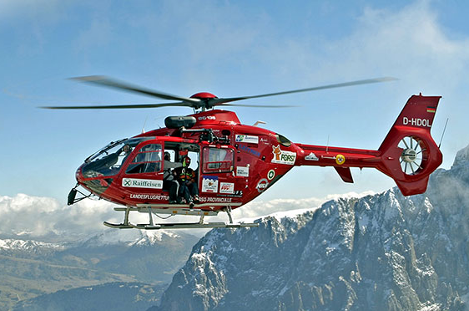
The most important emergency numbers
140 Austrian Mountain Rescue
128 Gas-emergency service
1455 Pharmacy-emergency
147 Emergency-service for children
0800 133 133 SMS police emergency for the deaf
01 406 43 43 Poison-control-centre
Notes:
http://www.val-gardena.com/images/gardena/735x458/winter/ro20052920b.jpg
http://www.clipartsheep.com/images/503/gas-mask-logo-design-graphic-503739.jpeg
https://www.google.it/imgres?imgurl=http://www.clipartbest.com/cliparts/9TR/o4L/9TRo4LeTe.svg&imgrefurl=http://www.clipartbest.com/pharmacy-symbol&h=500&w=500&tbnid=11T0UU1IVz04cM:&docid=bOYyhyKW_LCBRM&ei=p7dlVsHCJIGUPtrxpIgJ&tbm=isch&ved=0ahUKEwiBsuSsmcrJAhUBig8KHdo4CZEQMwhYKBwwHA
http://wellcommons.com/groups/wellness/2011/nov/22/poison-control-answers-most-common-thank/
http://www.knowyourmobile.com/glossary/sms
http://www.sos-kinderdorf.at/getmedia/42bfb8f6-cd2c-49bc-9cb2-192f581f6599/header_haupt3_rad.jpg?width=700&height=336&ext=.jpg&maxsidesize=700
https://encrypted-tbn2.gstatic.com/images?q=tbn:ANd9GcSNiHKlAo_Q4As8nLWMNQunl4JJJSKYvci274hsxleEqDv15HgQ
http://www.ahrthene.de/files/2011/05/Logo_Frauennotruf_Koblenz-266x300.jpg

Slide 12
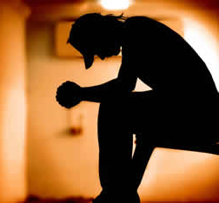
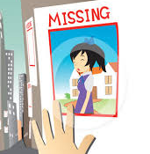
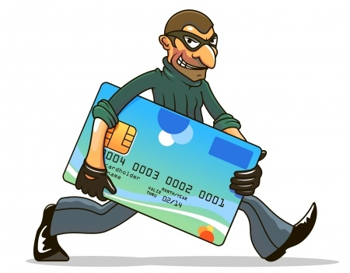
The most important emergency numbers
01 313 30 Psychiatric care
Blocking ATM and Credit-cards:
0800 2048800 Maestro
0800 900940 American Express
01 501 35 Diners Club
01 717 01 4500 Euro/Mastercard
01 711 110 Visa
01 717 19 Emergency hotline for women
116 000 Missing children hotline
120 Austrian breakdown service
Notes:
https://www.google.it/search?q=psychiatric+care&safe=off&source=lnms&tbm=isch&sa=X&ved=0ahUKEwjG27XBn8rJAhVBKg4KHUAwAzwQ_AUIBygB&biw=836&bih=859#safe=off&tbm=isch&q=stolen+credit+card+clipart&imgrc=ucH_OxfbpfL10M%3A
http://www.ppoosiri.info/wpstd/07/wp-content/uploads/2014/08/ChildPsychiatricCare.jpg
http://jeep.mopar.eu/jeep/publishingimages/assistance/roadside-assistance/140x140_workshop.png

Slide 13
General Practitioners Contact (Female)
Dr. Schönthaler-Rössler Cornelia
Dorfgasse 2, +43 (0) 512 291589
Dr.med. Hirschberger Franziska
Speckbacherstraße 3, +43 (0) 512 560305

Slide 14
General Practitioners Contact (Male)
Dr. Peter Kleboth
Viktor Franz Hess Strasse 1, 6020 Innsbruck, Tel. +43 (0) 512-281919
Dr. Wolfgang Müllauer
Technikerstrasse 3/1, 6020 Innsbruck, Tel. +43 (0) 512-293262

Slide 15
Dentist Contact (Female)
Dr. Ursula Grömmer
Dr.-Stumpf-Strasse 75/32, 6020 Innsbruck, Tel. +43 (0) 512-292936
Dr. med. univ. Susanne Pröll
Dr.-Ferd.-Kogler-Strasse, 6020 Innsbruck, Tel. +43 (0) 512-393340

Slide 16
Dentist Contact (Male)
Lars Heidenreich Mag. Dr. med.
Olympiastrasse 17/6, 6020 Innsbruck, Tel. +43 (0) 512-363738
Dr. Lothar Tirala
Müllerstraße 13a 6020 Innsbruck, Tel. +43 (0) 512-581806

Slide 17
Depression, Homesickness, PTSD
Homesickness - try to integrate into the Austrian culture. It is difficult in the beginning to be in a new country, but try to meet some locals, make new friends and try to participate in typical Austrian activities.
Depression, PTSD - Praying and Meditation helps.
Meditation: Close your eyes, focus on your breaths and count to one in your mind when you breath in and silent your mind when you breath out. Do that two times, 10 minutes a day - will feel better in about 2 months
For more severe cases call 01 313 30 - psychiatric care number -

Slide 18
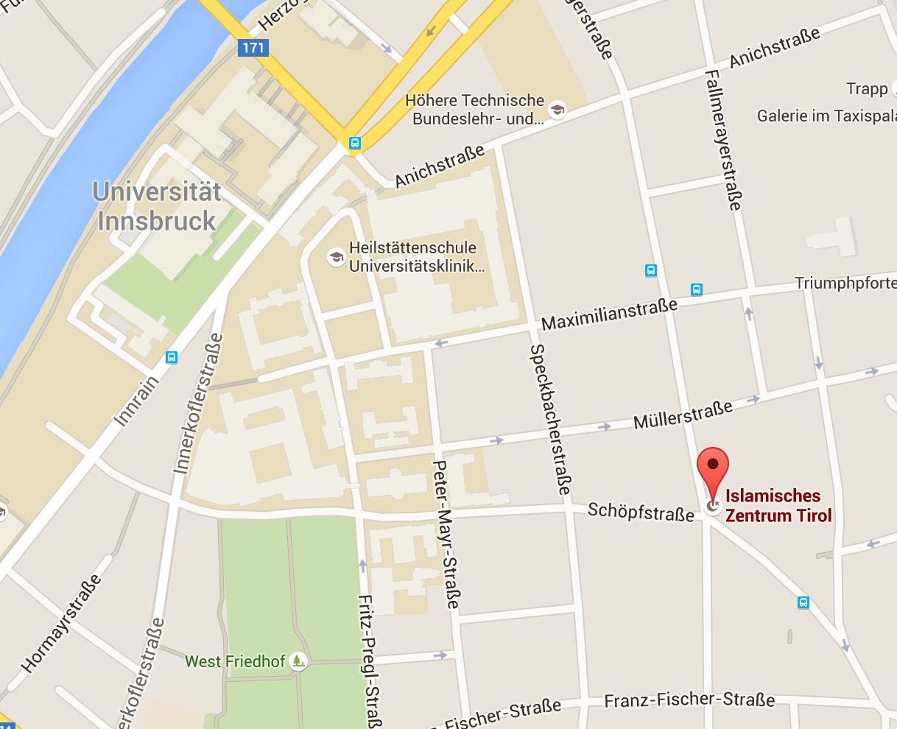
Mosque in Innsbruck
Islamisches Zentrum Tirol (Tyrolean Islamic Center)
Address: Andreas-Hofer-Straße 17a,
6020 Innsbruck
Tel. +43 (0) 512-562146

Slide 19
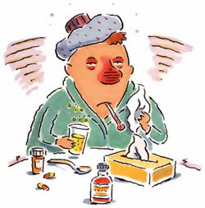
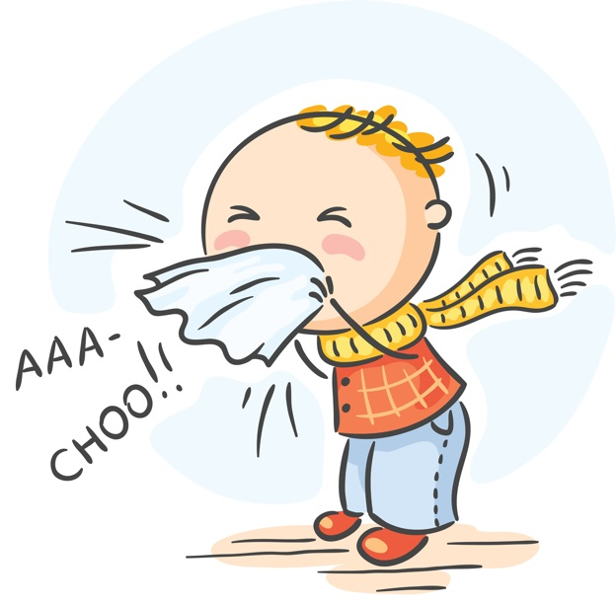
Doctors: two versions of the spreading of common cold
1. The cold virus spreads through body contact as well as
it can be inhaled.
2. The virus enters the body through sensible parts like
the mouth, the nose or the eyes.

Slide 20
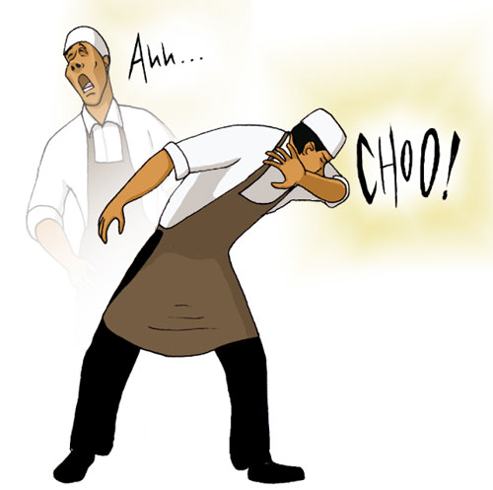
Healthy habits
Handle and prepare food safely
Clean and disinfect commonly used surfaces
In case you're ill cough and sneeze into your sleeve
Avoid touching wild animals
Don’t go out when you are ill

Slide 21
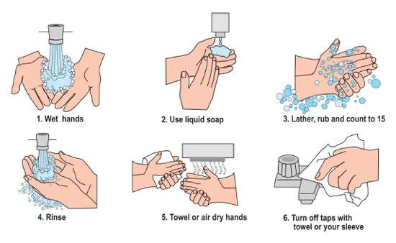
Wash your hands often
Hands can carry germs → wash hands often ( even if they don’t look dirty )
Wash before / after:
cooking, eating, changing diapers and
treating a wound
Wash after:
- using the bathroom
- coughing / sneezing,
- handling garbage
- touching other people or animals
Wash hands with soap and water for 20 seconds - if hands don’t look dirty, sanitizer can be used

Slide 22
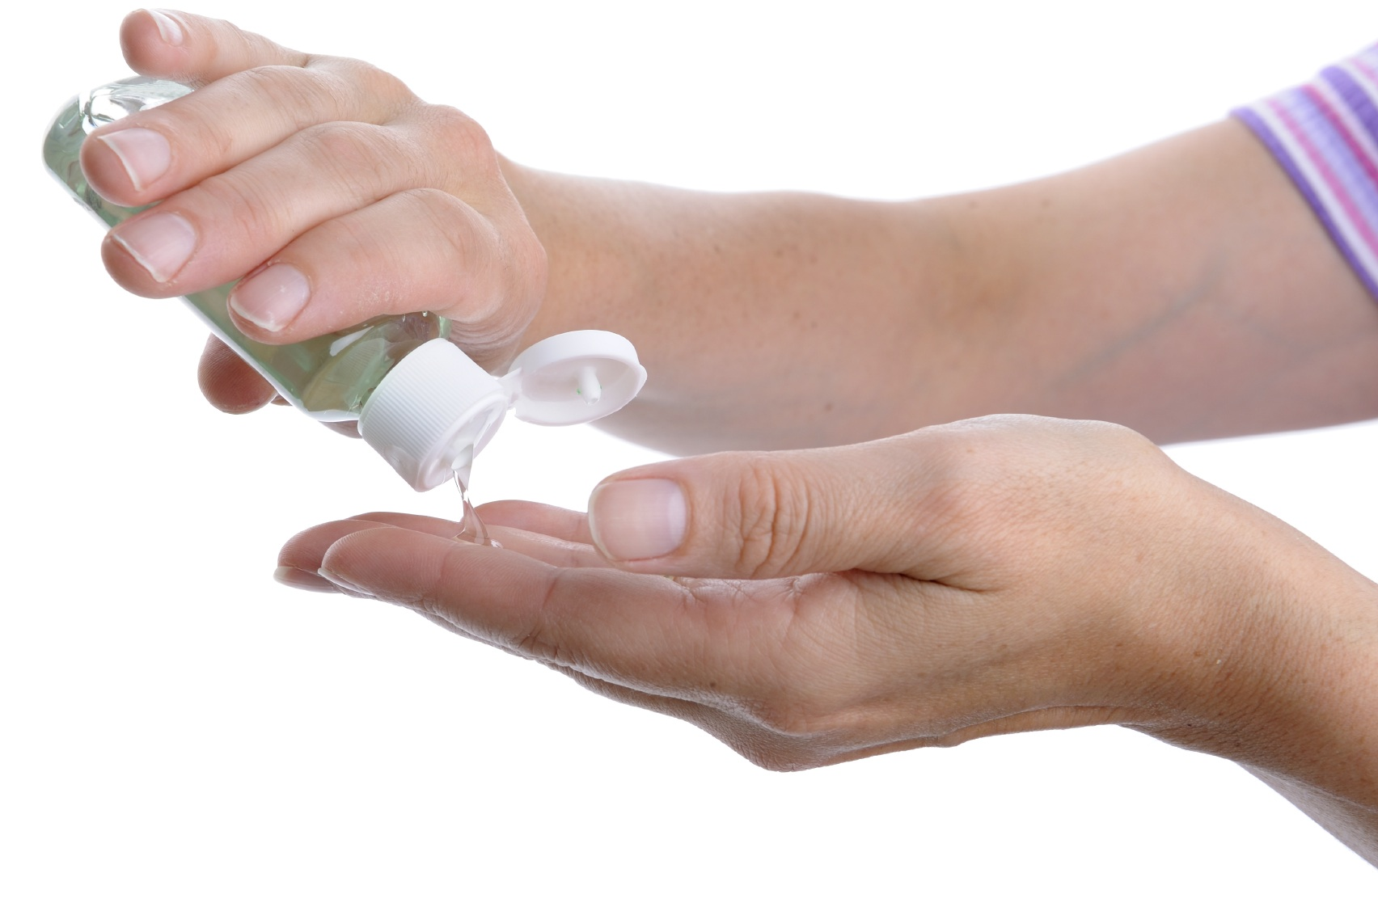
Useage of sanitizer (germ killer)
How to wash hands with sanitizer:
Apply product to the palm of one hand
Rub hands together
Rub the product over all surfaces of hands and fingers until everything is dry

Slide 23
Don’t share personal items
Avoid sharing personal items, which can be infected:
toothbrushes, razors, towels, comb, ...
Needles should never be shared!
Only use them once, then throw them away properly.

Slide 24
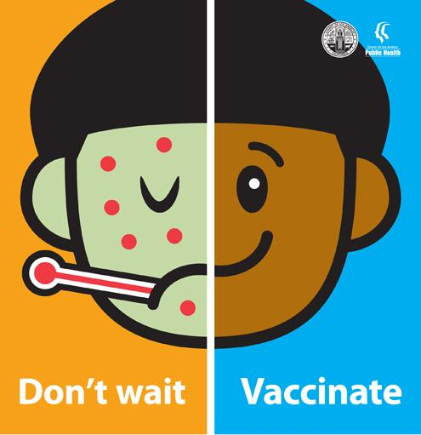
Get vaccinated
Vaccines prevent many infectious diseases.
Get some vaccinations as:
child / adult
for special situations (pregnancy and travel)
Make sure you and your family are up-to-date
on your vaccinations.

Slide 25
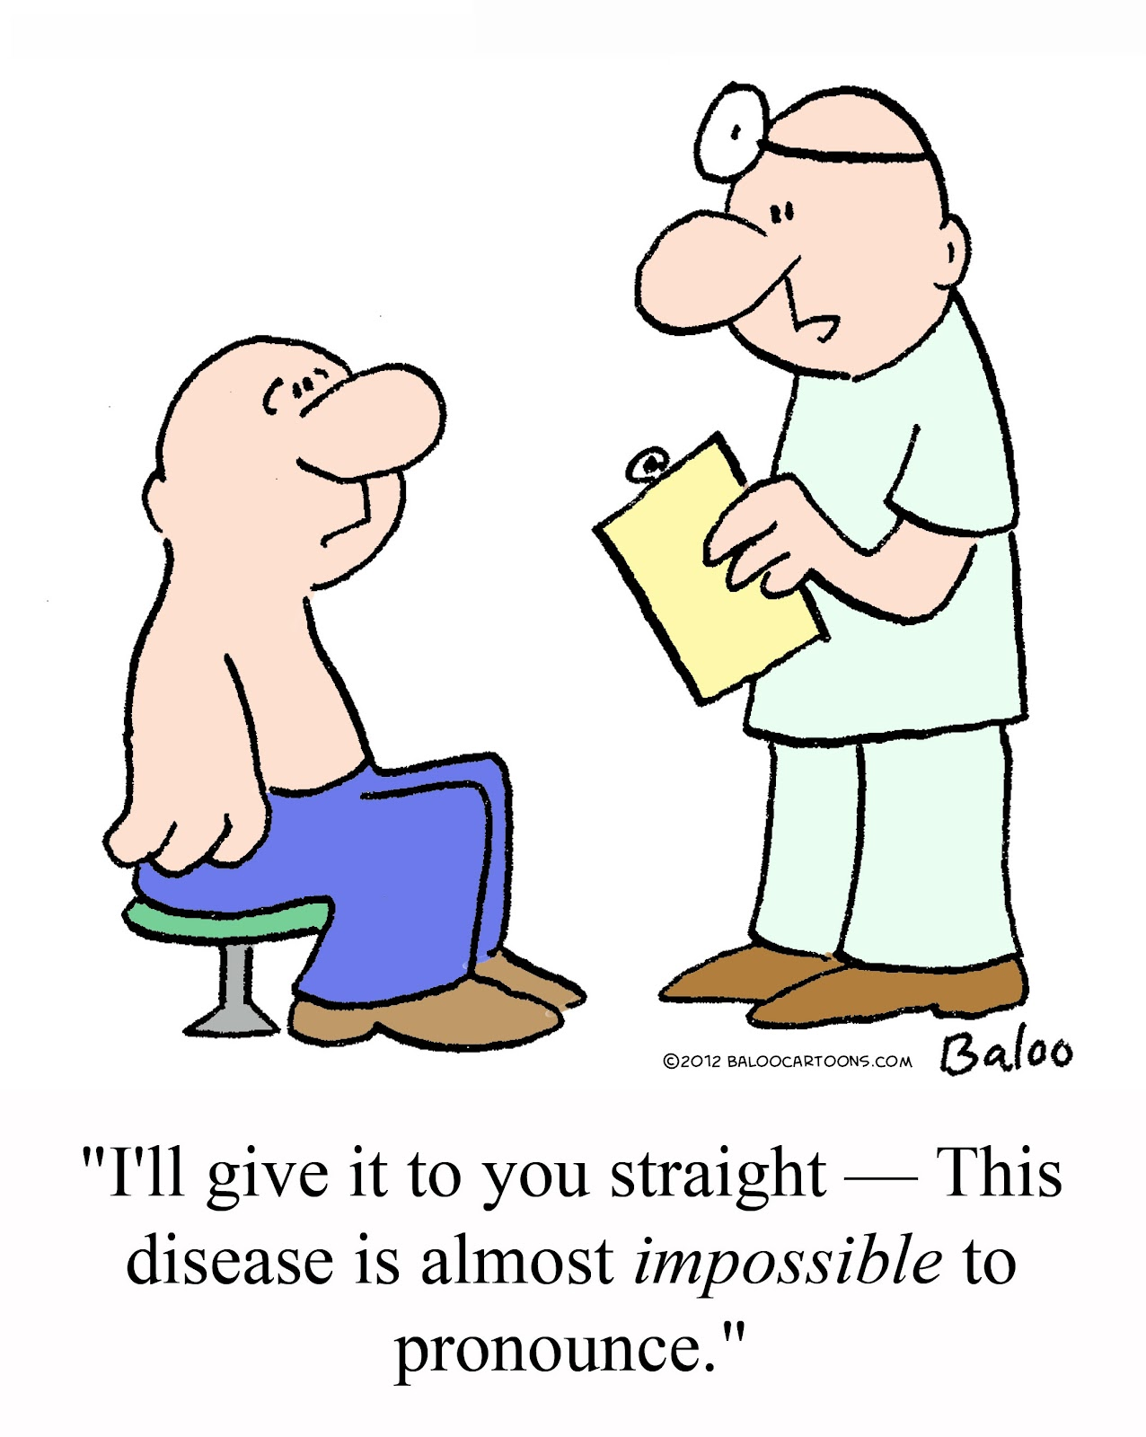
When to seek medical care
breathlessness / suffocate
cough lasting longer than a week
periods of rapid heartbeat
rash, especially if it’s accompanied by fever (higher temperature than 100.4° F / 37° C)
animal or human bite
swelling
blurred vision / difficulties in seeing
persistent vomiting
unusual or strong headache

Slide 26
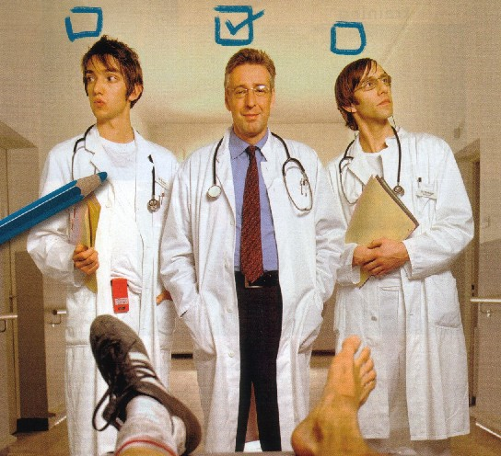
General rights
Everybody - irrespective of age, sex, origin, social status or income -
has guaranteed access to high quality health services
Free choice of doctors choice the doctor you prefer
primary care physician → medical specialist

Slide 27
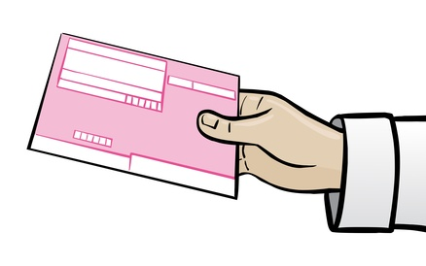
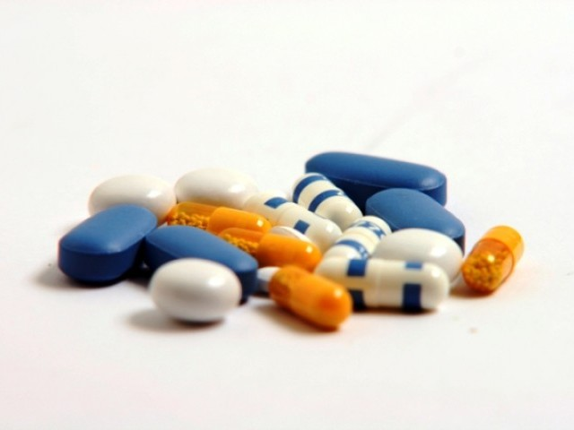
General rights
Prescription Medical Document to buy intensive drugs (antibiotics)
No Prescription Charge For prescription drugs you don’t have to pay
→
X
→

Slide 28
General rights
Self determination medical attendance, only if you agree on it
Duty of documentation necessity for every medical attendance

Slide 29
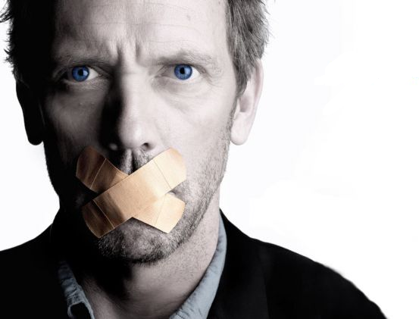
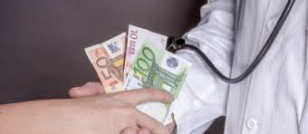
General rights
Discretion doctor is not allowed to talk about your diseases
Do not bribe the doctor no extra money needed - doctor will dress you
X

Slide 30
Thank you for your attention

