Slide 1
Etiquette in Austria
Bastiaan Buschman, Aiyyna Venzel, Chayanit Palm, Lisa Burger

Slide 2
Every day life in Austria
Family in Austria
Hygiene in Austria
Alarms on Saturday 12 pm
Dress codes in every day life

Slide 3
Family in Austria
The place of the family in every day in Austria varies from place to place. The standard family in Austria looks like a husband, wife, and children but there are also households where a single parent and child live, or where there are families who exist out of divorced parents or widowed women or men who raise and live their lives outside of marriage.
The place of marriage is in very modern families less important and there is a stronger focus on work.
In the rural areas, so the areas far away from the cities often have a more traditional family setting
The everyday life matters, such as breakfast, dinner and sitting together is often done with the entire family.
Notes:
Domestic unit: The place of the family in every day in Austria varies from place to place. The standard family in Austria looks like a husband, wife, and children but there are also households where a single parent and child live, or where there are families who exist out of divorced parents or widowed women or men who raise and live their lives outside of marriage. The place of marriage is in very modern families less important and there is a stronger focus on work. In the rural areas, so the areas far away from the cities often have a more traditional family setting, where you have a husband and wife and several children and where you can sometimes see the grandparent living under the same roof. The everyday life matters, such as breakfast, dinner and sitting together is often done with the entire family. Some families are less strict in this way and are more separate from each other but most do their everyday life together with their whole family.

Slide 4
Hygiene in Austria
Some examples:
Spitting is considered to be very rude, even when you do it on the streets.
If you have to clean your nose, you should use a handkerchief or a tissue.
It is against the law to urinate, defecate or be sexually indecent in public.
Toilet use
Washing hands after toilet use
(Sanitory pads for females)
Notes:
So there are some examples for hygiene for everyday life: Spitting is considered to be very rude, even when you do it on the streets. If you have to clean your nose, you should use a handkerchief or a tissue. It is against the law to urinate, defecate or be sexually indecent in public. When you have used the toilet for anything, you can dispose the toiletpaper in the toilet itself and just flush it. They also clean it if necessary, there will always be a brush next to the toilet to clean it if it is dirty after use. When you are done you just wash your hands in the sink that is outside the toilet and dry them. (Sanitory pads or tampons are not flushed down the toilet for female)

Slide 5
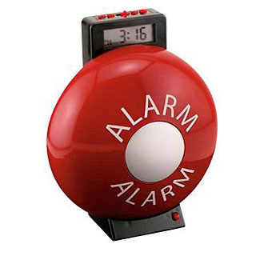
The alarms on Saturday
Every Saturday on 12:00 pm there is testing of the fire sirens all over Austria, except for Vienna. This is nothing to be afraid of, it is just routine work and it would not last that long. Sometimes they do it on Monday as well, but these test will always be executed at 12:00 pm.

Slide 6
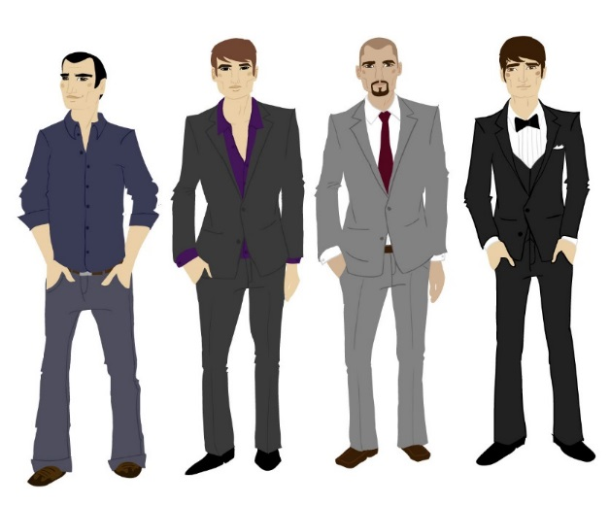
Every day life dress codes
In general for everyday life there are no dress codes for being in public.
However, in churches and similar places you should cover your shoulders and knees.
If you visit special events or visit restaurants, elegant or proper clothing will be required where they might otherwise decline you when you want to enter.
People in Austria like to look proper and take their pride in their appearance.

Slide 7
Meeting & Greeting

Slide 8
Hand shakes
Shake hands with everyone (incl. children) present at a business or social meeting; shake hands with women before men. Women should offer their hand first. Shake hands again when leaving.
Shake hands with the people you meet and look into their eyes. Eye contact is very important to Austrians.

Slide 9
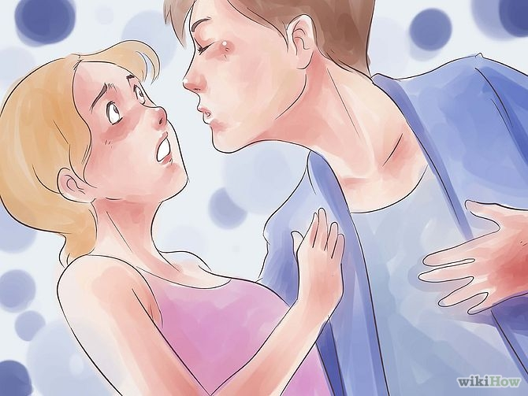
Kissing
Austrians are more reserved and formal. Kissing, hugging, touching and physical closeness with unfamiliar for you person are not common.

Slide 10
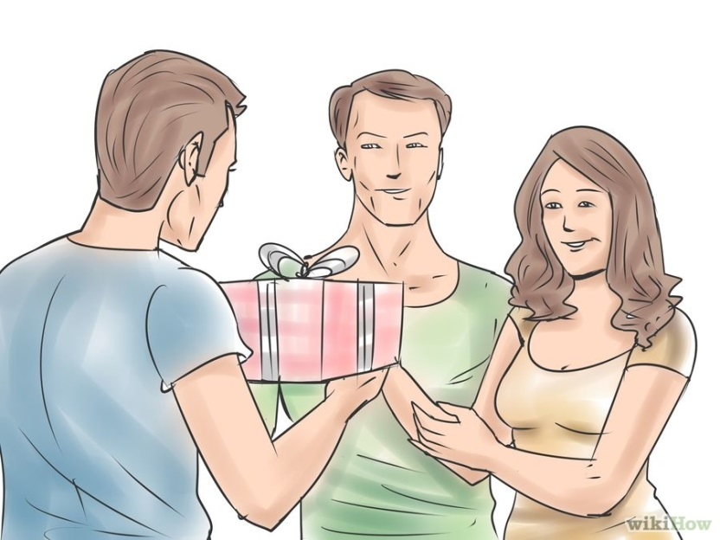
Invitations and gifts
It is very unusual for an outsider to be invited into an Austrian’s home but, if you are, you should go with gifts for your host.
A bottle of vintage wine, (French) champagne (not German Sekt) or brandy would make a good gift for your host and high-quality chocolates or a spray of flowers are suitable gifts for your hostess.
If giving flowers, give in odd numbers only – an even number means bad luck in Austria.
Red roses are the sign for love, red carnations the official flower of the Social Democratic Party and lilies are for funerals,are in transparent
Un-wrap the flowers before giving them to your hostess unless they plastic foil wrapping.
You can bring food to the house of close friends.

Slide 11
Religion

Slide 12
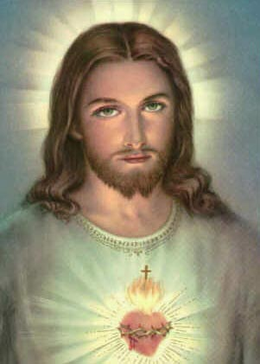
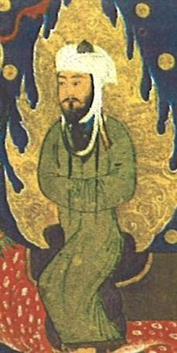
Catholicism and Islam
Christianity:
Roman Catholic
Orthodox
Protestant
Sunni and Shia
Denomination
Founder
Jesus Christ/ Mohammed
Notes:
Commonalities and differences

Slide 13
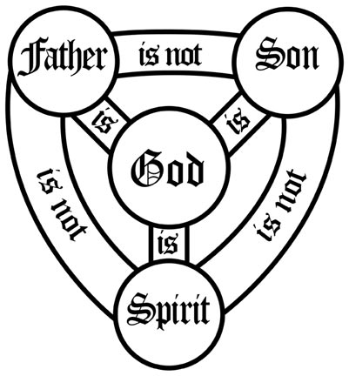
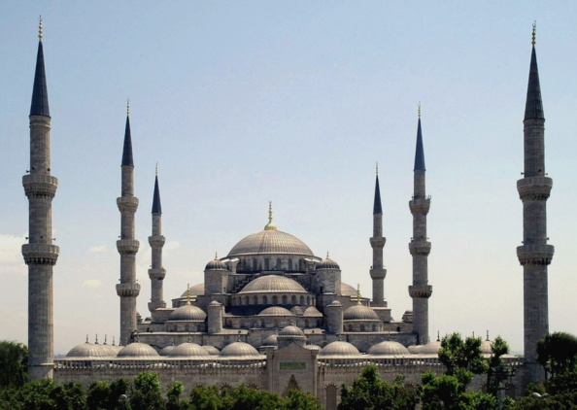
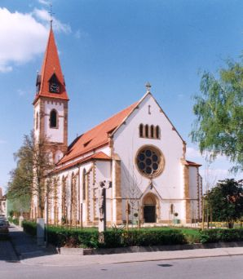
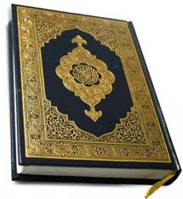
Nature of God
One God (Allah)
Church/Moschee
Bible/Koran
Notes:
One God, who exists in three distinct persons (The Trinity): Father, Son and Holy Spirit

Slide 14
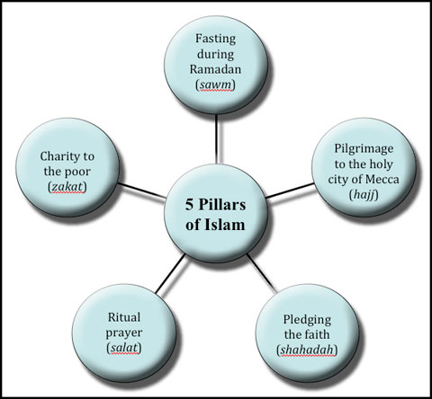
Rituals
Baptism, Holy Communion, Confirmation, Marriage, Penance, Holy Orders, Anointing of the sick
Notes:
1. Shahadah - A profession of faith.
2. Salat - Prayer five times daily.
3. Zakat - alms giving.
4. Sawm - Fasting during the Holy month of Ramadan.
5. Hajj - Pilgrimage to the Holy city of Mecca.

Slide 15
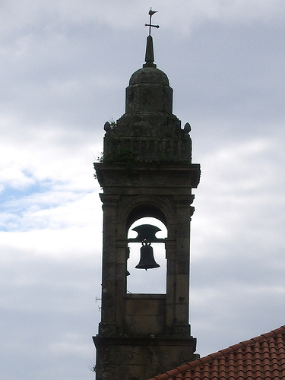
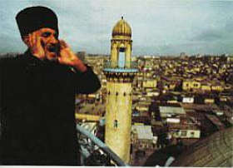
Sunday
Holy day
Friday
Church bells
Call to prayer
Adhan recited by the muezzin

Slide 16
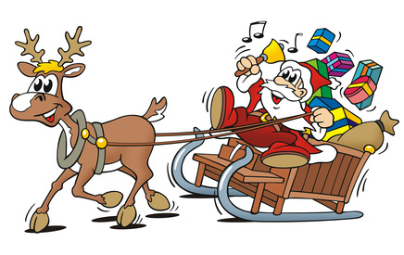
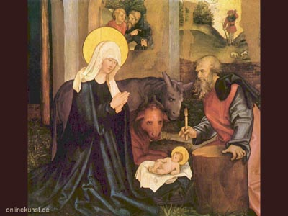
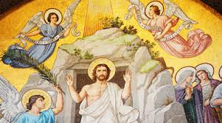
Religious Holidays
Notes:
Christmas: Birth of Jesus
Easter: Ressurraction of Jesus Christ

Slide 17
Religious and National Holidays
1 January | New Year's Day | National holiday day
6 January | Epiphany
* | Good Friday | Easter Sunday -2 days
* | Easter Monday | Easter Sunday +1day
1 May | International Workers' Day | National holiday day
* | Ascension Day | Easter Sunday +39 days
* | Whit Monday / Pentecost | Easter Sunday +50 days
* | Corpus Christi | Easter Sunday +60 days
15 August | Assumption of Mary
26 October | Austrian National Day | day of the Declaration of Neutrality
1 November | All Saints' Day
8 December | Feast of the Immaculate Conception | retail stores are allowed to open for Christmas shopping
25 December | Christmas Day
26 December | St. Stephen's Day
Notes:
The day with a sign * are flexible and change each year, 2016 Easter Sunday will be on 27th of March

Slide 18
Shops closed on Sundays
Notes:
Why are shops closed on Sundays?? Because Sunday is the holy day in the catholic religion and all shops are closed, nowbody should work…. If you are looking for an open shop you can find one at the train station (Mpreis)

Slide 19
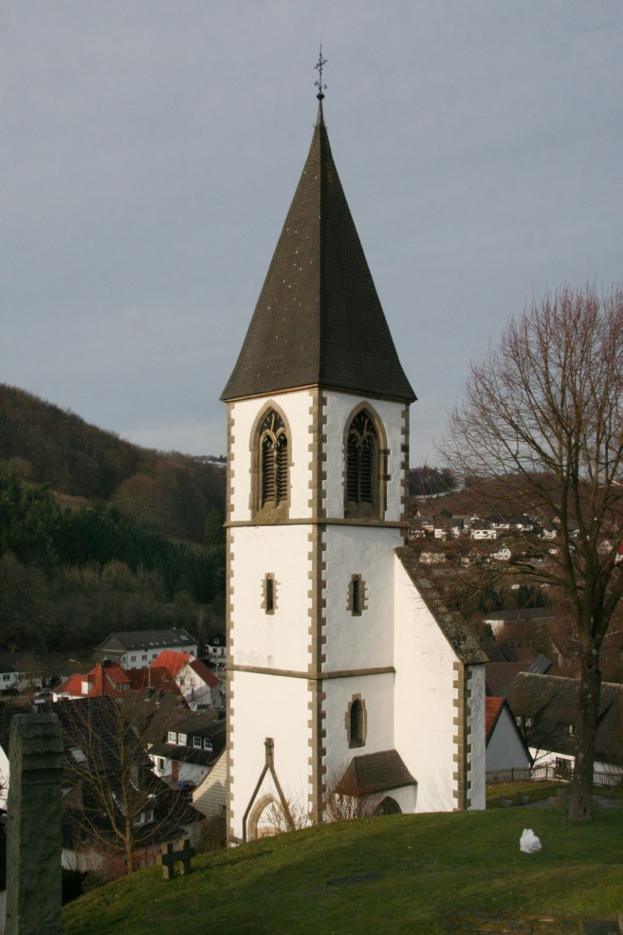
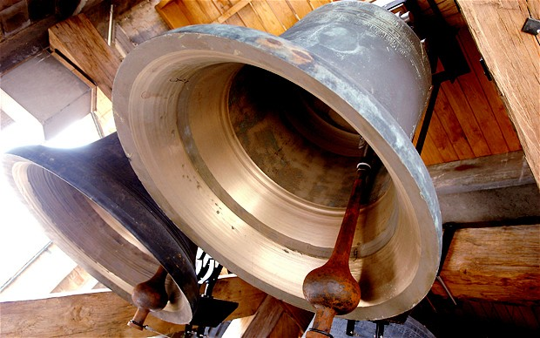
Church Bells
https://www.youtube.com/watch?v=tJNpa3DU1SY
Notes:
Before the holy mess starts, and during the holy mess, when the holy mess is depends from church to church. During the week normally in the early morning, than on Saturday evening and on Sunday morning.

Slide 20
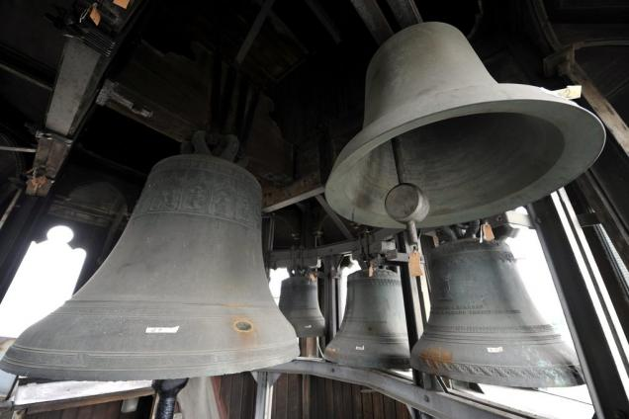
1 Dong
2 Dong
3 Dong
https://www.youtube.com/watch?v=tFb_vpTQHEs
4 Dong + 1 Dong for each hour
Notes:
Church bells are also used to indicate the time

Slide 21
Behavior in work life

Slide 22
How to deal with superiors
Keep the hierarchy in mind

Slide 23
How to deal with superiors
“DO”
Be responsible for your work that your superior assigns.
Be patience.
Talk to boss formal and directly about problems.
Be respectful

Slide 24
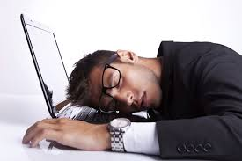
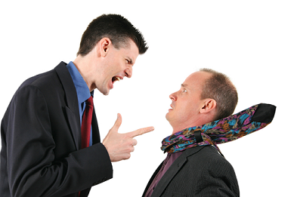
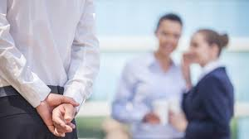
How to deal with superiors
“Don’t”

Slide 25
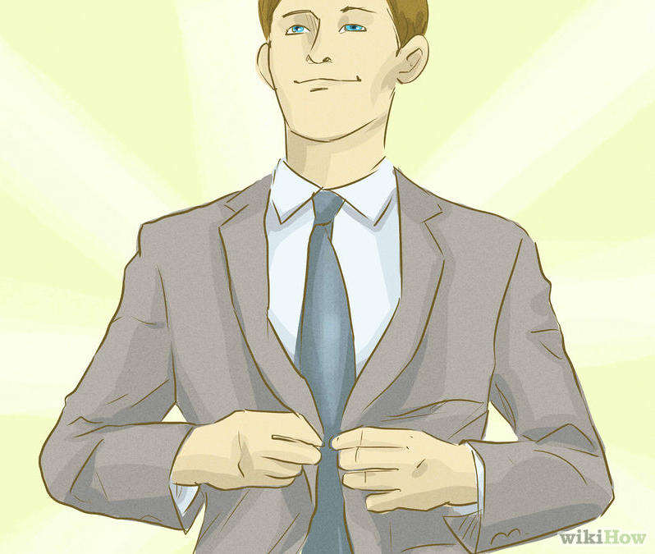
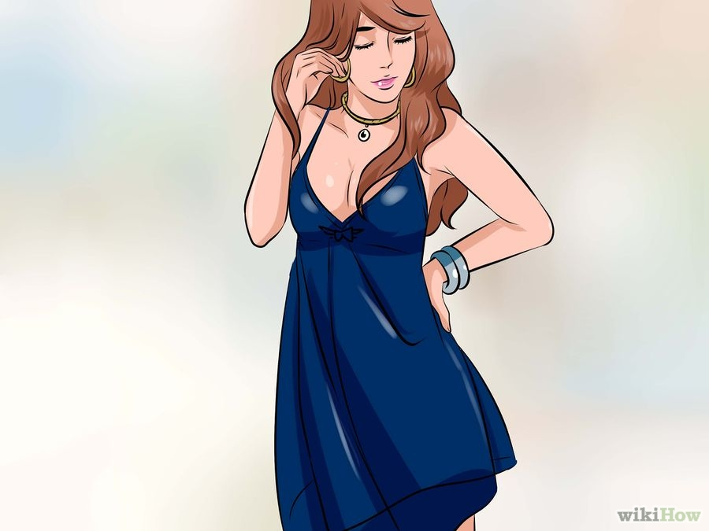
Names and titles
Herr Frau
Notes:
There are two ways of approaching people with "you" in German, "du" (casual) and "Sie" (formal).
Ladies (Damen) are referred to as "Frau" and the name (for example, "Frau Österreich"). Gentlemen (Herren) are referred to as "Herr" and the name (for example, "Herr Österreich").
Herr/Frau + professional title + surname are used when initially addressing someone. Example: Herr Doctor Bauer. Frau + professional title + surname are also used when addressing the wife of a professional. Example: Frau Doctor Bauer. All women over 18 are Frau, even if they are not married.
After you initially meet someone, you can drop his/her last name and address the person using Herr/Frau + professional title alone. Example: Herr Doctor or Frau Doctor.

Slide 26
Punctuality
Austrians are extremely punctual, and even a few minutes delay can offend.
Source: http://businessculture.org/western-europe/business-culture-in-austria/business-etiquette-in-austria/

Slide 27
Punctuality
Time is managed carefully, and calendars, schedules and agendas must be respected.
Do not turn up late for an appointment or when meeting people.
If you are going to be even slightly late, call ahead and explain your situation.
E.g. 5-10 minutes early for important appointments.
Source: http://businessculture.org/western-europe/business-culture-in-austria/business-etiquette-in-austria/

Slide 28
Dress code
Business dress is understated and conservative and follows most European conventions.

Slide 29
Dress code at work
Male
Businessmen should wear dark coloured, conservative business suits; solid, conservative ties, and white shirts.
Do not remove your jacket or tie before your Austrian colleague does so.
Source: http://businessculture.org/western-europe/business-culture-in-austria/business-etiquette-in-austria/

Slide 30
Dress code at work
Female
Business-women should wear either fashionable business suits or conservative dresses, complemented with elegant accessories.

Slide 31
How to do when you are sick on working day.

Slide 32
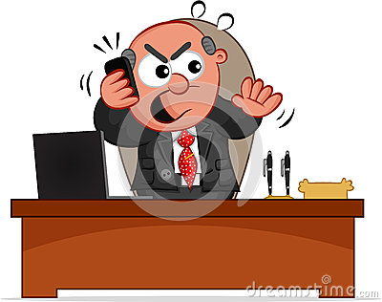
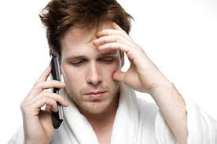
1st step >> On weekday
→ Call and send Email to inform Boss.
Sorry to hear that. Take care!
I am sick ):
Boss

Slide 33
1st step >> On weekend
→ Only Send Email to inform Boss.
Boss

Slide 34
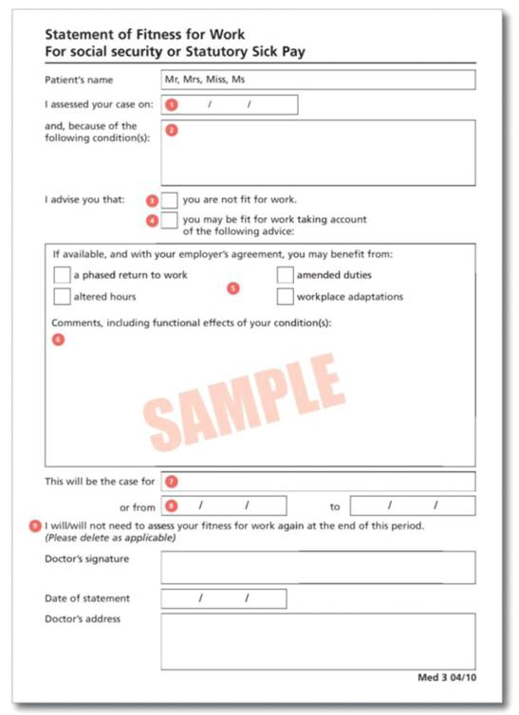
2nd Step >> Sick Note (The number of sick days that superior requires Sick Note is identified in Employee Contract)
→ Submit Sick Note to boss
Get Sick Note from Doctor

Slide 35
Thank you for your attention

