Slide 1
Behavior in work life

Slide 2
How to deal with superiors

Slide 3
How to deal with superiors
“DO”
Be responsible for your work
that your superior assigns.
Be patience
Talk to boss calmly about problems.
Be respectful

Slide 4
How to deal with superiors
“Don’t”

Slide 5
Punctuality
Be on time both start working time and all meeting.

Slide 6
Dress code

Slide 7
Dress code at work
Male

Slide 8
Dress code at work
Female

Slide 9
How to do when you are sick on working day.

Slide 10
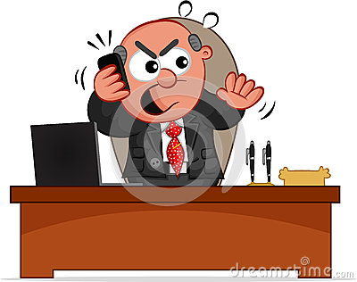
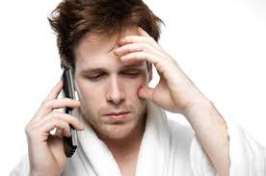
1st step >> On weekday
→ Call and send Email to inform Boss.
Sorry to hear that. Take care!
I am sick ):
Boss

Slide 11
1st step >> On weekend
→ Only Send Email to inform Boss.
Boss

Slide 12
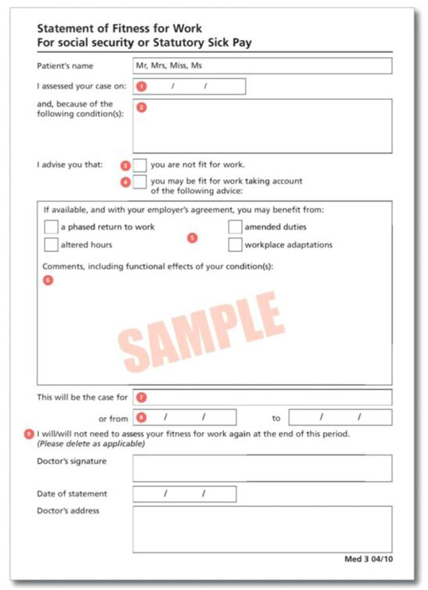
2nd Step >> Sick Note (The number of sick days that superior requires Sick Note is identified in Employee Contract)
→ Submit Sick Note to boss
Get Sick Note from Doctor

