Slide 1
Scoring Validity in
Austrian E8 National Writing Tests
E8 Baseline-Test 2009
Klaus Siller
BIFIE
(Federal Institute for Education Research, Innovation and Development of the Austrian School System)
IATEFL TEA-SIG and University of Innsbruck Conference
Innsbruck, September 2011

Slide 2
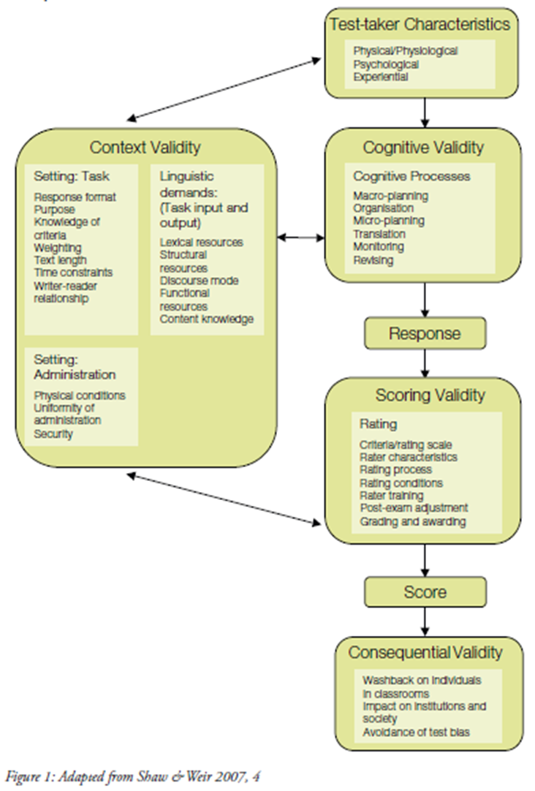
Overview
Background:
Baseline 2009
Test-takers
Purpose
Structure
Shaw, S. D. & Weir, C. J. 2007. Examining Writing. Research and practice in assessing second language writing. Cambridge: University Press.

Slide 3
Overview
Rating
Criteria/Rating Scale
Raters/Rating Process
Data Analyses
Methods
Results
Rater Feedback

Slide 4
Background: Test Takers
Pupils from last form of lower secondary schools in Austria (Year 8)
  14-year-olds
  All ability groups
    General Secondary School (APS)
    Academic Secondary School (AHS)

Slide 5
Background: Purpose
Identifying strengths and weaknesses in test takers‘ writing competence
  System monitoring
  Improvement of classroom procedures
  [Individual feedback for test taker]
Low-stakes exam → Motivation?

Slide 6
Background: Structure /1
Difficulty level: A2/B1
Short Task:
  Expected response 40-60 words
  10 minutes
Long Task:
  Expected response 120-150 words
  20 minutes
5 minutes revision/editing

Slide 7
Background: Structure /2
Task | Form1 | Form2 | Form3 | Form4 | Total
Short Task 1 (Note) | 2581 | - | 2549 | - | 5130
Short Task 2 (Postcard) | - | 2576 | - | 2599 | 5175
Long Task 1 (Letter) | 2586 | - | - | 2601 | 5187
Long Task 2 (Article) | - | 2578 | 2549 | - | 5127
Total | 5167 | 5154 | 5098 | 5200 | 20619
2 different short respectively long tasks in 4 booklets
N = ca. 5100 students/task/form

Slide 8
Rating: Criteria & Rating Scale
 | Task Achievement | Coherence & Cohesion | Grammar | Vocabulary
7
6
5
4
3
2
1
0
  Clear and meaningful mention/
  elaboration of expected content points
  Text-type
  Text-length
  Production of fluent text
  (using adequate devices at sentence, paragraph, text level)
  Range of grammatical structures
  Accuracy
  Range
  Accuracy
  Relevance
Adapted from: Tankó 2005, 127
Tankó, G. 2005. Into Europe. The Writing Handbook. Budapest: Teleki László Foundation.

Slide 9
Rating: Raters & Rater Training
43 Teachers of English
Different experiental background and professional training
4 Writing-Rater-Trainings
  2006/07; 2007/08; 2008/09; 2009

Slide 10
Rating: Rating Process /1
Standardisation-Meeting (2 days)
  Standardisation with benchmarked scripts
  On-Site-Rating
Individual Rating-Phase
  Ca. 6 -8 weeks

Slide 11
Rating: Rating Process /2
Scanning of texts at BIFIE
  8.1% APS / 1.1% AHS excluded from scanning process
Production of Rating-Booklets
  1 booklet per rater incl. 300 Short Texts
  1 booklet per rater incl. 300 Long Texts
Overlap for multiple/double-rating
  10 texts / 500 texts per task
  2 corresponding booklets with rating-sheets

Slide 12
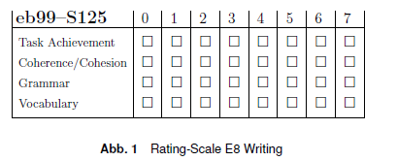
Rating: Rating Process /3
Rating-Sheets: Ratings electronically scanned at BIFIE

Slide 13
Data Analyses: Calibration and Scaling
Student
ability
Dimension
Task
difficulty
Rater
leniency
Interaction
effects
Ratings
To quantify the extent of variances of effect
To improve procedures
To give feedback to raters (self-reflexion)

Slide 14
Data Analyses: Methods
Variance Component Analysis
Quantification
Comparison of means
Rater Leniency
Rater Feedback
Rater Agreement
Correlations*
* c. between the observed ratings and the „true“ ratings (i.e. most frequent rating of all ratings in multiple marking (43 ratings)

Slide 15
Purpose: Variance Component Analysis
How big is the effect of the student‘s writing ability on the score? Source of Variance = 100%
  How much is the student‘s writing ability affected by components like task, dimension or interaction effects?

Slide 16
Results: Variance Component Analysis
Factor | Variance % | Source of V.
Student
Student x Task
Student x Dimension
Student x Task x Dimension
59.2
8.6
1.1
4.8
73.7

Slide 17
Purpose: Variance Component Analysis
How big is the effect of rater severity on the score? Source of Variance = 0%
  Is rater severity affected by components like task, dimension or interaction effects? Variance = 0%
How big is the effect of measurement errors? (Halo Effect; Residuum) Variance = 0%

Slide 18
Results: Variance Component Analysis
Factor | Variance % | Source of V.
Rater
Rater x Task
Rater x Dimension
Rater x Task x Dimension
2.8
1.7
0.7
0.4
10.7
10.0
5.6
20.7
Student x Task x Rater
Residuum

Slide 19
Individual Rater Feedback
Purpose:
To highlight effects on ratings
To start a process of self-reflexion
Individual Rater Brochure:
General explanations
Sample charts and interpretations (incl. „ideal“ values) re. rater agreement and rater severity
Guiding questions to support self-reflexion
Individual results (charts) re. rater agreement and severity

Slide 20
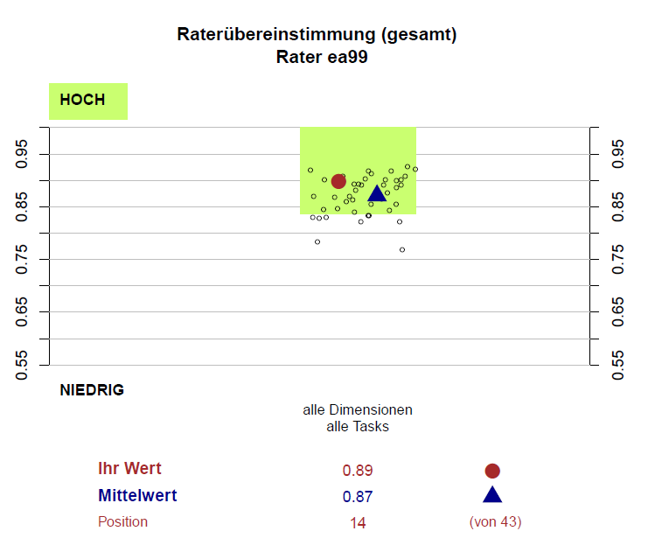
Rater Feedback: Rater Agreement

Slide 21
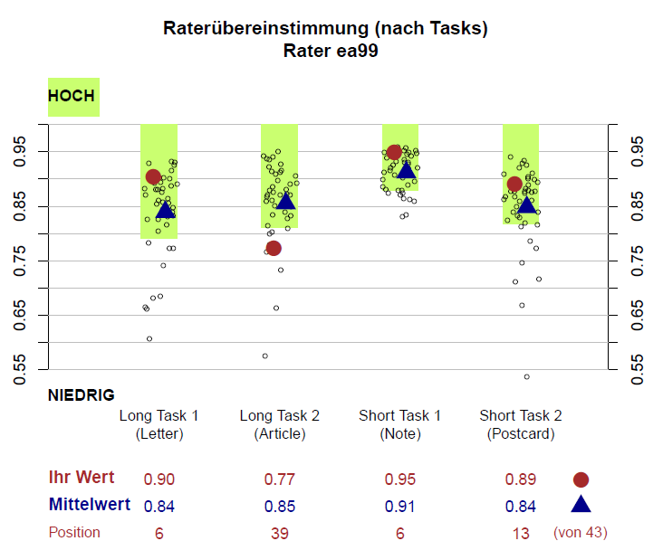
Rater Feedback: Rater Agreement

Slide 22
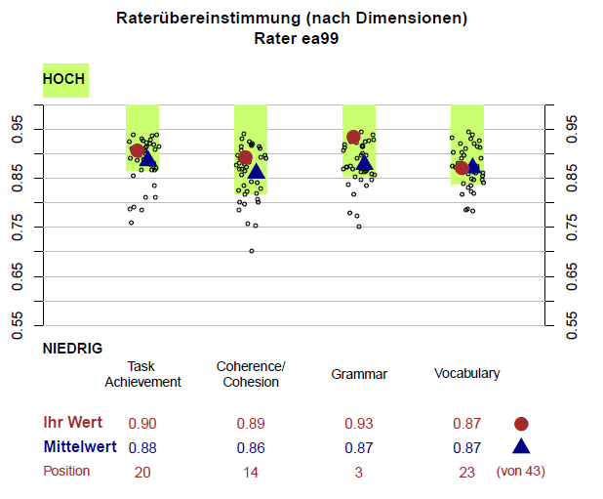
Rater Feedback: Rater Agreement

Slide 23
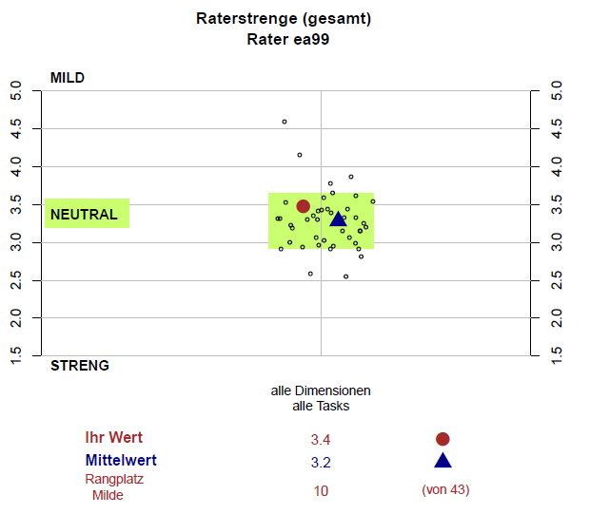
Rater Feedback: Rater Leniency/Harshness

Slide 24
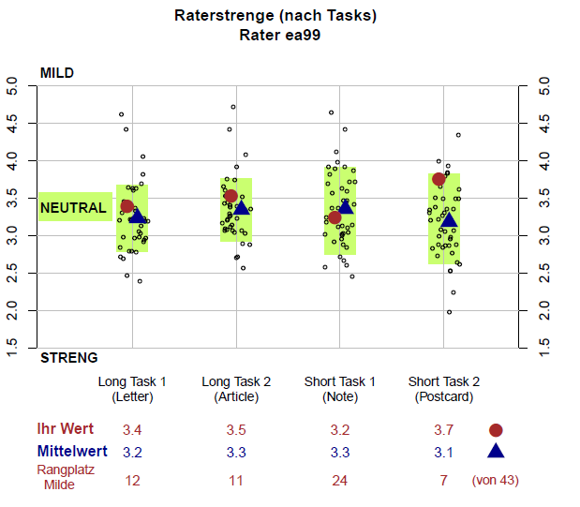
Rater Feedback: Rater Leniency/Harshness

Slide 25
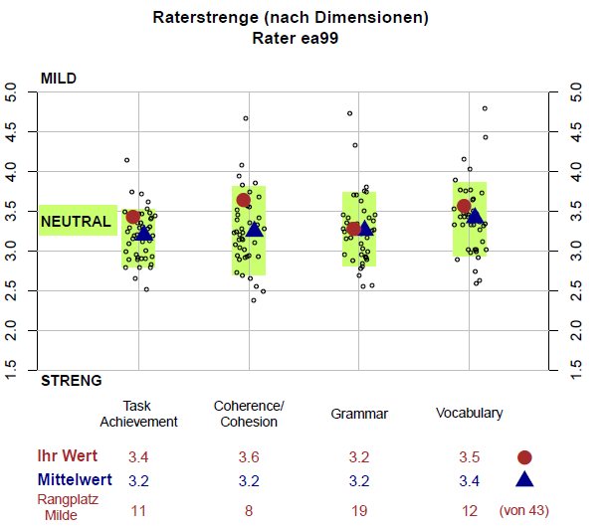
Rater Feedback: Rater Leniency/Harshness

Slide 26
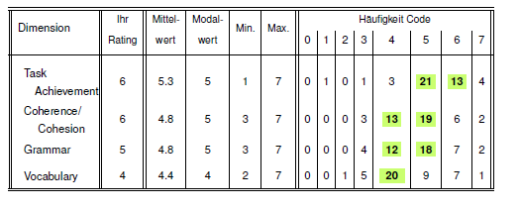
Rater Feedback:
Sample Texts + Individual Ratings

Slide 27
Conclusions / Further Research
Rater Training/Rating:
Political decisions to be applied (e.g. duration of training)
Improved material for trainings
Clarifications re. rating scale (e.g. additional scale interpretations for all dimensions)
Further Research:
On all aspects of the scoring process (e.g. correlation between school type, gender, year of training, age and rater leniency)
CEF-Linking!

Slide 28
References
Breit, S. & Schreiner, C. (Eds.) (2010). Bildungsstandards: Baseline 2009 (8. Schulstufe). Technischer Bericht. Salzburg: BIFIE. Available as download from http://www.bifie.at/buch/1056 [14. April, 2011]
Eckes, T. (2011). Introduction to Many-Facet Rasch Measurement. Frankfurt: Peter Lang
Gassner, O., Mewald C., Brock, R., Lackenbauer, F. & Siller, K. (to be published). Testing Writing for the E8 Standards. Technical Report 2011. Salzburg: BIFIE
Lumley, T. (2005). Assessing Second Language Writing. The Rater’s Perspective. Frankfurt: Peter Lang.
Shaw, S. D. & Weir, C. J. (2007). Examining Writing. Research and practice in assessing second language writing. Cambridge: University Press.
Tankó, G. (2005). Into Europe. The Writing Handbook. Budapest: Teleki László Foundation.

Slide 29
Thank you!
www.bifie.at/bildungsstandards
k.siller@bifie.at

