Slide 1



Is rater training worth it?
Mag. Franz Holzknecht
Mag. Benjamin Kremmel
IATEFL TEASIG Conference
September 2011
Innsbruck

Slide 2
Overview
Overview
Literature
CLAAS
Study
Results
Discussion
Research literature on rater training
CLAAS
CEFR Linked Austrian Assessment Scale
Study
Participants
Procedure
Results
Discussion

Slide 3
Rater training
Overview
Literature
CLAAS
Study
Results
Discussion
need for training highlighted in testing literature
Alderson, Clapham & Wall, 1995; McNamara, 1996; Bachman & Palmer, 1996; Shaw & Weir, 2007
training helps clarify rating criteria, modifies rater expectations and provides a reference group for raters
Weigle, 1994
training can increase intra-rater consistency
Lunz, Wright & Linacre, 1990; Stahl & Lunz, 1991; Weigle, 1998
training can redirect attention of different rater types and so decrease imbalances
Eckes, 2008

Slide 4
Rater training
Overview
Literature
CLAAS
Study
Results
Discussion
effects not as positive as expected
Lumley & McNamara, 1995; Weigle, 1998
eliminating rater differences unachievable and possibly undesirable’
McNamara, 1996: 232
“Rater training is more successful in helping raters give more predictable scores [...] than in getting them to give identical scores“
Weigle, 1998: 263

Slide 5
CLAAS
Overview
Literature
CLAAS
Study
Results
Discussion
CEFR-Linked Austrian Assessment Scale
developed over 2 years
tested against performances from 4 field trials
item writers, international experts, standard setting judges
analytic scale with 4 criteria
Task Achievement
Organisation and Layout
Lexical and Structural Range
Lexical and Structural Accuracy
11 Bands per criterion
6 described
5 not described

Slide 6
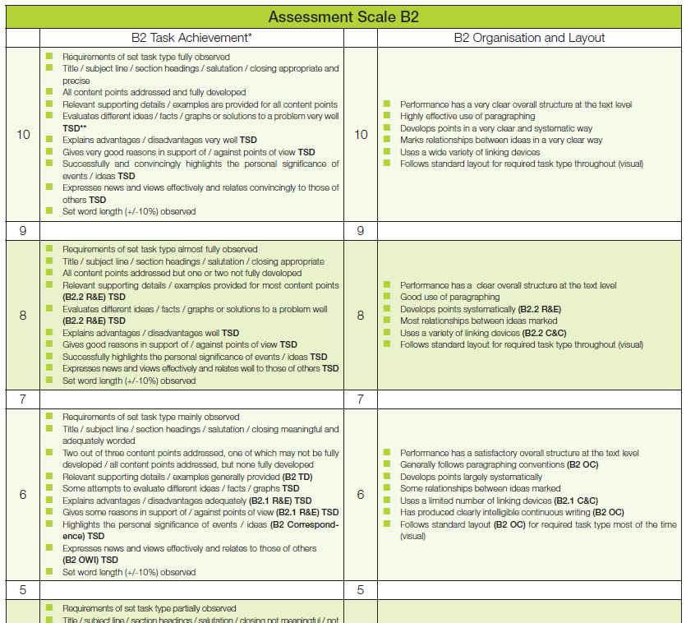
Overview
Literature
CLAAS
Study
Results
Discussion
Bifie, 2011

Slide 7
Participants
Overview
Literature
CLAAS
Study
Results
Discussion
3 groups of raters:
 | days of training | N | provinces of Austria
group 1 | 5 | 15 | 8
group 2 | 2 | 12 | 5
group 3 | 0 | 13 | 6

Slide 8
Procedure [1]
Overview
Literature
CLAAS
Study
Results
Discussion
groups were asked to rate a range of performances
different task types
article
email
essay
report
selected criteria
Task Achievement [TA]
Organisation and Layout [OL]
Lexical and Structural Range [LSR]
Lexical and Structural Accuracy [LSA]

Slide 9
Procedure [2]
Overview
Literature
CLAAS
Study
Results
Discussion
 | TA | OL | LSR | LSA
Article | 2743 2722 | 2743 2540 | 2743 | 2743
Email | 2288 | 2630 | 2288 | 2449
group 1
[5 days training]
group 2
[2 days training]
group 3
[no training]
 | TA | OL | LSR | LSA
Essay | 1071 1152 | 1071 | 1071 | 1071 1152
Report |  |  | 1348
Article |  | 2701
Email | 2428
 | TA | OL | LSR | LSA
Essay |  |  |  | 1152
Report |  |  | 1348
Article | 2743 | 2743 2540 | 2743 | 2743
Email | 2288 | 2630
 | 2438

Slide 10
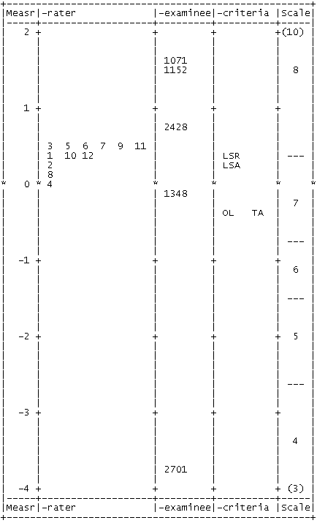
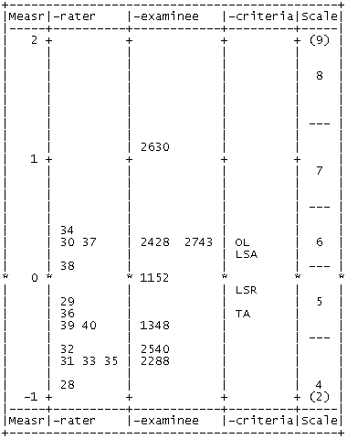
Results [1]
Overview
Literature
CLAAS
Study
Results
Discussion
group 2 [2 days training]:
Inter-rater reliability
group 3 [no training]:

Slide 11
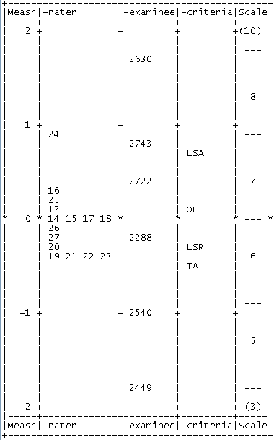
Results [2]
Overview
Literature
CLAAS
Study
Results
Discussion
group 1 [5 days training]:
Inter-rater reliability
group 3 [no training]:

Slide 12
Results [3]
Overview
Literature
CLAAS
Study
Results
Discussion
Inter-rater reliability
Separation index
are rater measurements statistically distinguishable?
Reliability
not inter-rater
how reliable is the distinction between different levels of severity among raters?
high separation = low inter-rater reliability
high reliability = low inter-rater reliability

Slide 13
Results [4]
Overview
Literature
CLAAS
Study
Results
Discussion
Inter-rater reliability
 | Separation | Reliability
group 3 [no training]
group 2 [2 days training]
group 1 [5 days training]
1.48
0.69
Fairly low inter-rater reliability
0.00
0.00
High inter-rater reliability
0.52
0.21
High inter-rater reliability

Slide 14
Results [5]
Overview
Literature
CLAAS
Study
Results
Discussion
Intra-rater reliability
Infit Mean Square:
values between 0.5 – 1.5 are acceptable
Lunz & Stahl, 1990
values above 2.0 are of greatest concern
Linacre, 2010

Slide 15
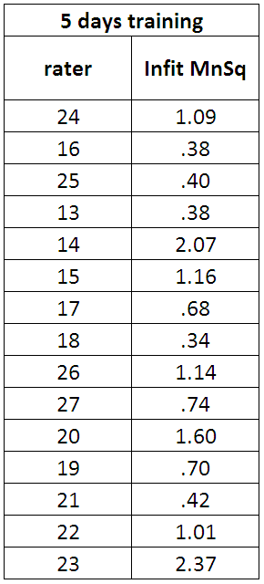
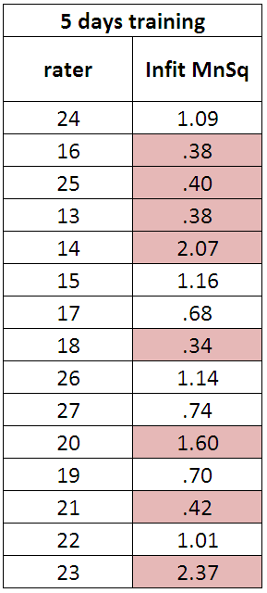
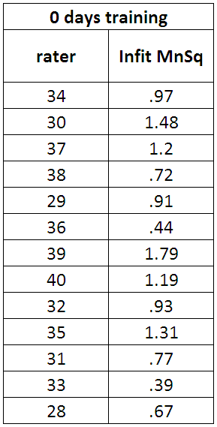
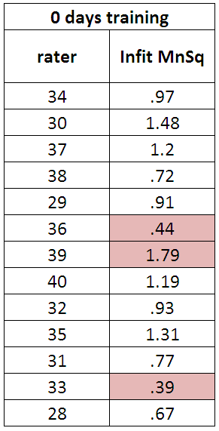
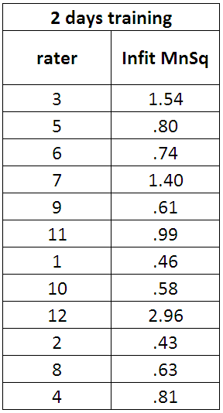
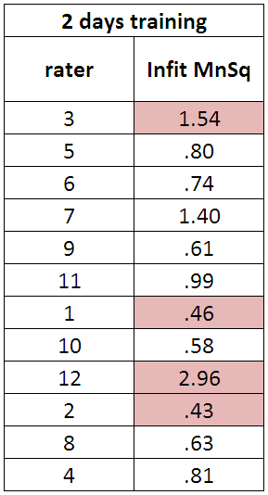
Overview
Literature
CLAAS
Study
Results
Discussion
Results [6]
Intra-rater reliability
53%
23%
33%

Slide 16
Discussion
Overview
Literature
CLAAS
Study
Results
Discussion
Weigle’s [1998] findings could not be confirmed
trained raters showed higher levels of inter-rater reliability
intra-rater reliability decreased with more days of rater training
Results maybe due to form of rater training
Is rater training worth it?

Slide 17
Further research
Overview
Literature
CLAAS
Study
Results
Discussion
monitoring of future ratings of group 1 [5 days training]
larger number of data points per element [= ratings per rater / per examinee] Linacre, personal communication
More data points for examinees for group 3 [no training]
More data points for raters for group 1 [5 days training]
group 1 [5 days training] rate same scripts again after 10 days training
Compare inter- and intra-rater reliability of first and second ratings

Slide 18
Bibliography
Overview
Literature
CLAAS
Study
Results
Discussion
Alderson, J.C., Clapham C., & Wall, D. [1995]. Language test construction and evaluation. Cambridge: Cambridge University Press.
Bachman, L.F., & Palmer, A.S. [1996]. Language testing in practice. Oxford: Oxford University Press.
Bifie. [2011]. CEFR linked Austrian assessment scale. <https://www.bifie.at/system/files/dl/srdp_scale_b2_2011-05-18.pdf>. Retrieved on September 19th 2011.
Eckes, T. [2008]. Rater types in writing performance assessments: A classification approach to rater variability. Language Testing, 25 [2], 255-185.
Linacre, J.M. [2010]. Manual for Online FACETS course [unpublished].
Lumley, T., & McNamara, T.F. [1995]. Rater characteristics and rater bias: implications for training. Language Testing 12 [1], 54-71.
Lunz, M.E. & Stahl, J.A. [1990]. Judge Consistency and Severity Across Grading Periods. Evaluation and the Health Professions 13, 425-444.
Lunz, M.E., Wright, B.D., & Linacre, J.M. [1990]. Measuring the impact of judge severity on examination scores. Applied Measurement in Education 3 [4], 331-45.
McNamara, T.F. [1996]. Measuring Second Language Performance. London: Longman.
Shaw, S.D., & Weir, C.J. [2007]. Examining Writing: Research and practic in assessing second language writing. Cambridge: CUP.
Stahl, J.A., & Lunz, M.E. [1991]. Judge performance reports: Media and message, paper presented at the annual meeting of the American Educational Research Association, San Francisco, CA.
Weigle, S.C. [1994]. Effects of training on raters of ESL compositions. Language Testing 11 [2], 197-223.
Weigle, S.C. [1998]. Using FACETS to model rater training effects. Language Testing 15 [2], 263-87.

