Slide 1

Is it all in the blend?
Dianne Davies
English Department
Innsbruck University

Slide 2
Overview
The study
The course
Methodology
Test score comparison
Students‘ attitudes
Critical reflection
Bibliography

Slide 3
Research question
Do different teaching methodologies have an impact on exam results?
Blended learning in the Austrian context
Possibly extend Innsbruck University‘s blended learning programme

Slide 4
Blended Learning definition
  [Blended Learning] is a mixture of online and face-to-face course delivery
  Dudeney & Hockly, 2008: 137
  Blended learning refers to a language course which combines a face-to-face (F2F) classroom component with an appropriate use of technology
  Sharma & Barrett, 2007:7

Slide 5
The study
Comparing exam results of blended and F2F learning
Students‘ attitudes to blended learning

Slide 6
The course
Language Awareness I
Obligatory course taken in first year
Students studying English
  B.A.
  M.A. with teaching qualification
Lexical syllabus

Slide 7
Methodology
Case study
4 parallel courses (N=85)
1 blended learning course (N=21)
  4 online sessions
  8 conventional sessions
1 control group (N=22)
No self-selection for blended learning
Both groups same information/ work sheets

Slide 8
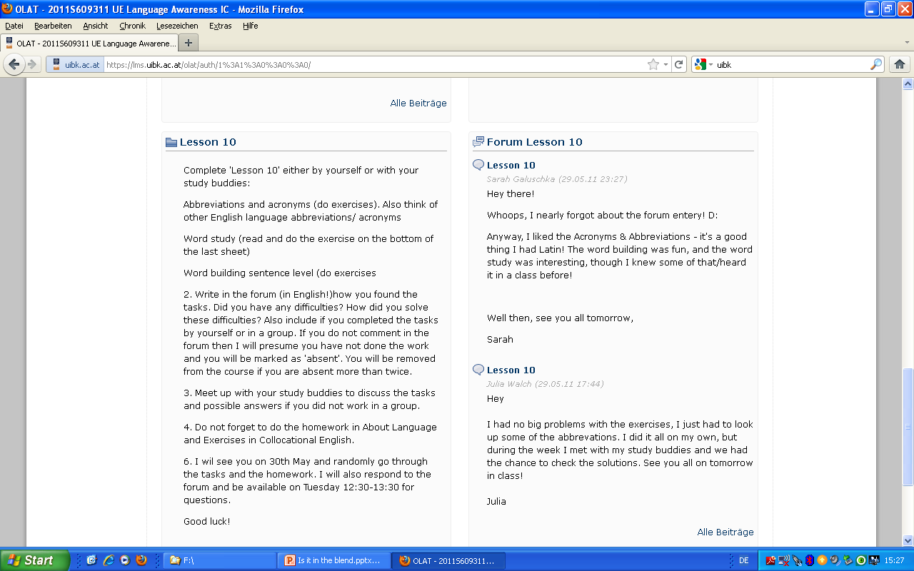
Example forum entry

Slide 9
Test score comparison
Do different teaching methodologies have an impact on exam results?

Slide 10
Participants
85 students
Gender: 80% female, 20% male
Course of study
    67.1% MA
    28.2% BA
Country of school completion
    75.3% Austria
    15.3% South Tyrol
    3.5% Germany
Mother tongue
    87.1% German
    2.4% Italian
    2.4% German/ Italian bilingual

Slide 11
Test
End of semester achievement test
133 items
Cronbachs Alpha .927
  2 items problematic alpha
Corrected Item Total Correlation
  Mean .266
  6 items negative discrimination
42 items selected for the comparison based on blended learning content

Slide 12
Score analyses of 42 items
Blended learning group
Control group
Mean | 31.47
St. D | 4.94
Min | 21
Max | 40
Mean | 33.59
St. D | 4.5
Min | 21
Max | 40

Slide 13
Score analyses of 42 items
Scores
  No significant differences
  Only 3 items were statistically significant
  Results were corroborated by 2 additional tests
  [Independant samples t-test, Mann-Whitney U]

Slide 14
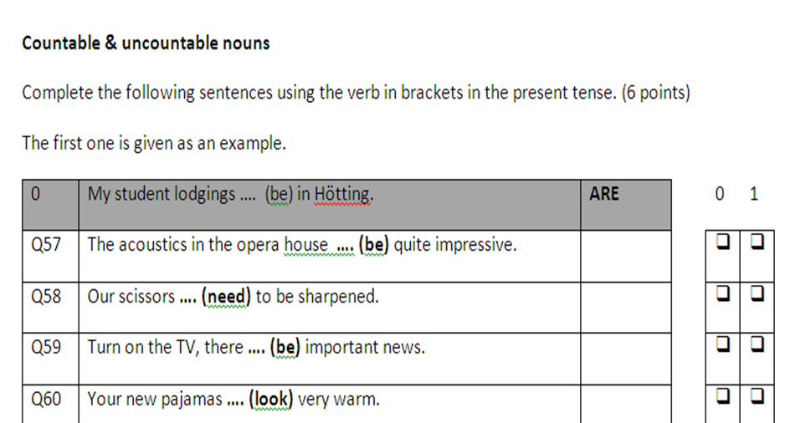
Example section 1

Slide 15
Not statistically significant – Q58
 | N | Facility value
Blended learning | 21 | 90,5%
Control group | 22 | 72,7%
p = .135

Slide 16
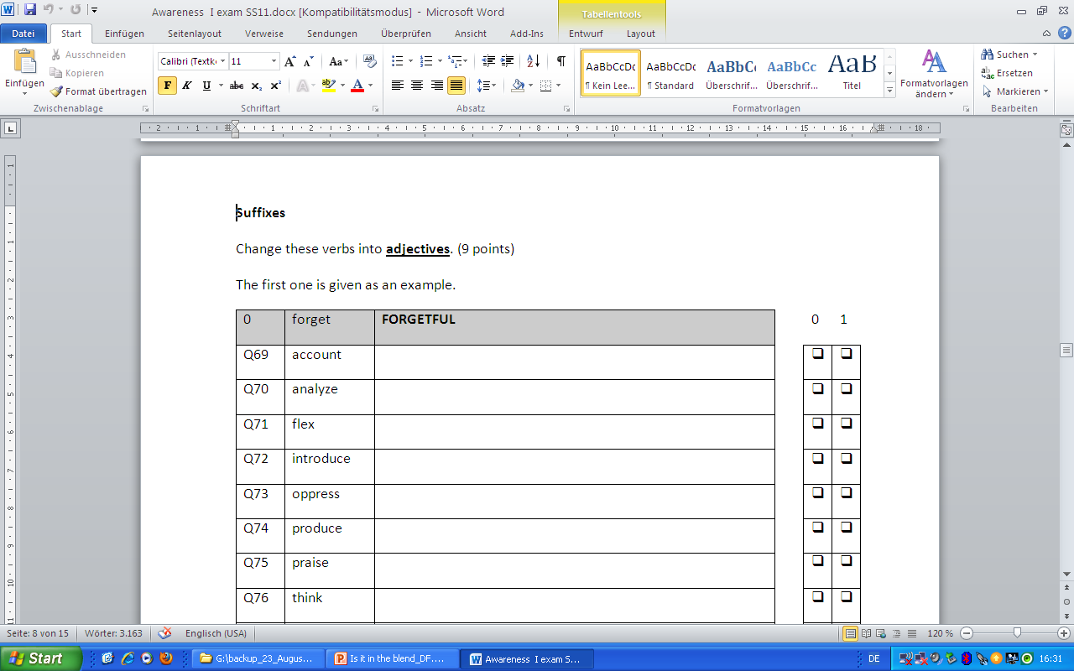
Example section 2

Slide 17
Statistically significant- Q72
 | N | Facility value
Blended learning | 21 | 33.3%
Control group | 22 | 81.8%
p = .001*

Slide 18
Summary
Control group scores slightly better
Only 3 items significant difference
Different teaching methodologies do not make a big difference to exam results

Slide 19
Students‘ attitudes
What are the students‘ attitudes to blended learning?

Slide 20
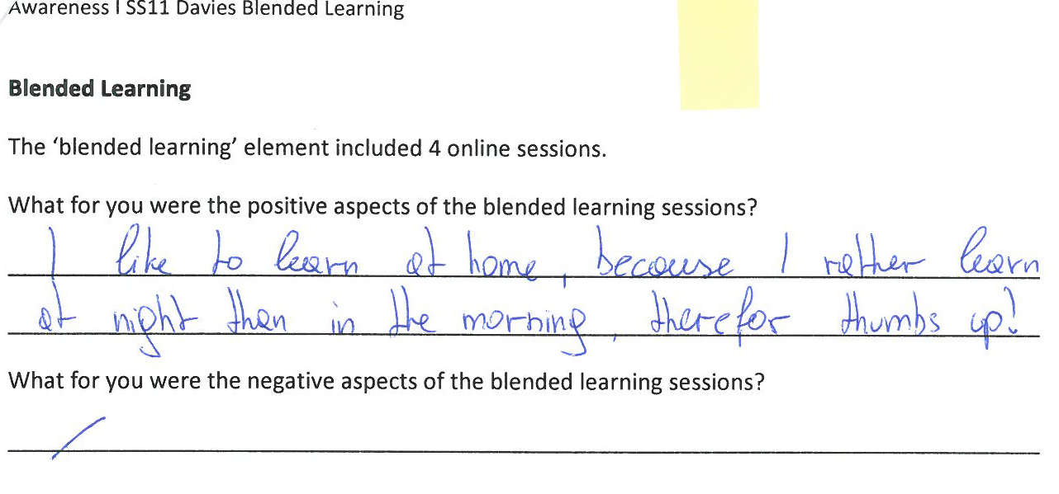

Slide 21
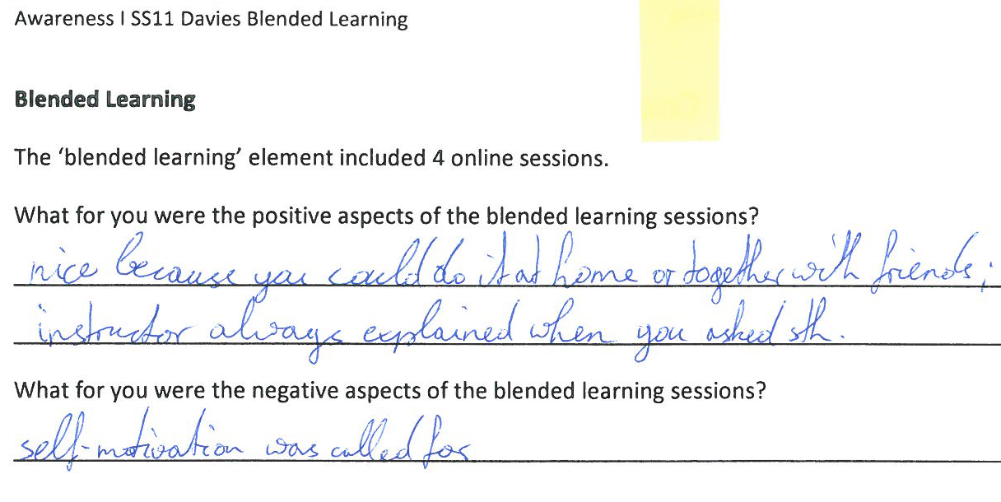

Slide 22
Summary
Blended learning benefits:
  learner autonomy, opportunity to learn at their own pace, in their own time and at their chosen location
  encourages students to interact in English using electronic media

Slide 23
Critical Reflection
Test limitations
Levels not assessed before exam (proficiency test?)
Time of blended learning course
More online interaction needed (collaborative wiki, feedback on forum?)
Language Awareness 1 project

Slide 24
Bibliography
  Dudeney, G. and Hockly, N. 2008. How to teach English with Technology. Pearson Longman, pp. 137
  Sharma, P. and Barrett, B. 2007. Blended Learning. Macmillan.
  Green, R. (forthcoming) Statistics for Language Test Developers

Slide 25
Contact details
Dianne Davies
English Department
Innsbruck University
Innrain 52d,
Innsbruck 6020
Austria
dianne.davies@uibk.ac.at
0043 512 507 4168

