Slide 1




Validating analytic rating scales for speaking at tertiary level
Armin Berger

Slide 2
Overview
Background
Rating scale development
The study
  Research questions
  Method
  Analysis
Expected results
Conclusion

Slide 3
Testing speaking: some challenges
Definition of the construct
  What is speaking?
Construct-irrelevant variance
  What influences performance?
Reliability
  What do raters do?

Slide 4
ELTT scale: presentation
 | Lexico-grammatical resources and fluency | Pronunciation and vocal impact | Structure and content | Genre-specific presentation skills: formal presentation
1 | Descriptor | Descriptor | Descriptor | Descriptor
2
3 | Descriptor | Descriptor | Descriptor | Descriptor
4
5 | Descriptor | Descriptor | Descriptor | Descriptor
6

Slide 5
ELTT scale: presentation
 | Lexico-grammatical resources and fluency | Pronunciation and vocal impact | Structure and content | Genre-specific presentation skills: formal presentation
C2 | Descriptor | Descriptor | Descriptor | Descriptor
 | Descriptor | Descriptor | Descriptor | Descriptor
C1 | Descriptor | Descriptor | Descriptor | Descriptor
below C1

Slide 6
ELTT scale: presentation
Lexico-grammatical resources and fluency | Pronunciation and vocal impact | Structure and content | Genre-specific presentation skills: formal presentation
flexibility range control fluency | segmentals suprasegmentals prosodic features | overall structure coherence cohesion relevance | visuals time-keeping take-home message rhetorical features audience rapport paralinguistic features

Slide 7
ELTT scale: interaction
Lexico-grammatical resources and fluency | Pronunciation and vocal impact | Content and relevance | Interaction
flexibility range control fluency | segmentals suprasegmentals prosodic features | task awareness relevance contribution to discussion | flexibility collaboration strategies

Slide 8
ELTT descriptor units
 | Lexico-grammatical resources and fluency |  |  | Pronunciation and vocal impact |  |  | Structure and content |  |  | Genre-specific presentation skills: formal presentation
 | 11 | 6 | 10 | 22 | 1 | - | 16 | - | 5 | 18 | - | -
 | Lexico-grammatical resources and fluency |  |  | Pronunciation and vocal impact |  |  | Content and relevance |  |  | Interaction
 | 11 | 6 | 10 | 22 | 1 | - | 12 | 3 | 20 | 35 | 2 | 9
ELTT
CEFR
adapted

Slide 9
Scale development
Intuitive methods
  Expert judgement
  Committee
  Experiential
Empirical methods
  Data-based
  Empirically derived, binary-choice, boundary definition
  Scaling descriptors
  (Fulcher 2003)

Slide 10
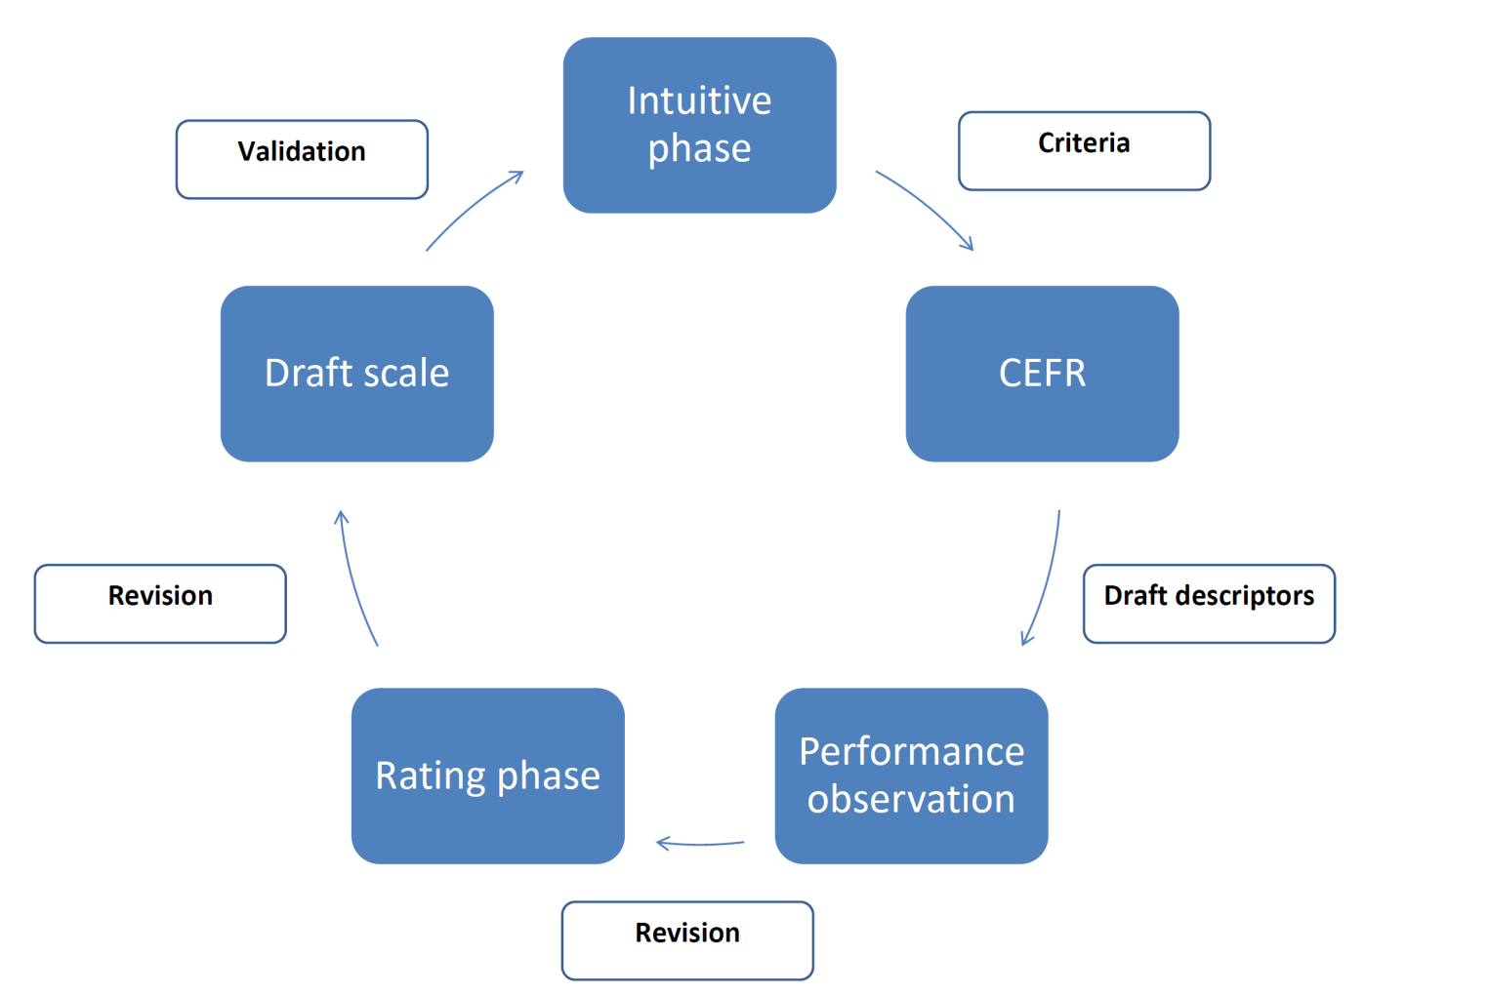
Scale development: ELTT

Slide 11
Scale validation
Threats to validity
  “... descriptions of expected outcomes, or impressionistic etchings of what proficiency might look like as one moves through hypothetical points or levels on a developmental continuum” [own emphasis] (Clark 1985)

Slide 12

Scale validation
(McNamara 2008)

Slide 13
Scale validation
Threats to validity
  “... descriptions of expected outcomes, or impressionistic etchings of what proficiency might look like as one moves through hypothetical points or levels on a developmental continuum” [own emphasis] (Clark 1985)
  scale use
Validation prior to use
  Milanovic et al. 1996; Taylor 2000

Slide 14
Research questions
Do the descriptors of the ELTT speaking scales form implicational scales of language development?
  To what extent are raters consistent in sequencing the ELTT rating scale descriptors?
  Do the ELTT scale descriptors represent the stages of developing speaking proficiency in a consecutive order?
Are users of the scales consistent in their scale interpretations?
Can users of the scales clearly distinguish between the successive scale levels?

Slide 15
Research design
 | Phase 1 | Phase 2
Subjects | 80-90 students of English 15 language teachers at Austrian English departments
Instruments | task prompts video performances
 | sorting task rating sheet rater questionnaire | rating scale rating sheet rater manual rater questionnaire
Procedures | sorting task descriptor scaling rater feedback | rating trial verbal protocol rater feedback
Analyses | correlations multifaceted Rasch questionnaire analysis | multifaceted Rasch verbal protocol analysis questionnaire analysis
Triangulation

Slide 16
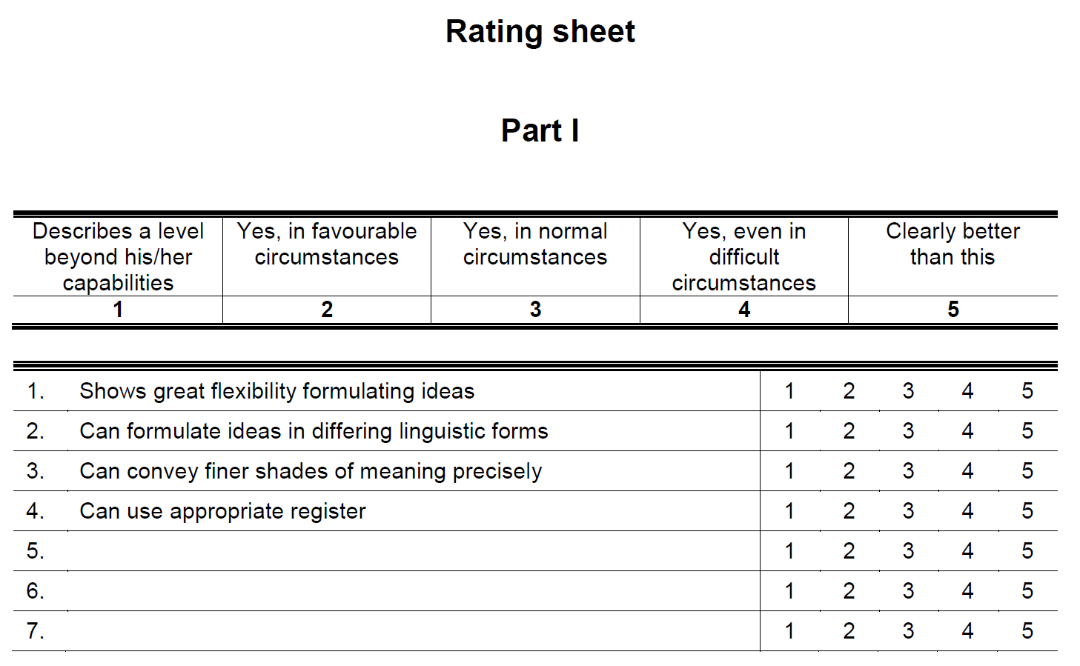
Stages
Stage 1: Development and piloting of instruments
Stage 2: Mock exams

Slide 17
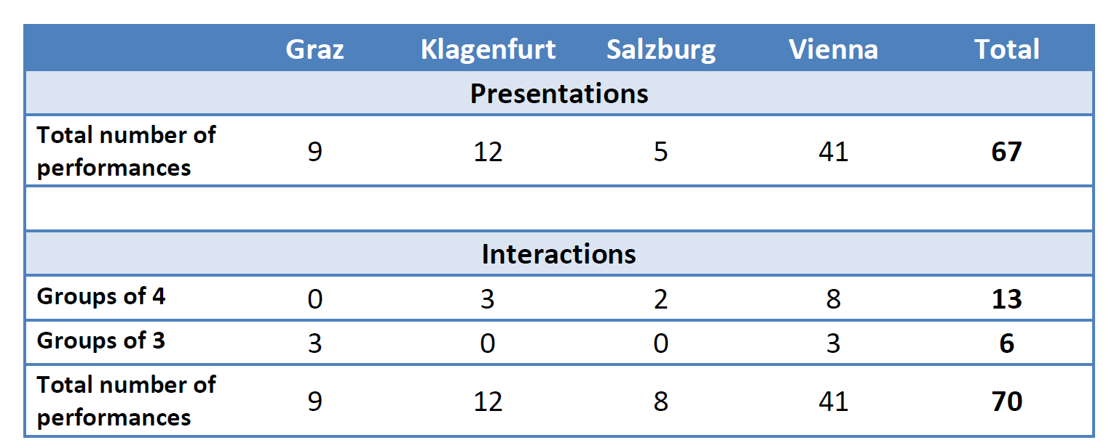
Data collection I

Slide 18
Stages
Stage 1: Development and piloting of instruments
Stage 2: Mock exams
Stage 3: Raters’ data
Stage 4: Data analysis

Slide 19
Analysis
Rasch analysis
is grounded in probability theory
allows the calibration of items and persons on a linear scale
is used to determine the difficulty of individual test items
is based on a simple assumption

Slide 20
Analysis
(McNamara 2008)

Slide 21
Analysis
Multifaceted Rasch analysis
is grounded in probability theory
allows the calibration of items and persons on a linear scale
is used to determine the difficulty of individual test items
is based on a simple assumption
takes additional variables into account
is adapted for descriptor scaling to indicate the relative difficulty of descriptors

Slide 22
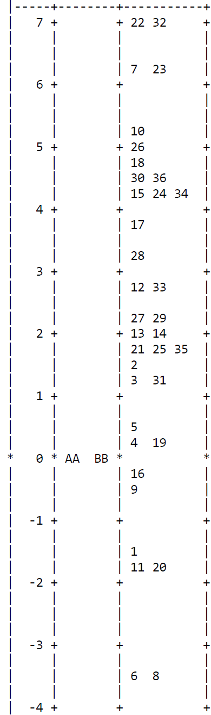
Illustrative output
Relative difficulty of descriptors
Logit scale

Slide 23
Expected results
RQ1:
  If raters are able to sequence the descriptor units consistently, this can be interpreted as validity evidence.
  If multifaceted Rasch analysis generates a scale that reflects the intended order, this can be interpreted as validity evidence.
  Since the ELTT rating scales have largely been modelled on the CEFR, it is expected that most ELTT descriptors will form a unidimensional scale of increasing speaking ability. However, it will be interesting to see how those descriptors unique to the ELTT scales perform psychometrically.

Slide 24
Implications
The results will shed light on the developmental continuum of speaking ability underlying the ELTT scales.
The study will tease out the implications of the results for scale revision and rater training.
The results will allow conclusions about the specific methodology employed in the construction of the ELTT rating scales.
The results will indicate how readily the upper levels of the CEFR, C1 and C2, can be further divided into more subtle yet distinguishable levels.
Generally speaking, it is hoped that the study can make a contribution to a better understanding of the assessment of advanced second language speaking.

Slide 25
References
Brindley, Geoff. 1998. "Describing language development? Rating scales and SLA." In:
Clark, John. 1985. "Curriculum renewal in second language learning: An overview." Canadian modern language review 42, 342-360.
Fulcher, Glenn. 2003. Testing second language speaking. London: Pearson Longman.
Kaftandjieva, Felianka and Sauli Takala. 2002. "Council of Europe scales of language proficiency: A validation study." In: Council of Europe. Common European framework of reference for languages: Learning, teaching, assessment: Case studies, 106-129.
Linacre, Mike. 2010a. FACETS: Rasch measurement computer program. Chicago: MESA Press.
McNamara, Tim. 1996. Measuring second language performance. London: Longman.
Milanovic, Michael et al. 1996. "Developing ratings scales for CASE: Theoretical concerns and analyses." In: Cumming, Alister and Richard Berwick (eds.). Validation in language testing. Clevedon: Multilingual Matters, 15-38.
North, Brian. 2000. The development of a common framework scale of language proficiency. New York: Peter Lang.
Tyndall, Belle and Dorry Kenyon. 1996. "Validation of a new holistic rating scale using Rasch multi-faceted analysis." In: Cumming, Alister and Richard Berwick (eds.). Validation in language testing. Clevedon: Multilingual Matters, 39-57.

Slide 26
Thank you!
Armin Berger
armin.berger@univie.ac.at

