Slide 1
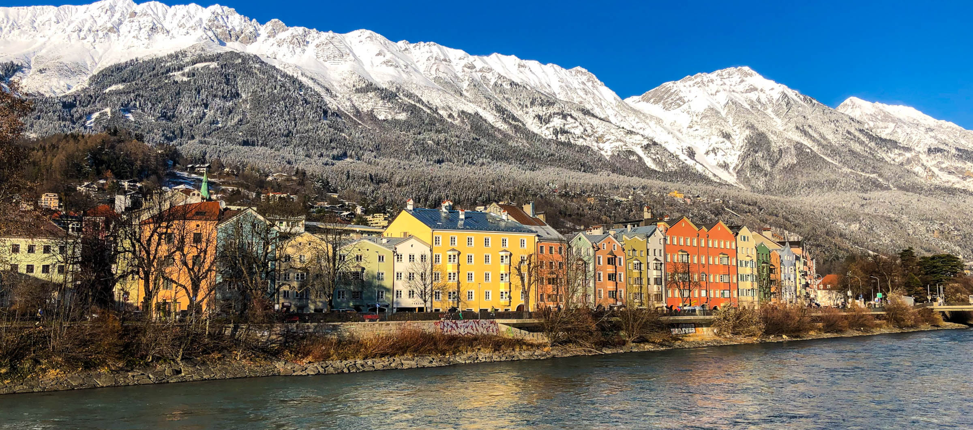
EPoS WINTER SUMMIT 2021
ENCOUNTER NEW THINGS COURAGEOUSLY AND OPENLY!

Slide 2
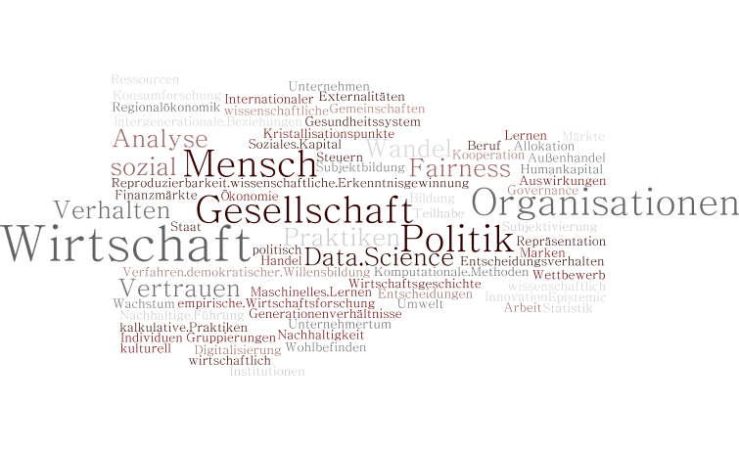
EPoS – Economics, Politics & Society
Notes:
A lot of work was done behind the scenes
get to know each other better in the managing team
define statutes and our way of working
Connecting two platforms
Develop homepage, visual language, workflows

Slide 3
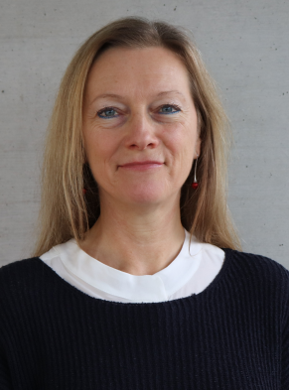
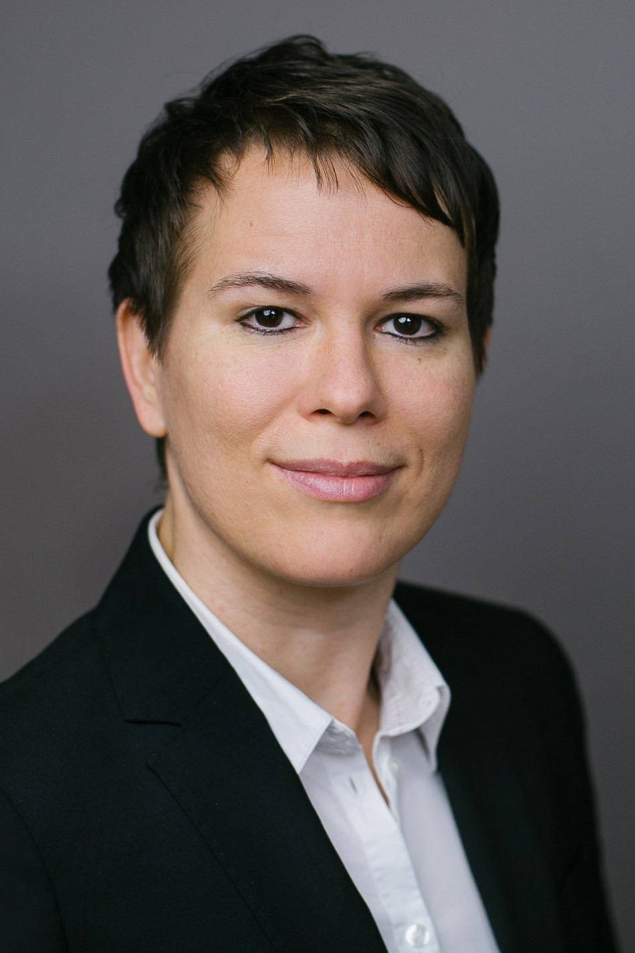
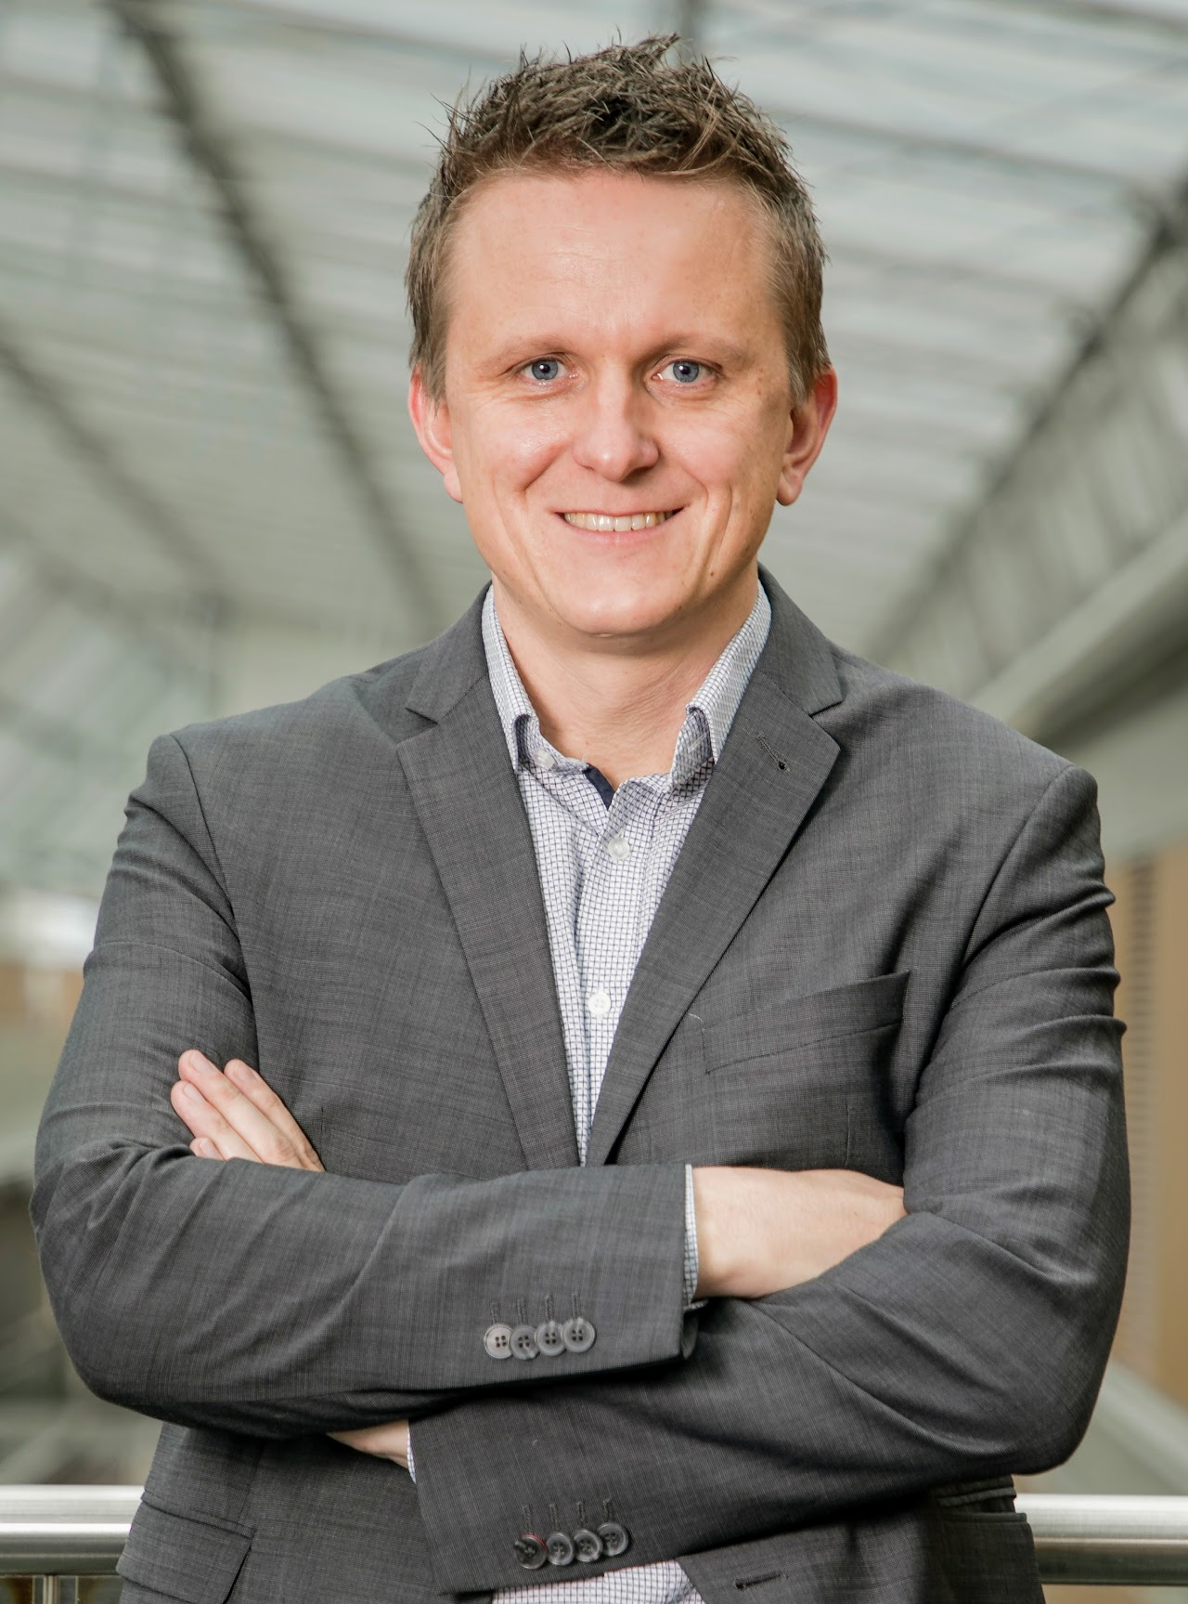
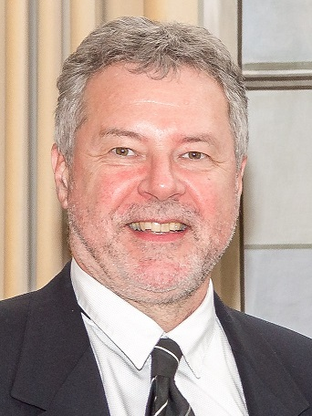
PROGRAM
9:00 Welcome & Review of Events and News
Andrea Hemetsberger
9:30 Introduction Institute for the Sociology of Law and Criminology (IRKS) Meropi Tzanetakis
9:45 Introduction Research Group Innsbruck Quantitative Social Sciences – IQSS Andreas Steinmayr
10:00 Research Center Media Studies
Theo Hug
Mach mal Pause und trag was bei/Have a break and contribute
Notes:
Das IRKS zählt zu den führenden Instituten in der europäischen Sicherheitsforschung und hat seinen Sitz in Wien. Es wurde 1973 als außeruniversitäre Forschungseinrichtung gegründet und ist seit März 2021 Teil der Fakultät für Soziale und Politische Wissenschaften der Leopold-Franzens-Universität Innsbruck. Stellt sich im Anschluss genauer vor.
IQSS Neugründung und erstes Kennenlernen bei einem Workshop im Oktober – mehr wird Andreas selber vorstellen

Slide 4
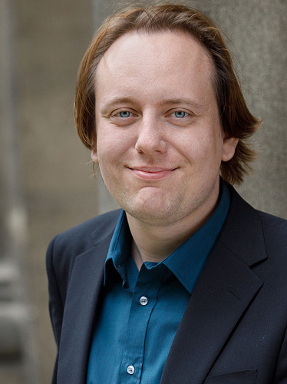
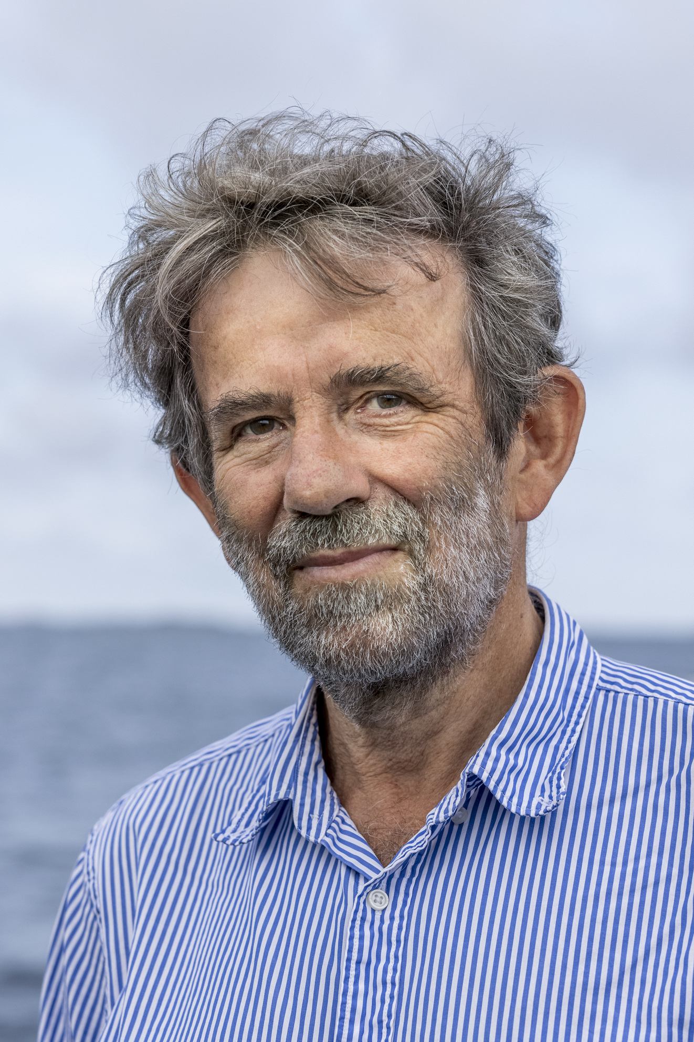
PROGRAM
11:00 AUSSDA - The Austrian Social Science Data Archive
Dimitri Prandner
11:15 Keynote 1 "Pricing Carbon" Thomas Sterner Professor of environmental economics at the University of Gothenburg
Mach mal Pause und besuch uns/Have a break and drop by
Notes:
In den Pausen gerne im Büro vorbei kommen

Slide 5
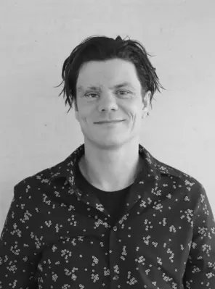
PROGRAM
12:45 Research Spotlight - Getting a Handle on Sales: Shopping Carts Affect Purchasing by Activating Arm Muscles
Mathias Streicher
13:15 Keynote 2 „Giving Reasons" John Levi Martin Florence Borchert Bartling Professor of Sociology at the University of Chicago

Slide 6
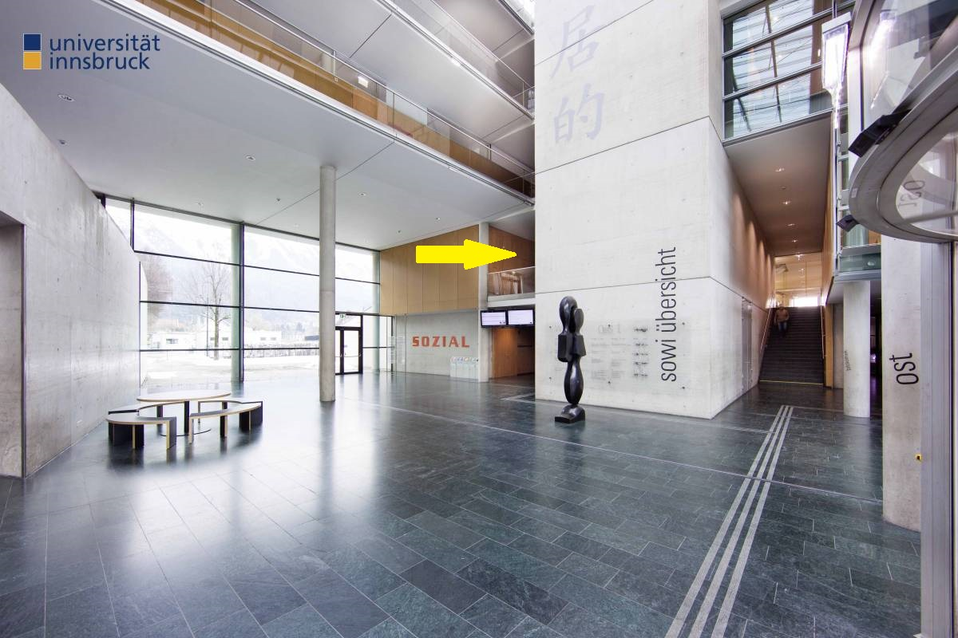
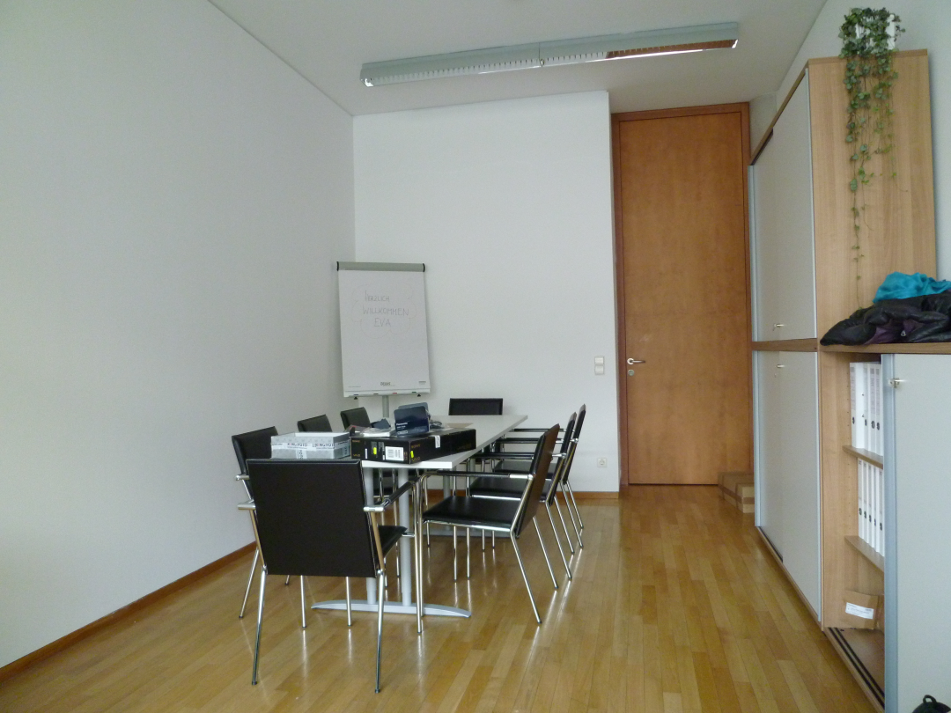
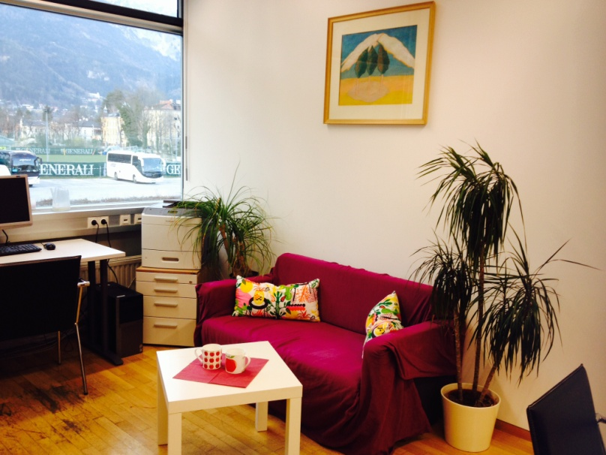
THE EPoS OFFICE….. drop by during the break for refreshments
Find our office on the East part of the SOWI building,
1st floor, right next to the library

Slide 7
BEGRÜSSUNGSWORTE / OPENING WORDS
Encounter new things courageously and openly!
About Openness
Notes:
About openness
What is openness?
A mindset. People who score low on openness tend to be conventional and traditional in their outlook and behavior. They prefer familiar routines to new experiences, and generally have a narrower range of interests. Openness has moderate positive relationships with creativity, intelligence and knowledge.
Openness motivational and structural components. People high in openness are motivated to seek new experiences and to engage in self-examination. Structurally, they have a fluid style of consciousness that allows them to make novel associations between remotely connected ideas.
There are social and political implications to this trait. People who are highly open to experience tend to be liberal and tolerant of diversity. As a consequence, they are generally more open to different cultures and lifestyles.
A set of ideas: Openness in government applies the idea of freedom of information to information held by authorities and holds that citizens should have the right to see the operations and activities of government at work. Open-source grants users the rights to use, study, change, and distribute the software and its source code to anyone and for any purpose.
A set of practices: Open innovation and open strategy: to stay ahead of disruption, adopting and implementing innovative strategies. They open up strategic initiatives to a diverse group of stakeholders—front-line employees, experts, suppliers, customers, entrepreneurs, and even competitors.
Open economies tend to prosper more than closed economies.
Don’t take me wrong, openness also has its downsides when executed without limits and borders. Overheated markets, potential financial fragmentation, coping with global challenges – climate crisis, pandemics,…
As a research area spanning so many fields, EPoS has all ingredients at hand to reap the benefits of openness and respect its boundaries.
Therefore, open access to knowledge is important to support free access to a broad array of scholarly works and ideas. Open access (OA) is a set of principles and a range of practices through which research outputs are distributed online, free of cost or other access barriers. AUSSDA, exchanging our own interests, ideas and work.
It is this spirit of exploring new things, being conscious about how things are related that enables us to see, reflect, examine, engage in critical thinking and discussion, investigate, and find possible solutions to the most pressing issues of contemporary society.
Encounter new things courageously and openly! Including a hopefully Happy New Year 2022

Slide 8
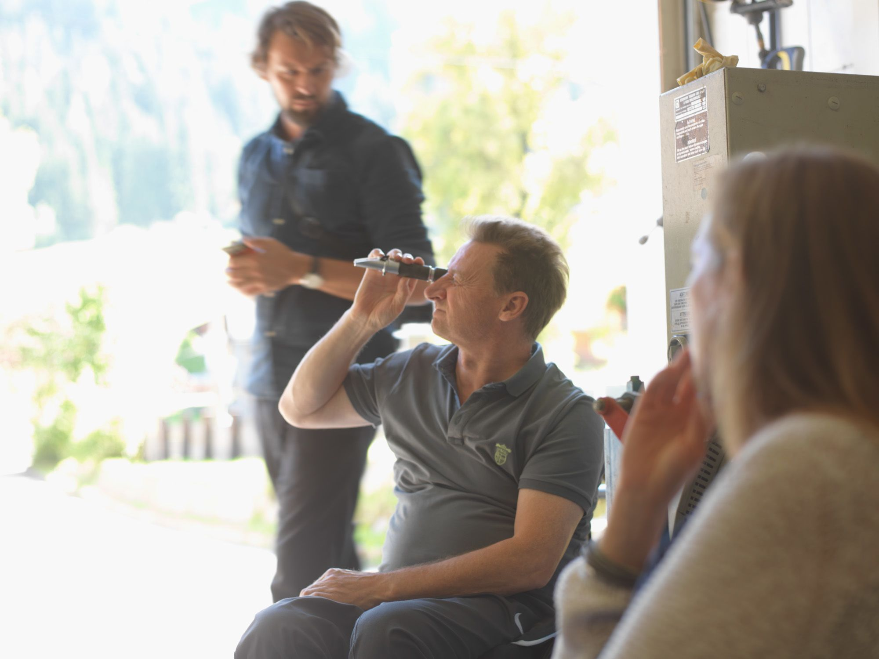
OUR MISSION AND GOALS
Bring researchers of several disciplines together to enrich and enhance knowledge
Provide a nurturing environment for research
Facilitate exchange of research ideas
Support young scholars
Stimulate bottom-up research centers, groups, doctoral schools, and other research initiatives
Third-mission activities
Enhance visibility
Notes:
Funding application on our homepage

Slide 9
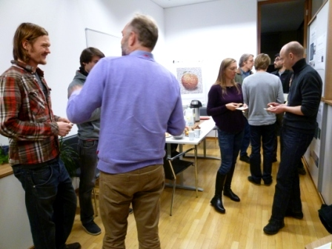
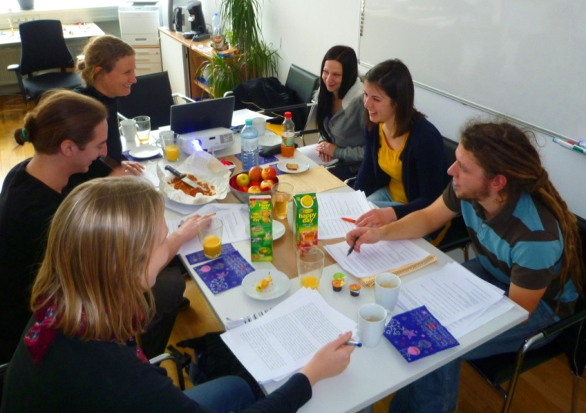
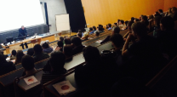
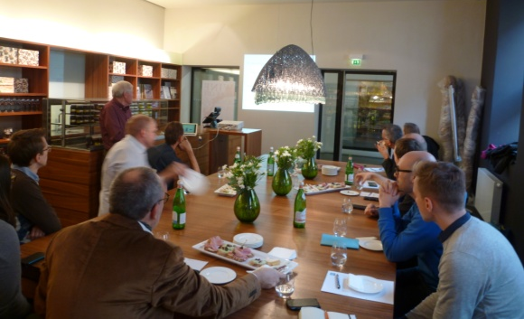
ACTIVITIES
Notes:
For this we have a whole range of formats and possibilities

Slide 10
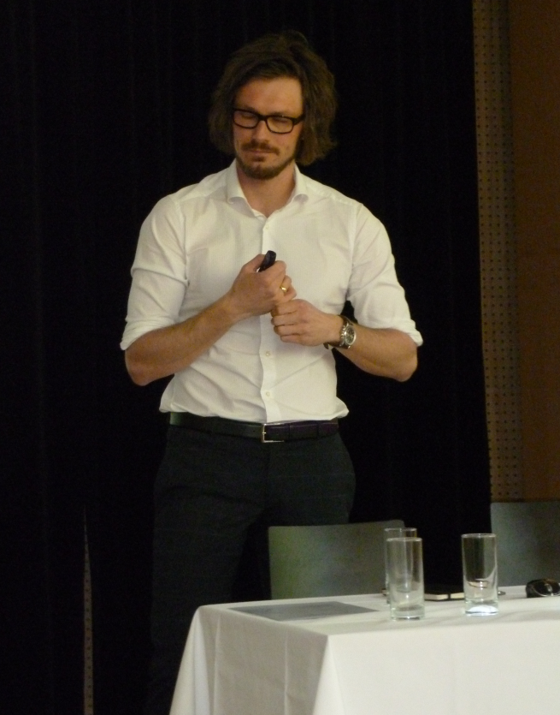
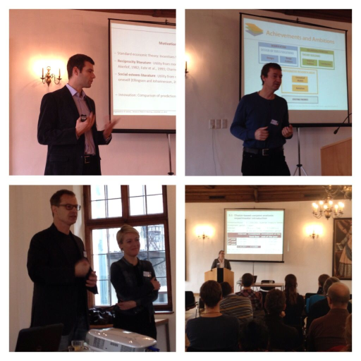
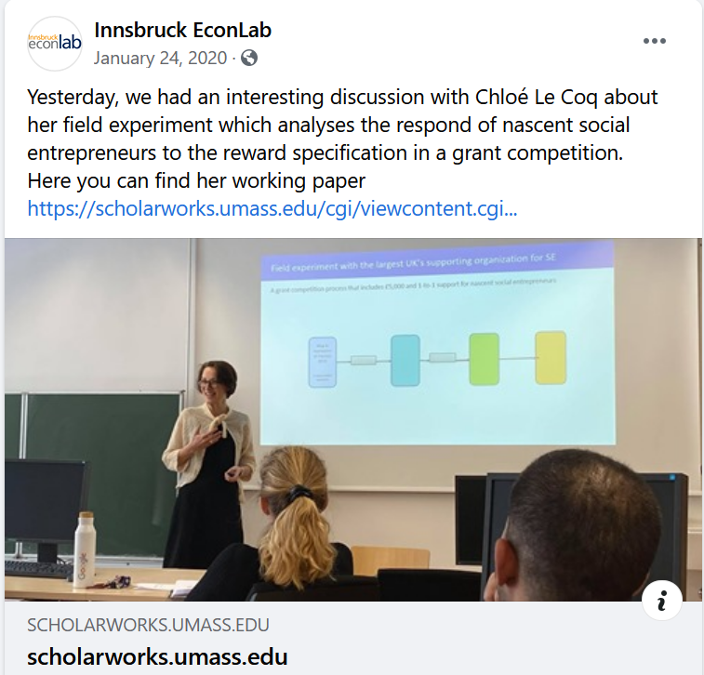
RESEARCH SEMINARS, MEETINGS, GUEST LECTURES

Slide 11
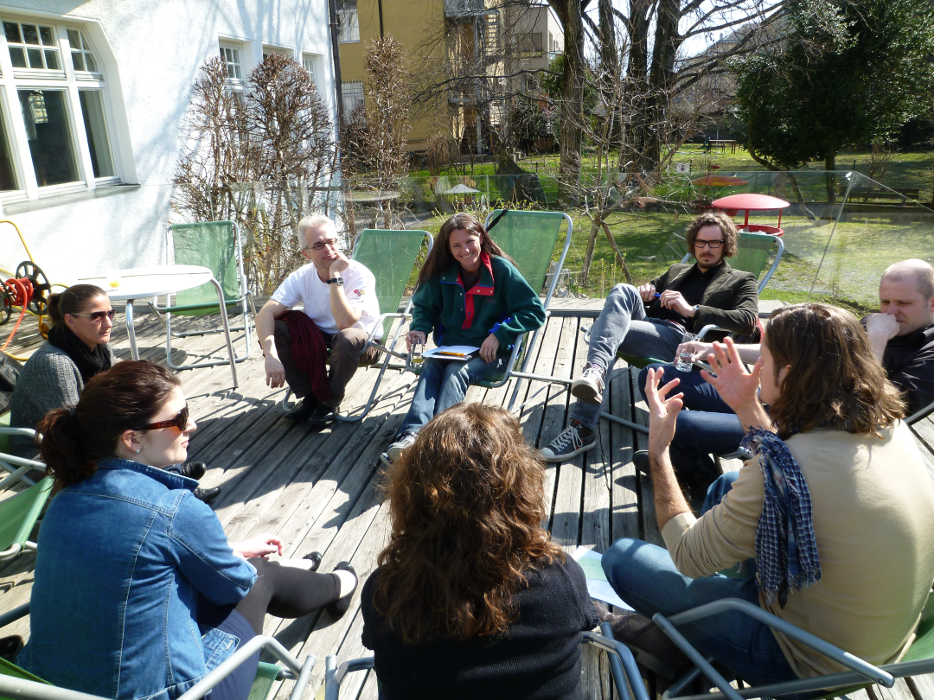
METHODS AND PUBLICATION WORKSHOPS EXCHANGE AND COOPERATION
We are organizing and funding
Workshops, conferences, and seminars

Slide 12
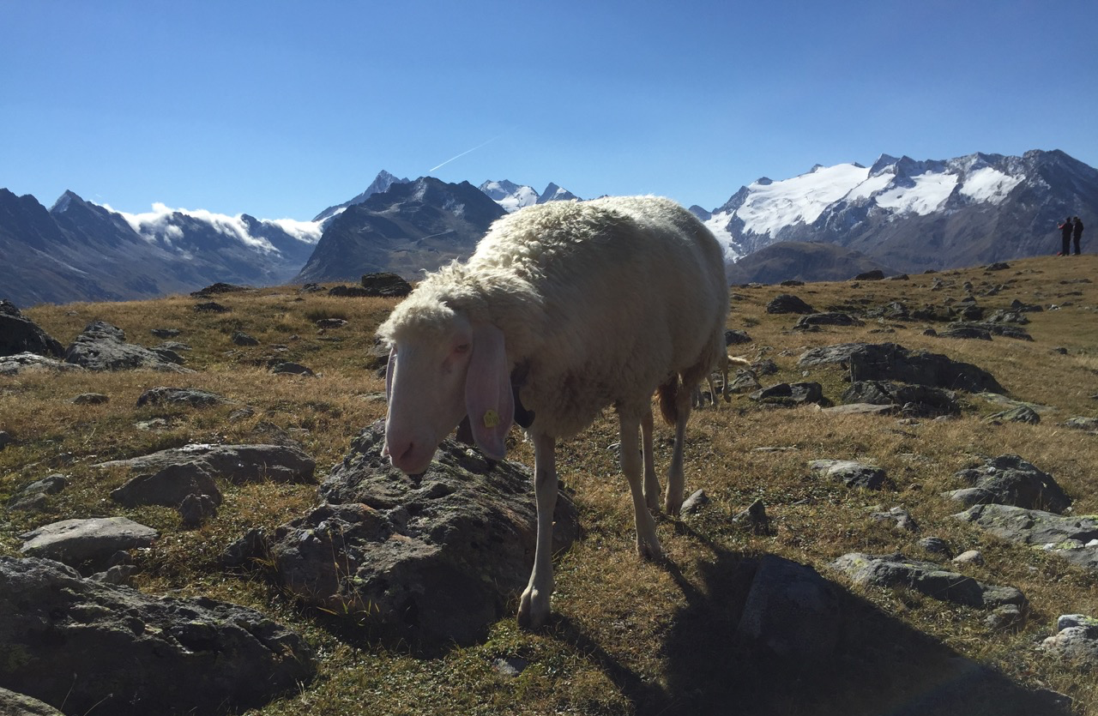
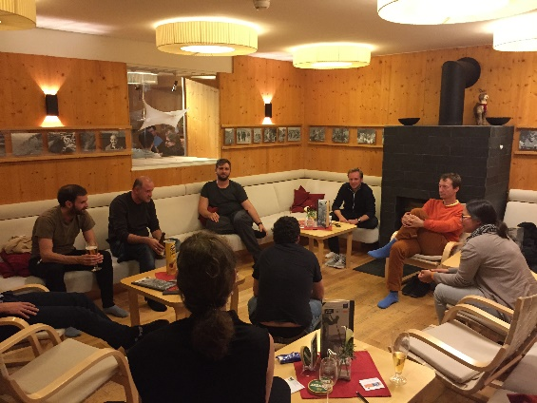
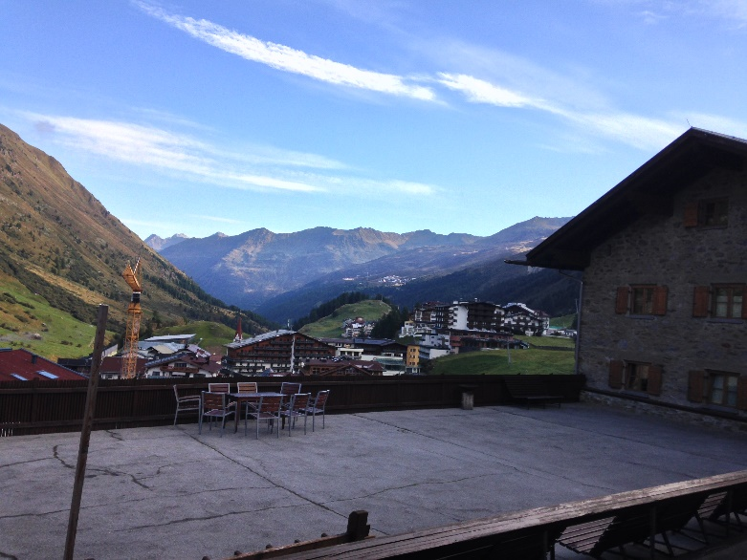
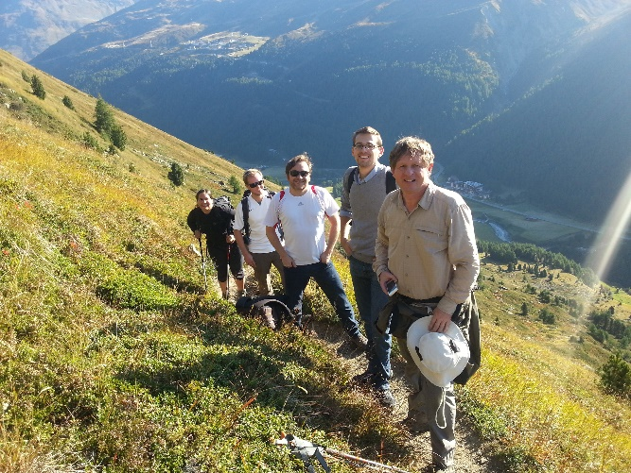
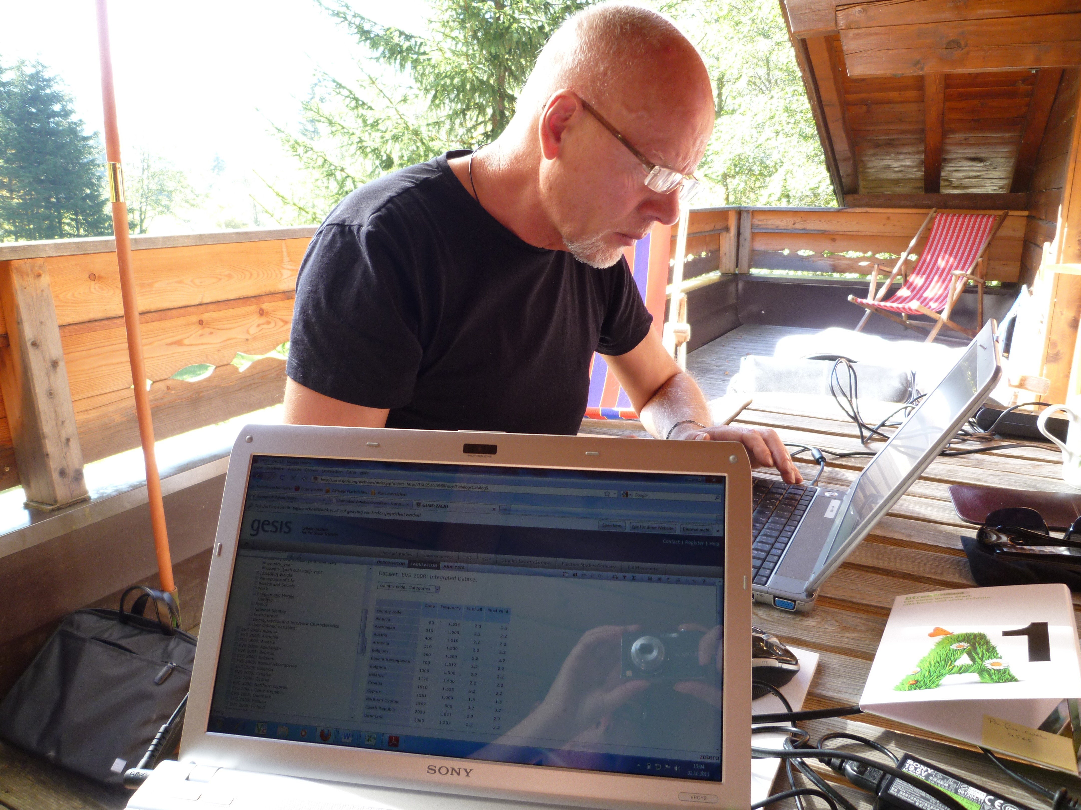
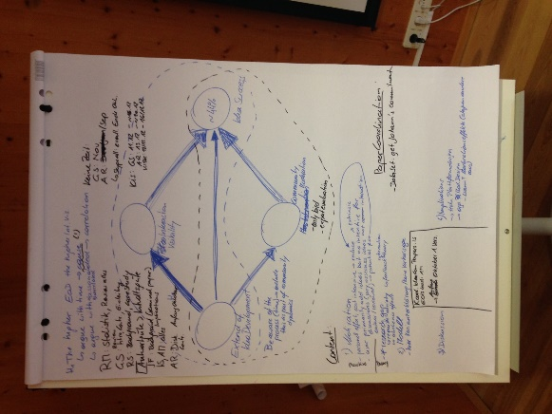
WRITING RETREATS PumA

Slide 13
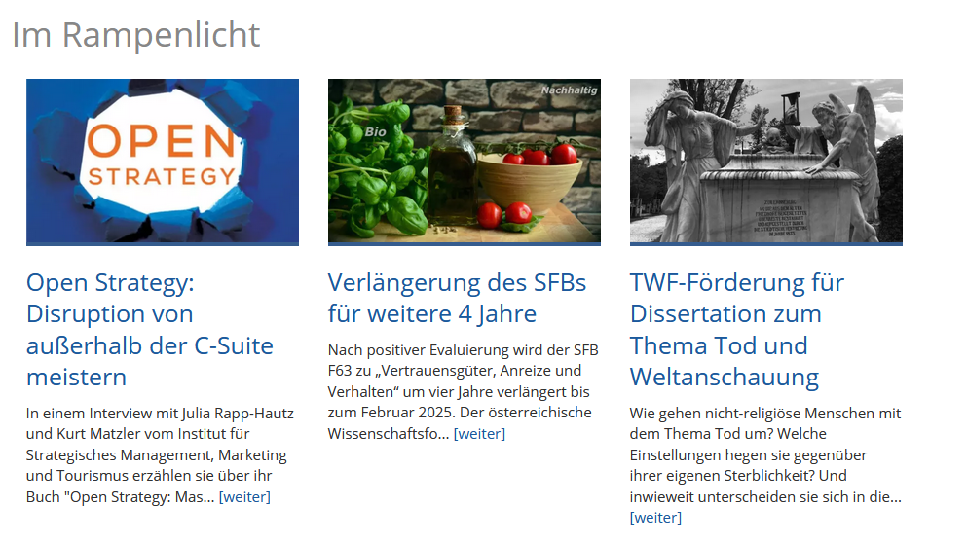
IN THE SPOTLIGHT– share your most valuable research and ideas

Slide 14
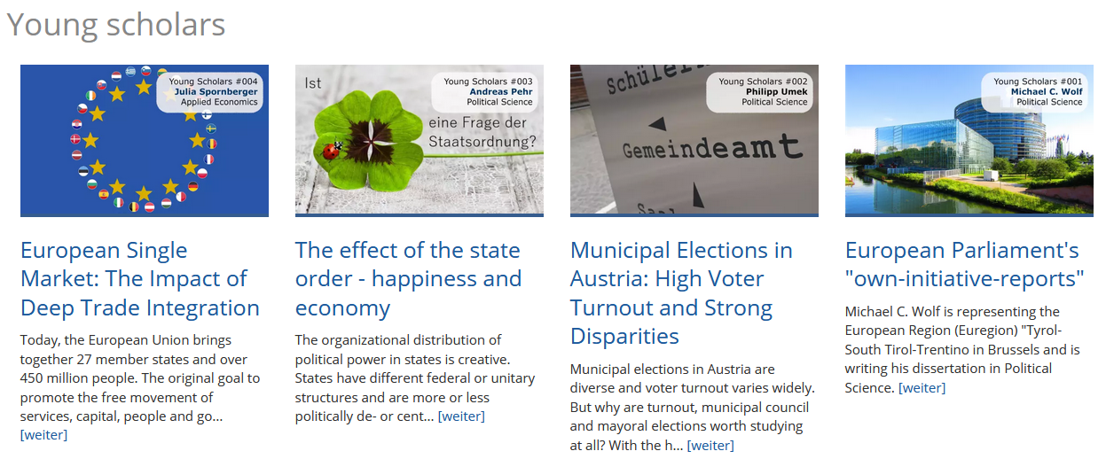
YOUNG SCHOLARS – present your research

Slide 15
Managing Team Research Area EPoS Andrea Hemetsberger
Esther Blanco
Marcelo Jenny
Coordinators
Eva Zipperle-Mirwald / Josephine Pöll Room o.1.3 | Universitätsstraße 15 | A-6020 Innsbruck
Telefon +43 (0) 512 / 507 - 39870 epos@uibk.ac.at http://www.uibk.ac.at/epos/
Get in Contact

Slide 16
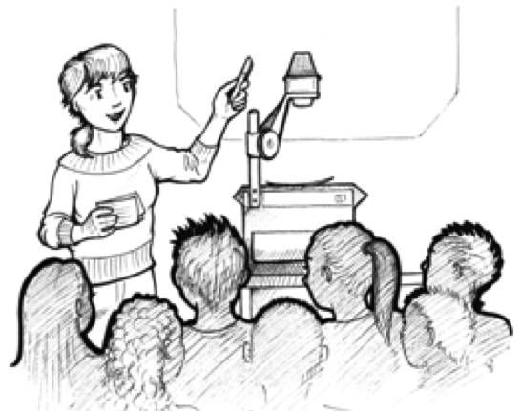
SUPPORTING YOUNG SCHOLARS - PEERS und BEERS (PuBs)

Slide 17
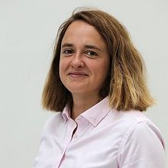
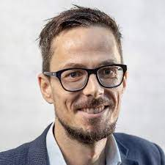
PuB 19 - PEERS und BEERS – 15. April 2021
PhD Regulars' Table Revise and Resubmit - Dealing with the Review Process.
Oana Albu Associate Professor of Corporate Communication and PR Department of Management, Society and Communication COPENHAGEN BUSINESS SCHOOL
Martin Senn Associate Professor of International Relations Department of Political Science University of Innsbruck
Notes:
Rückblick: Exchange of tips and experiences in dealing with the review process, do's and don'ts in revision strategies of your own publications. Afterwards, Oana and Martin answered all the pending questions. It was a very productive discussion and of course we had a drink on hand.

Slide 18
DOCTORAL PROGRAMS

Slide 19
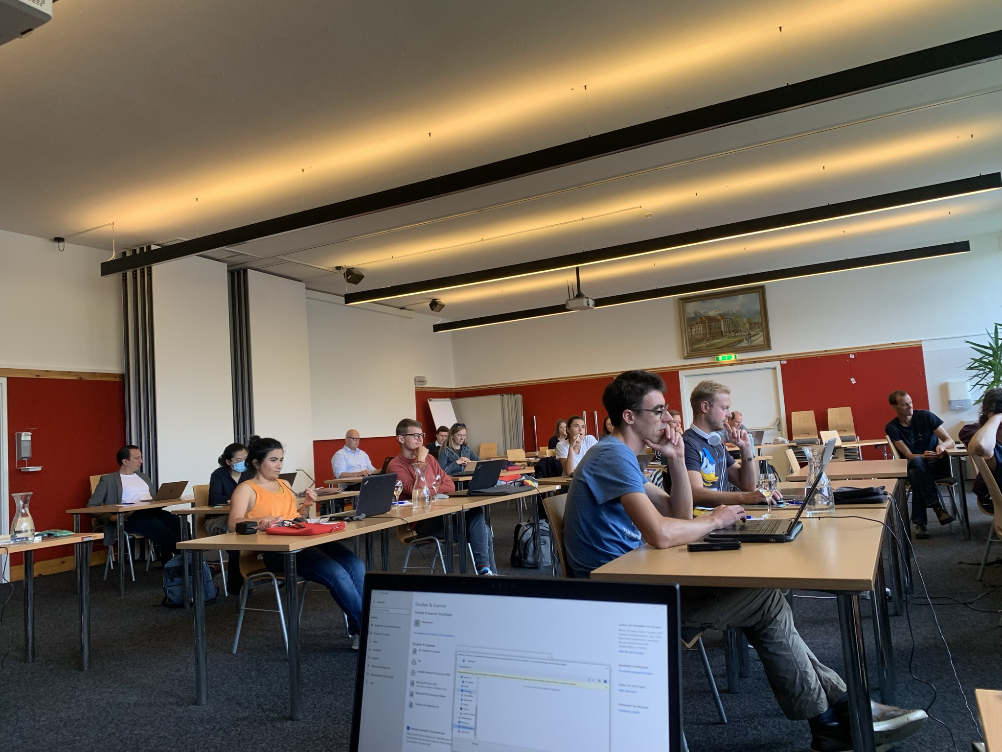
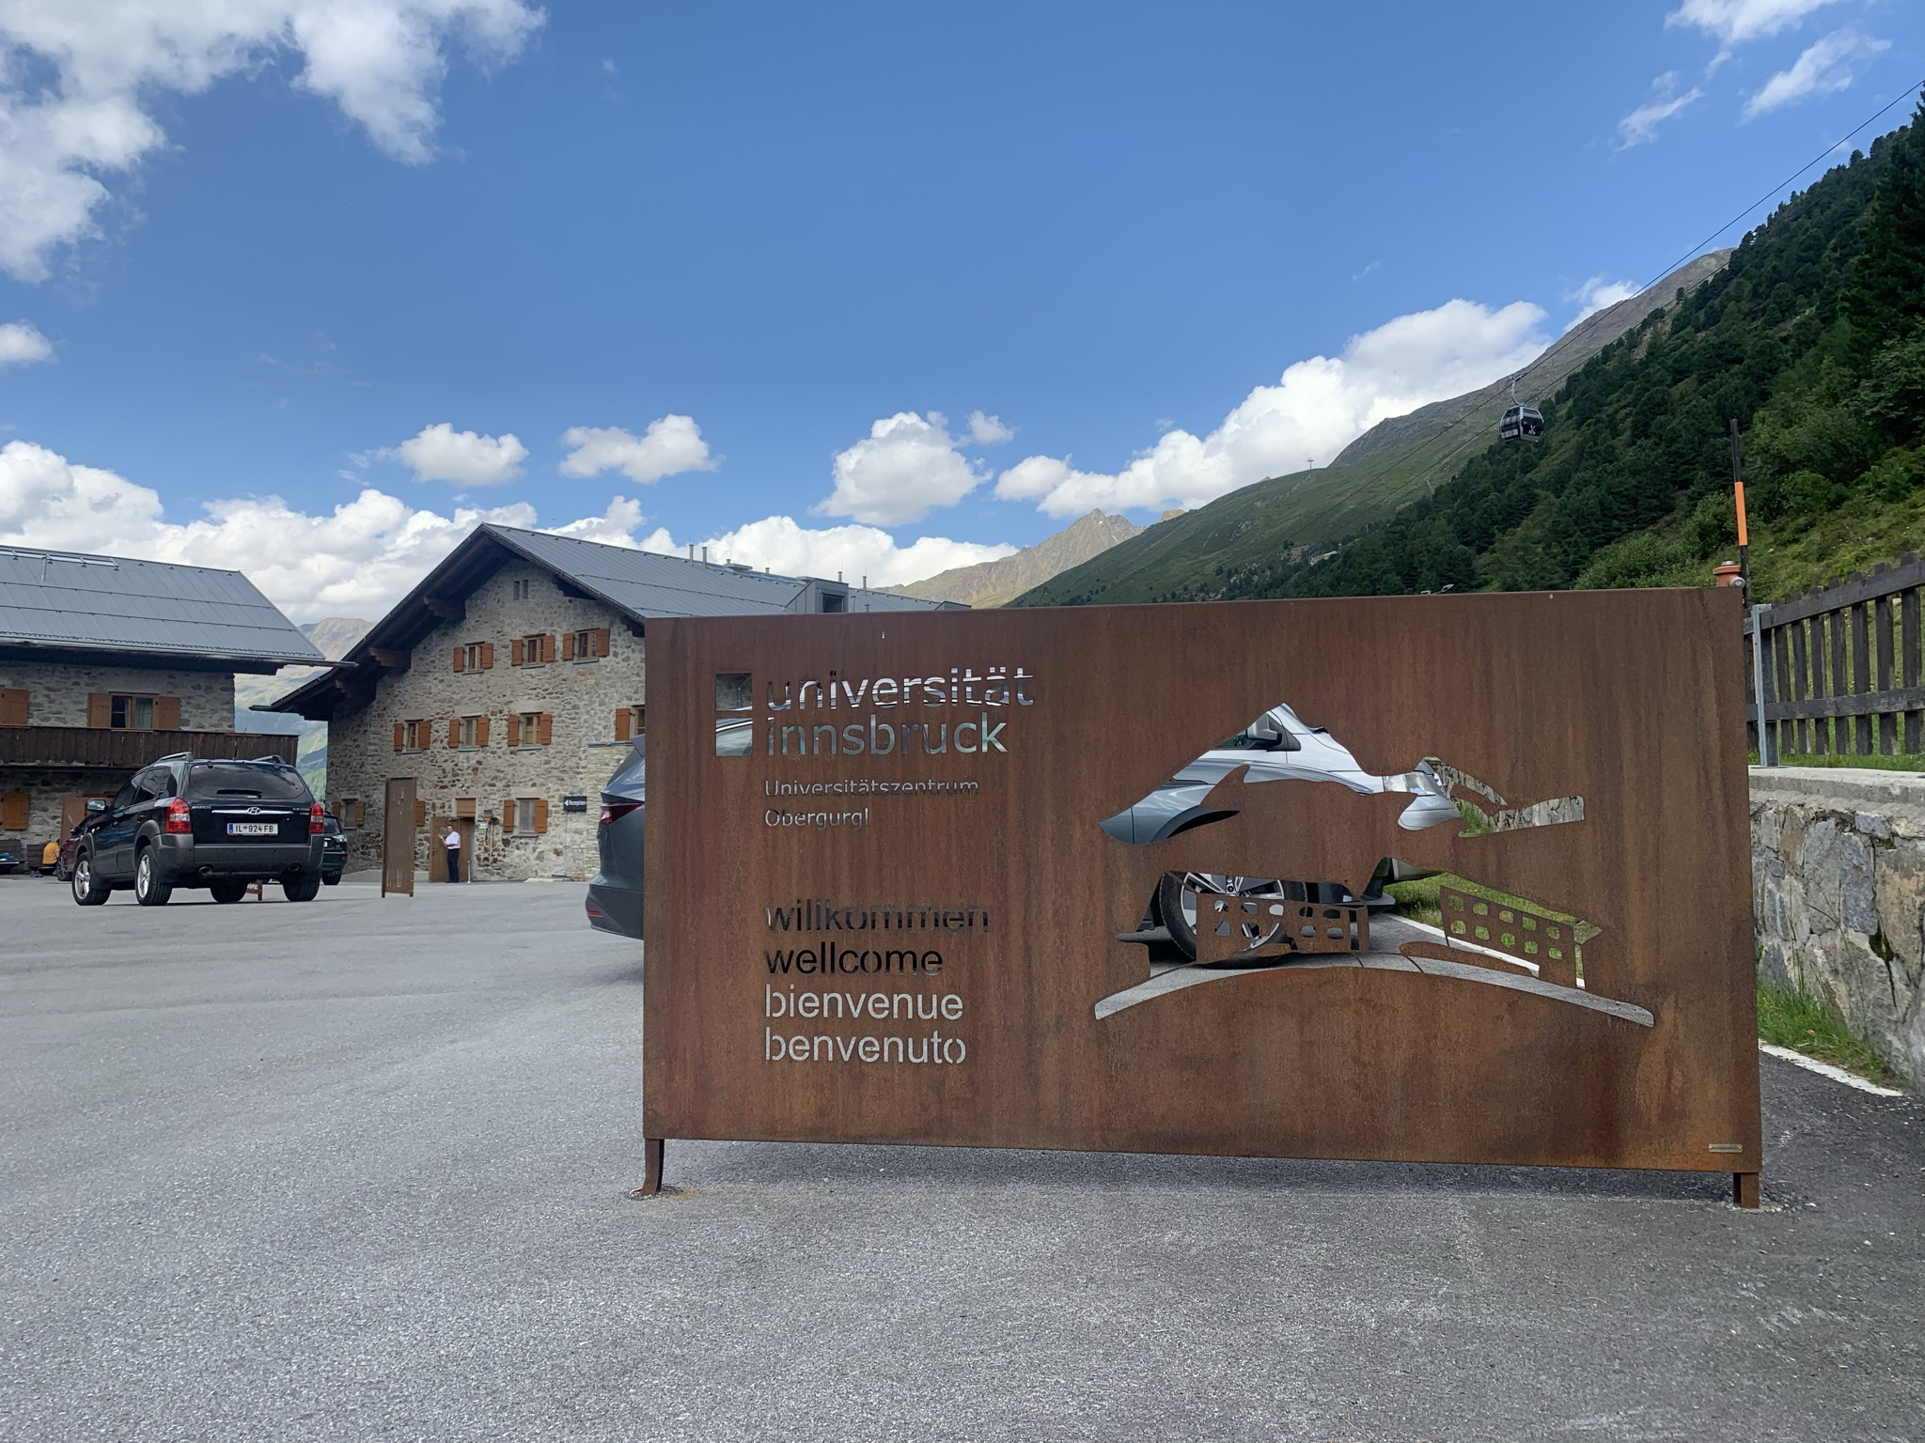
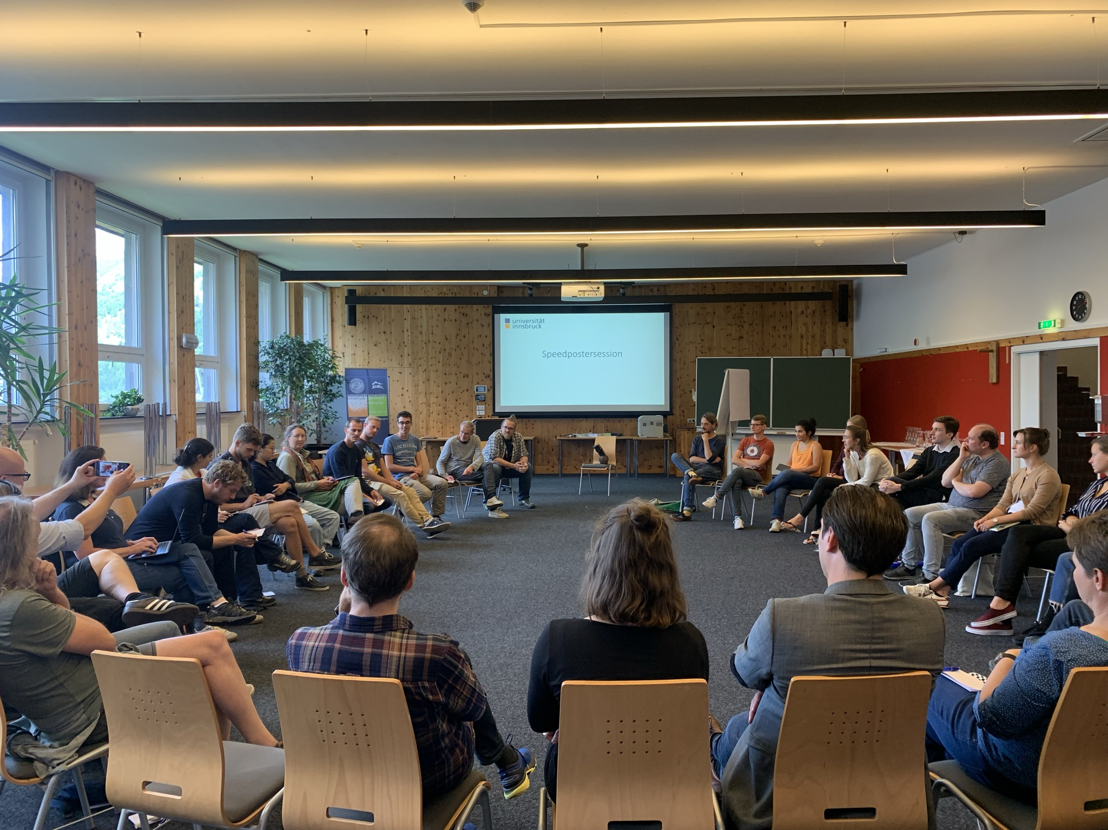
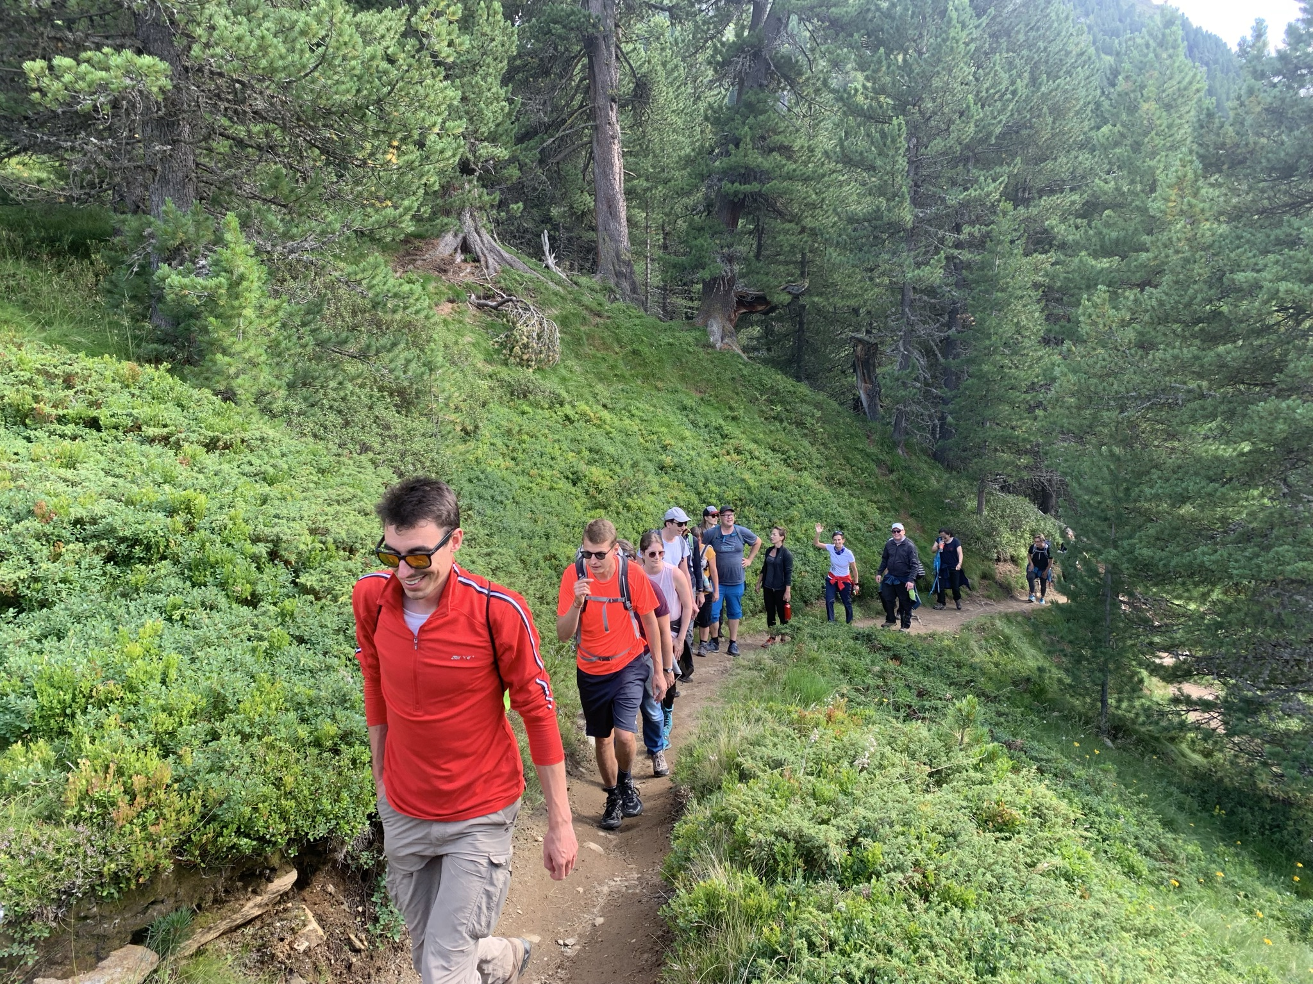
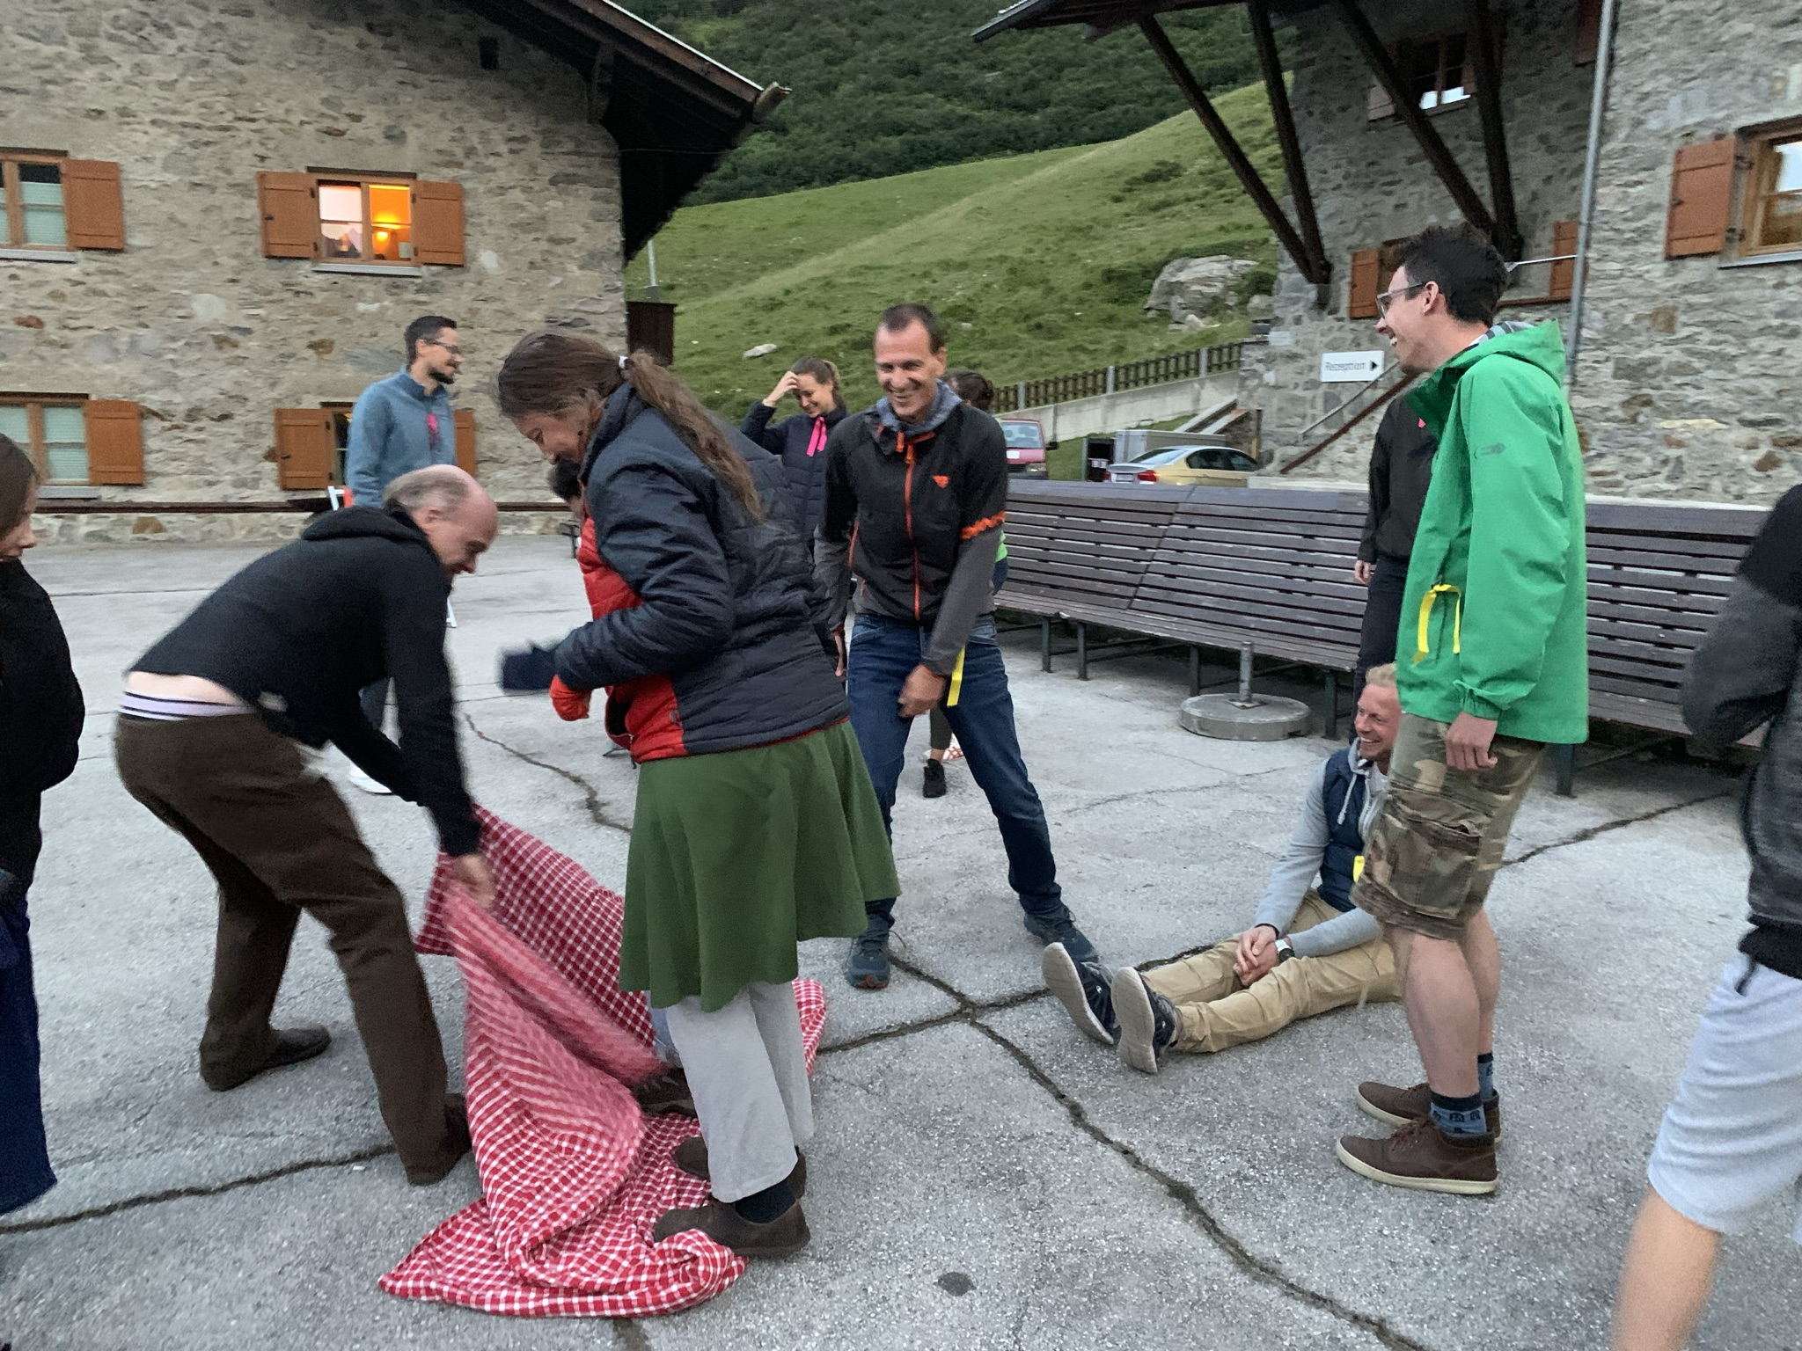
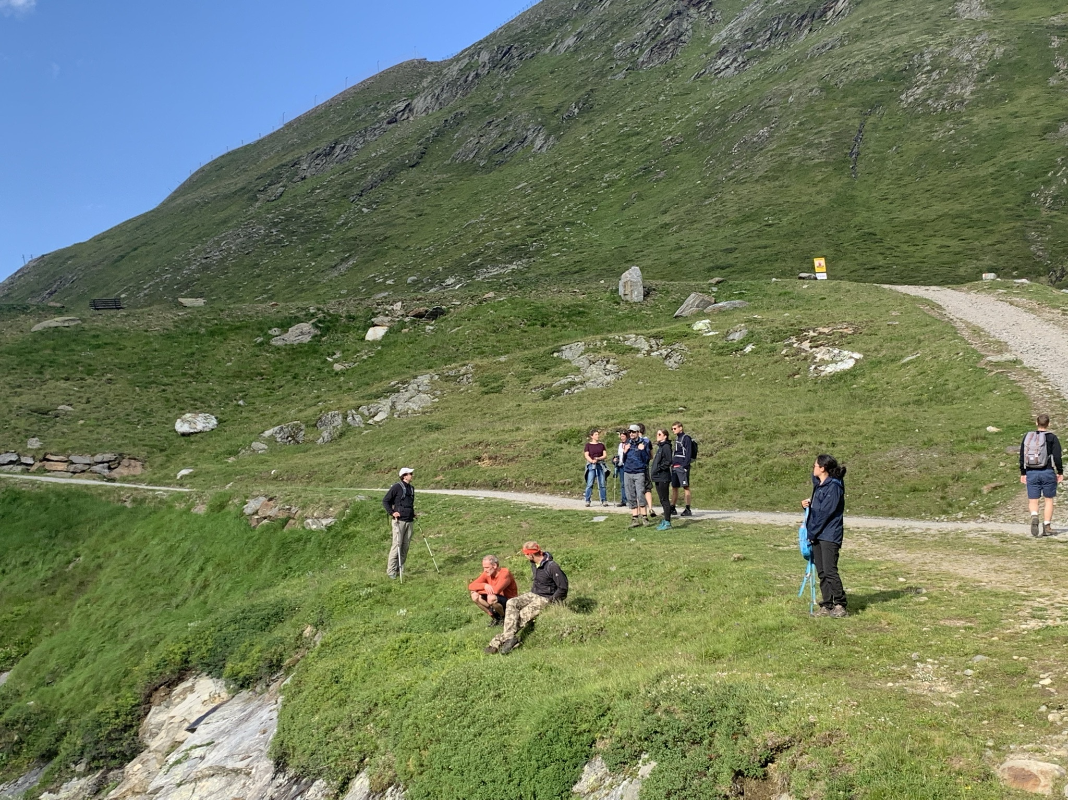
1. DK - X – CHANGE 9.-13. August – Obergurgl
Notes:
PhDs from the doctoral programs "Dynamics and Inequality and Difference in the Age of Globalization", "Natural Hazards in Mountain Regions", "Political Institutions and Leadership in a Contingent World" and "#OrganizingtheDigital" were able to network at the first DK-X-Change and new opportunities for collaboration were identified. The week in Obergurgl was planned and organized by Dipl.-Geogr. Günter Scheide, from the Transferstelle Wissenschaft - Wirtschaft - Gesellschaft in close cooperation with the DP leaders and Daniela Rothe from the writing center of the Library. I successful mix to be continued 2022, 25.-29 July.

Slide 20
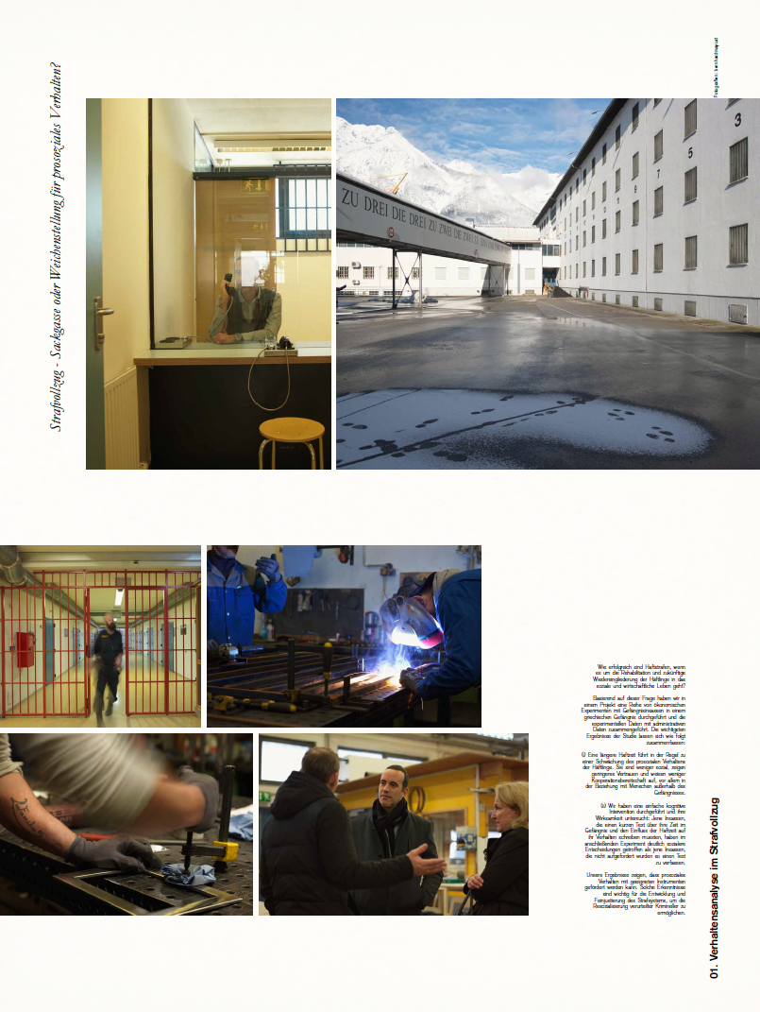
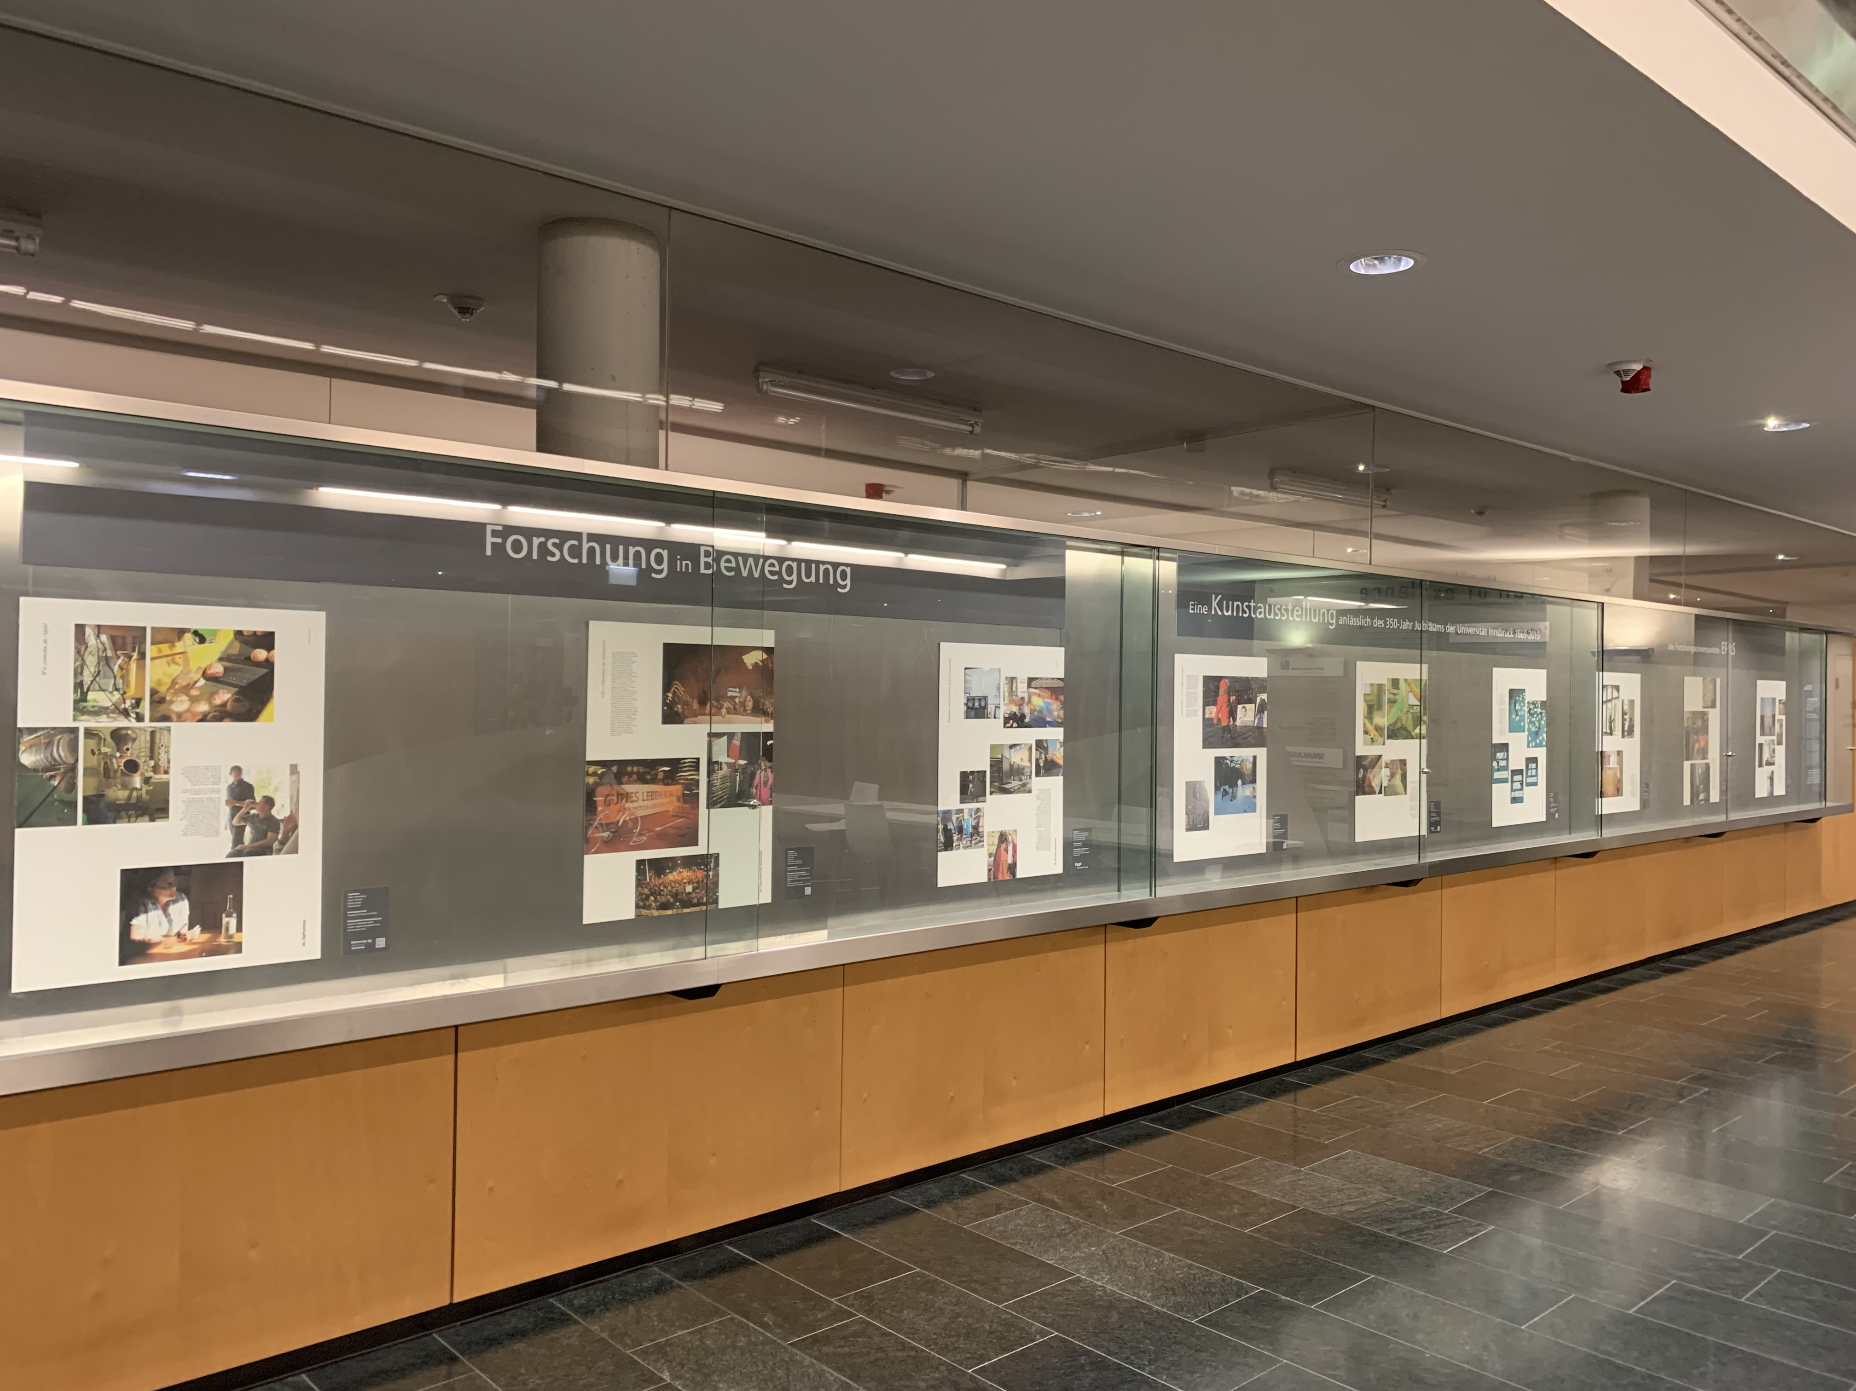
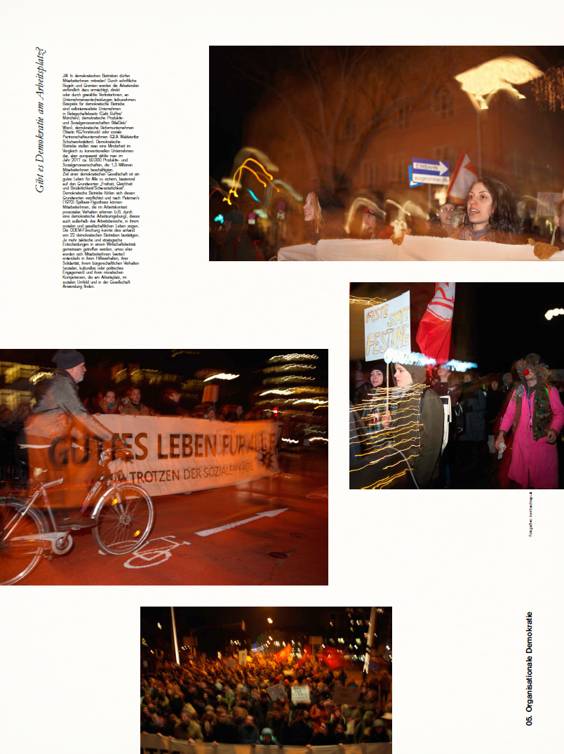
FORSCHUNG IN BEWEGUNG
Notes:
Our beautiful exhibition has found a permanent home on the 3rd floor of the Sowi

Slide 21
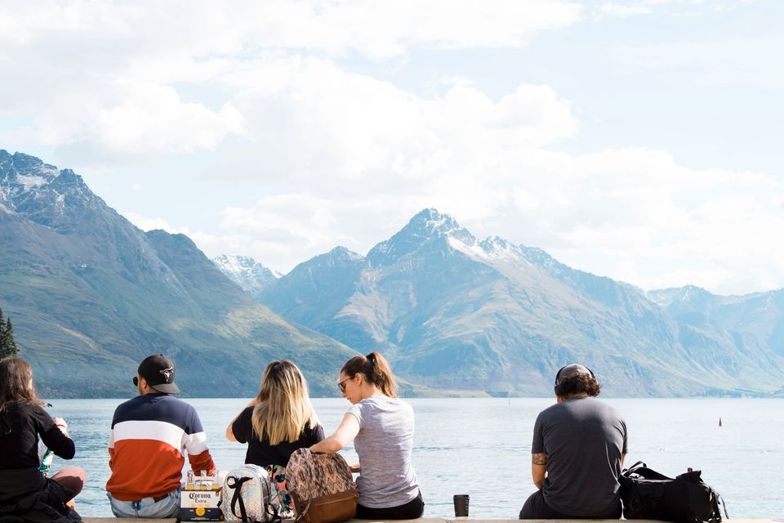
COOPERATION
„Verortung und Perspektiven im Alpen-Tourismus“
A panel talk with tourism experts and scientists in cooperation
with Wissenschaft und Verantwortlichkeit and Impact Hub Tirol
November, 11th, 2021
Notes:
https://www.uibk.ac.at/wuv/programm/wise-2122/perspektiven-im-alpen-tourismus.html

Slide 22
Title: Data sharing: An open mind on open data
Date: Tuesday, 18.01.2022 via Zoom
Program:
15:00 - Welcome
15:15 - Talk Brian Nosek (Center for Open Science)
16:00 - Discussion with Brian Nosek
16:15 - Talk Lars Kaczmirek (AUSSDA)
17:00 - Discussion moderated by Lisa Lechner
An open mind on open data
Notes:
Event organisiert von Franz Eder in Kooperation mit EPoS – Herr Prandner stellt heute kurz vor – dieses Event geht in die Tiefe und lässt mehr Raum für Diskussion

Slide 23
PROGRAM
9:00 Welcome & Review of Events and News
Andrea Hemetsberger
9:30 Introduction Institute for the Sociology of Law and Criminology (IRKS) Meropi Tzanetakis
9:45 Introduction Research Group Innsbruck Quantitative Social Sciences – IQSS Andreas Steinmayr
10:00 Research Center Media Studies
Theo Hug
Mach mal Pause und trag was bei/Have a break and contribute
Notes:
Das IRKS zählt zu den führenden Instituten in der europäischen Sicherheitsforschung und hat seinen Sitz in Wien. Es wurde 1973 als außeruniversitäre Forschungseinrichtung gegründet und ist seit März 2021 Teil der Fakultät für Soziale und Politische Wissenschaften der Leopold-Franzens-Universität Innsbruck. Stellt sich im Anschluss genauer vor.
IQSS Neugründung und erstes Kennenlernen bei einem Workshop im Oktober – mehr wird Andreas selber vorstellen

Slide 24
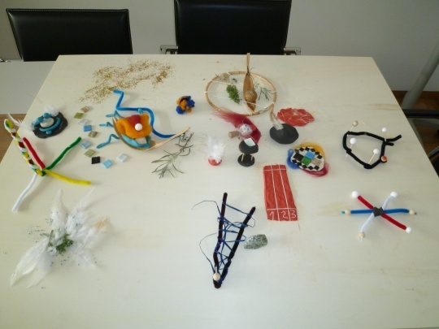
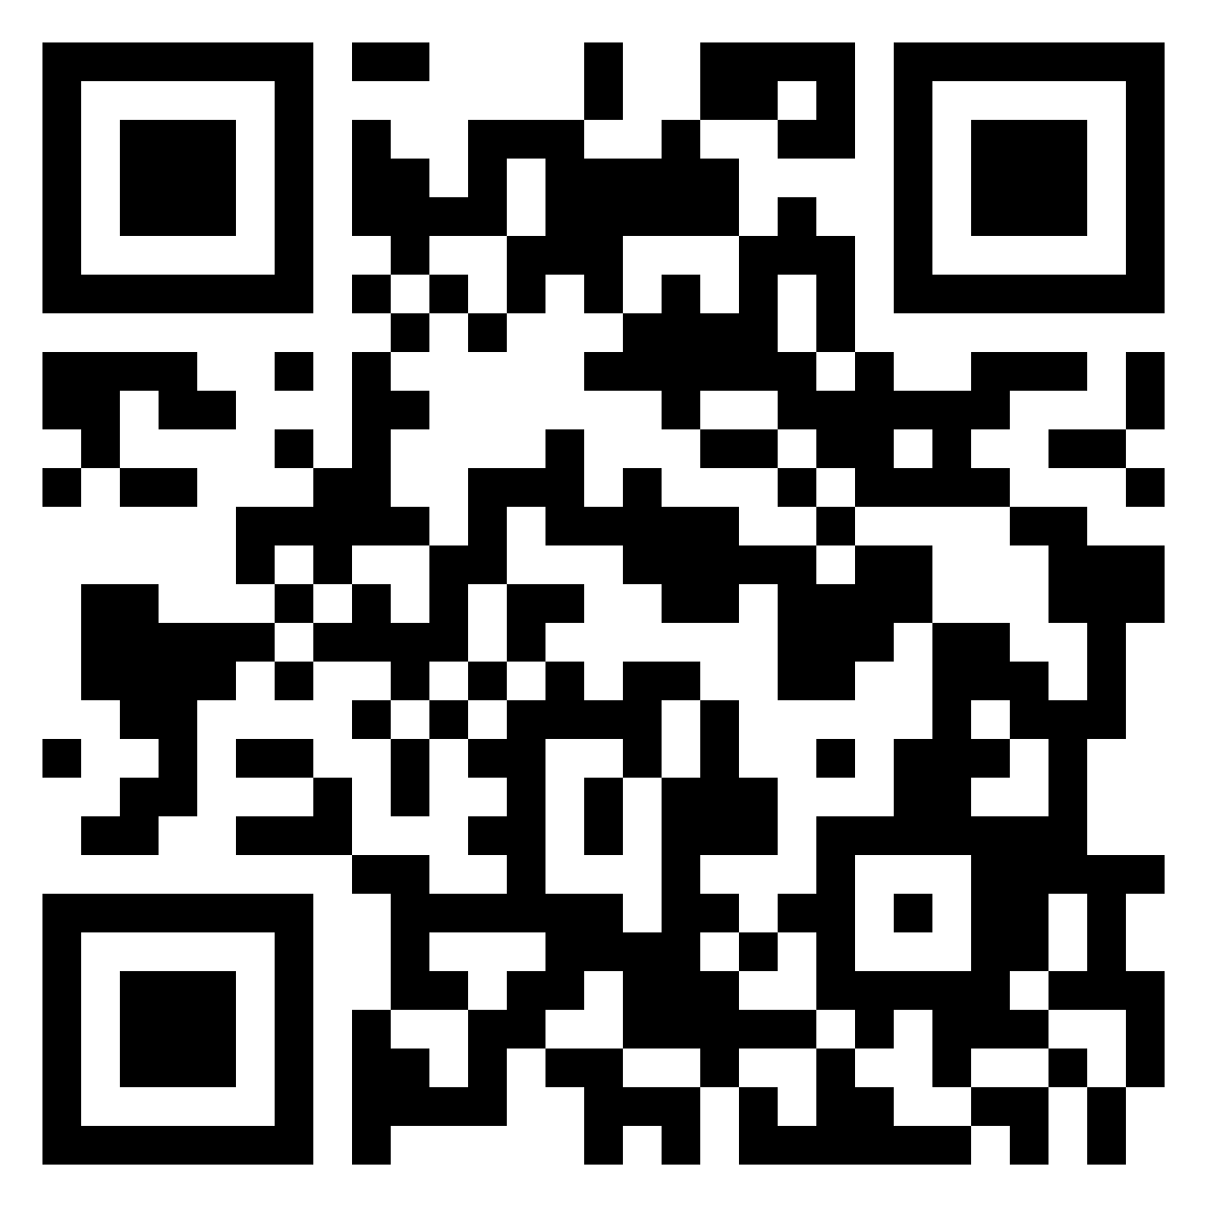
CALL FOR PARTICIPATION AND CONTRIBUTION
Co-create our Padlet - The research field/topic that fascinates me the most
https://padlet.com/andreahemetsberger/qrusdzvop0mfppc5

Slide 25
HAVE A BREAK

Slide 26
PROGRAM
11:00 AUSSDA - The Austrian Social Science Data Archive
Dimitri Prandner
11:15 Keynote 1 "Pricing Carbon" Thomas Sterner Professor of environmental economics at the University of Gothenburg
Mach mal Pause und besuch uns/Have a break and drop by
Notes:
In den Pausen gerne im Büro vorbei kommen

Slide 27
SECRET SANTA
Share your favorite article from 2021 & some good wishes for 2022

Slide 28
HAVE A BREAK

Slide 29
PROGRAM
12:45 Research Spotlight - Getting a Handle on Sales: Shopping Carts Affect Purchasing by Activating Arm Muscles
Mathias Streicher
13:15 Keynote 2 „Giving Reasons" John Levi Martin Florence Borchert Bartling Professor of Sociology at the University of Chicago

Slide 30
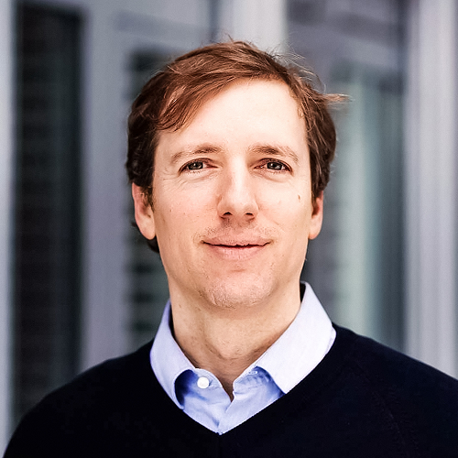
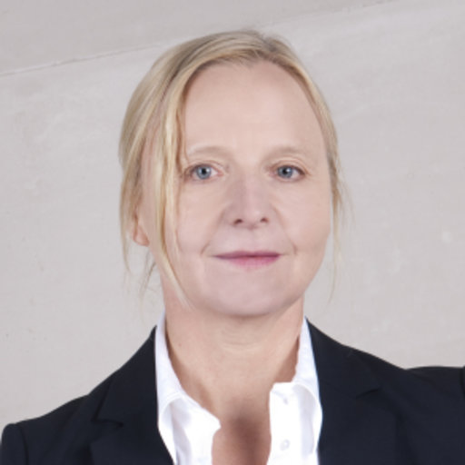
EPOS SUMMER SUMMIT 2022 - 8. APRIL
Keynotes Dominik Hangartner (ETH Zürich) & Ingrid Volkmer (University of Melbourne)
Thank you for your valuable contributions
Looking forward to filling EPoS with life at our next meeting in spring / summer 2022 !
Andrea, Esther, Marcelo, Eva and Josephine
Notes:
Dominik received his Ph.D. in social science from the University of Bern in 2011. In the same year, he joined the London School of Economics as an assistant professor and was promoted to tenured associate professor in 2013. He joined ETH Zurich in 2017, and was promoted to full professor at the end of 2020. Dominik uses field work and statistics to study the effects of migration policies and political institutions.
Ingrid Volkmer is Associate Professor and Head of the Media and Communications Program at the University of Melbourne, Australia. She has held visiting positions at the LSE, Harvard and MIT. She has widely published in the area of transnational political communication and implications on societies and cultures.

Slide 31
MERRY CHRISTMAS AND A HAPPY NEW YEAR 2022 !
Encounter new things courageously and openly!

Slide 32
Managing Team Research Area EPoS Andrea Hemetsberger
Esther Blanco
Marcelo Jenny
Coordinators
Eva Zipperle-Mirwald / Josephine Pöll Room o.1.3 | Universitätsstraße 15 | A-6020 Innsbruck
Telefon +43 (0) 512 / 507 - 39870 epos@uibk.ac.at http://www.uibk.ac.at/epos/
Contact

