Slide 1
EPOS Research Talk: Dkfm. Dr. Mathias C. Streicher
Getting a Handle on Sales
Shopping Carts Affect Purchasing by Activating Arm Muscles
Assistant Professor
Department of Strategic Management,
Marketing & Tourism, University of Innsbruck
”My research is inspired by the idea that decision-making is strongly situated in a physical context”
Streicher, M. C. and Estes, Z. (2016). Shopping to and fro: Ideomotor compatibility of arm posture and product choice.
Journal of Consumer Psychology, 26(3), 325-336.
Estes, Z. and Streicher (2022), Getting a Handle on Sales: Shopping Carts Affect Purchasing by Activating Arm Muscles. Journal of Marketing

Slide 2
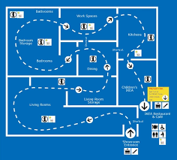
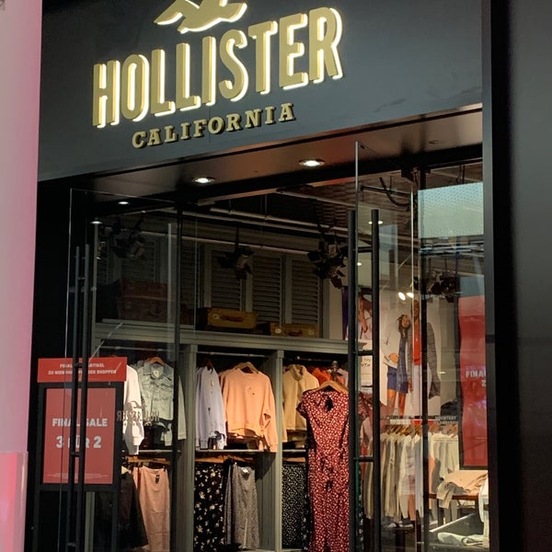
Introduction
+50% of all purchase decisions in supermarkets are unplanned (POPAI 2014)!
unplanned purchases are an important source for incremental profits
Several tools:
In-Store Promotion
Store Layout
Store Atmosphere
Slide 2/23

Slide 3
How about shopping carts?
Shopping carts may be seen as another tool to maximize in-store decisions
transport more than
your arms can carry
Prior Research
Shopping carts can be tracked to examine in-store travel behaviors (Larson, Bradlow, and Fader 2005),
revealing for instance that shoppers who park their carts more often during their trip ultimately make more purchases (Wagner et al., 2014)
Similarly, “smart” carts that provide real-time feedback to shoppers on the total cost of their purchases can entice shoppers to max out their budgets (Van Ittersum et al. 2013).
Gap: No research has ever addressed how the physical properties
of shopping carts determine product purchasing
Slide 3/23

Slide 4
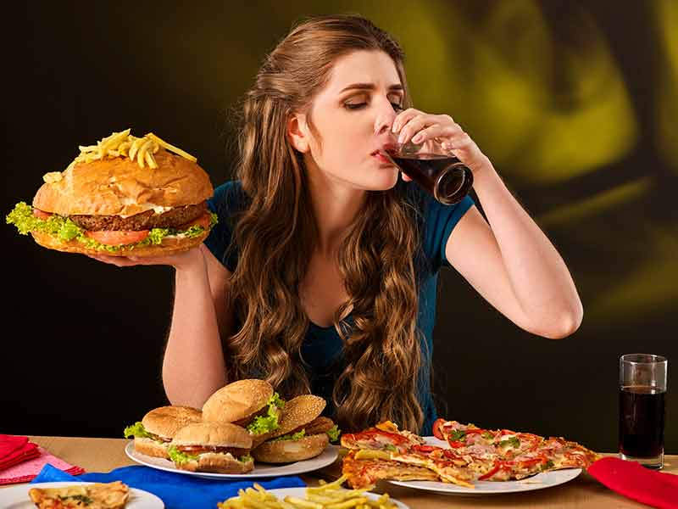
What are these physical properties?
Retail environments offer many contact points that require motor activities
Example: Product choice and consumption are typically enacted by motion toward the body!
Cacioppo, Priester, and Bernston 1993
Slide 4/23

Slide 5
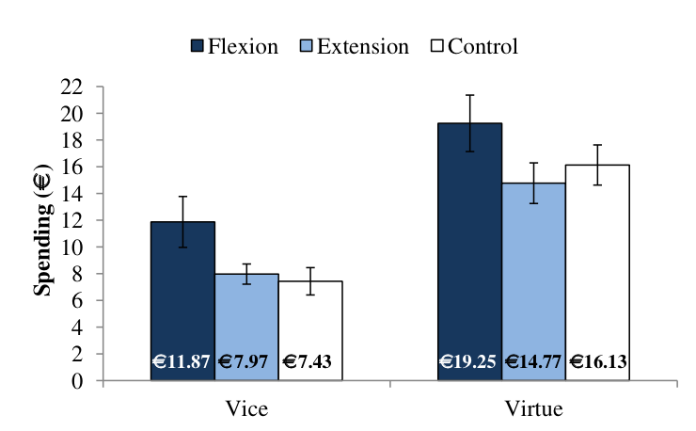
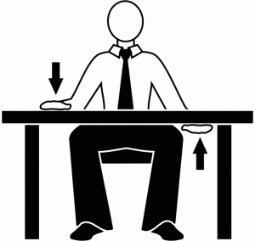
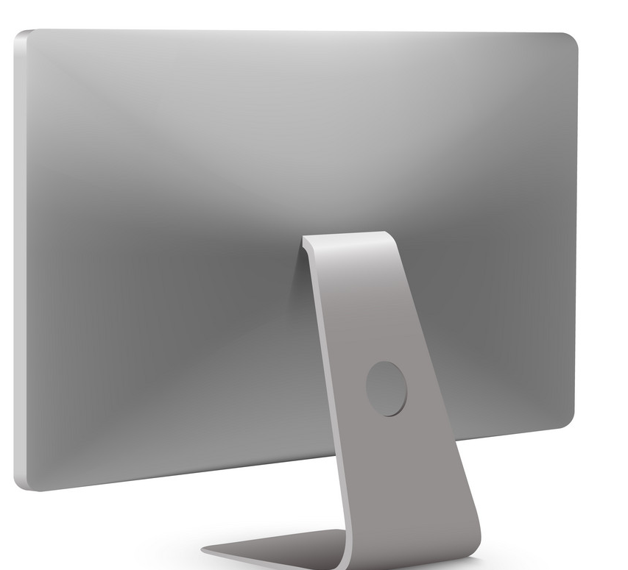
Arm flexion/extension and shopping (Streicher and Estes 2016)
Streicher, M. C., & Estes, Z. (2016). Shopping to and fro: Ideomotor compatibility of arm posture and product choice. Journal of Consumer Psychology, 26(3), 325-336.
44 products
hypotetical purchases
33 %
33 %
Slide 5/23

Slide 6
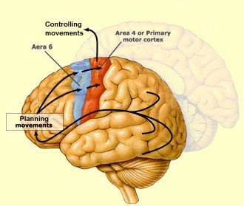
What is the explanation for the effect?
A classic view within cognitive psychology is that perception affords action, or in other words, “seeing is for doing” (Gibson 1979).
When consumers see products they mentally simulate motor actions that functionally prepare the motor system for an appropriate response (Tucker and Ellis 1998) like grasping a product (Elder and Krishna 2012).
When people viewed the products, their motor circuits were simultaneously involved in two tasks: controlling the arm posture and and mentally simulating choosing products!
Mental motor simulations and motor feedback become processed at the same time in adjunct neural regions
Much evidence points towards the possibility that arm posture consequences represent a compatibility effect between actual doing and simulated action (e.g, Streicher and Estes 2016).
Slide 6/23

Slide 7
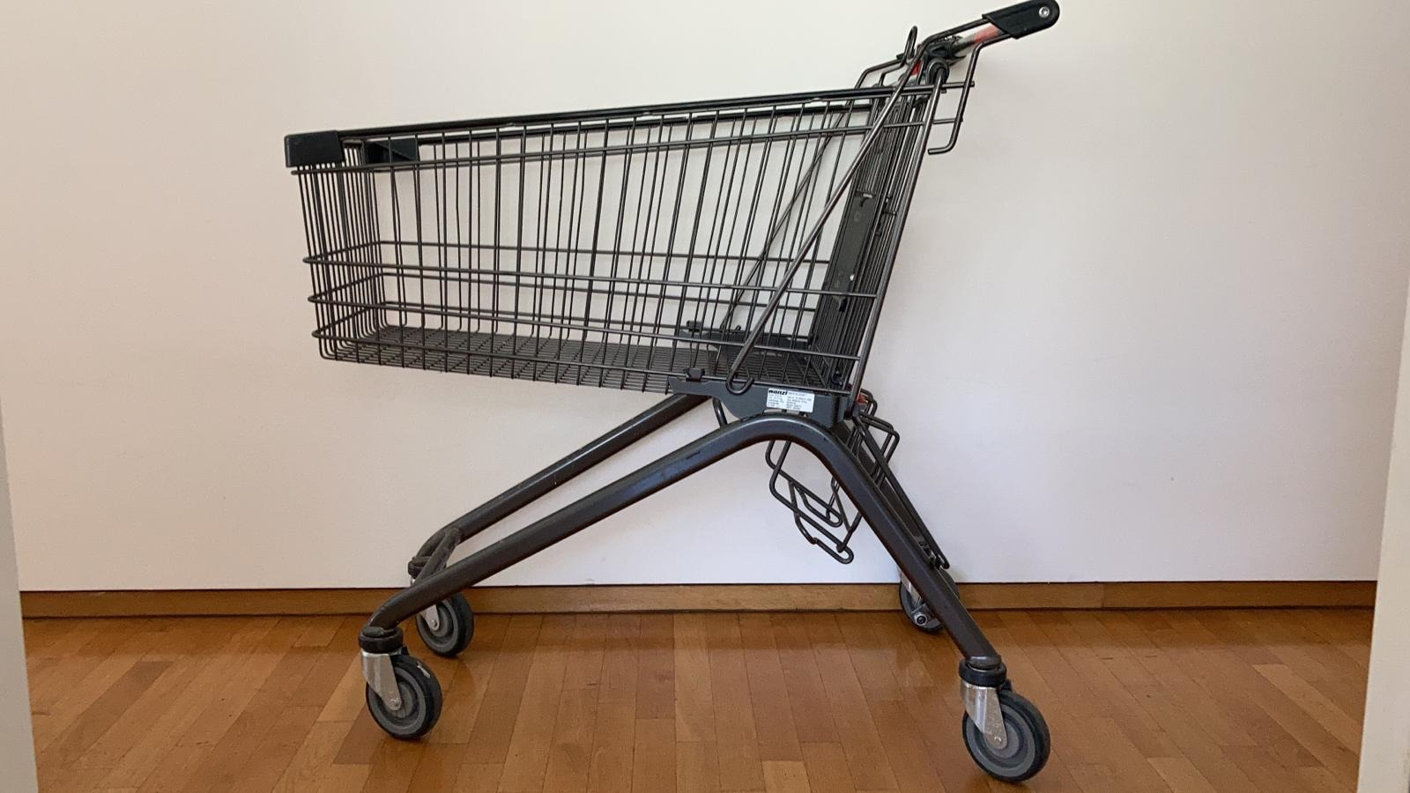
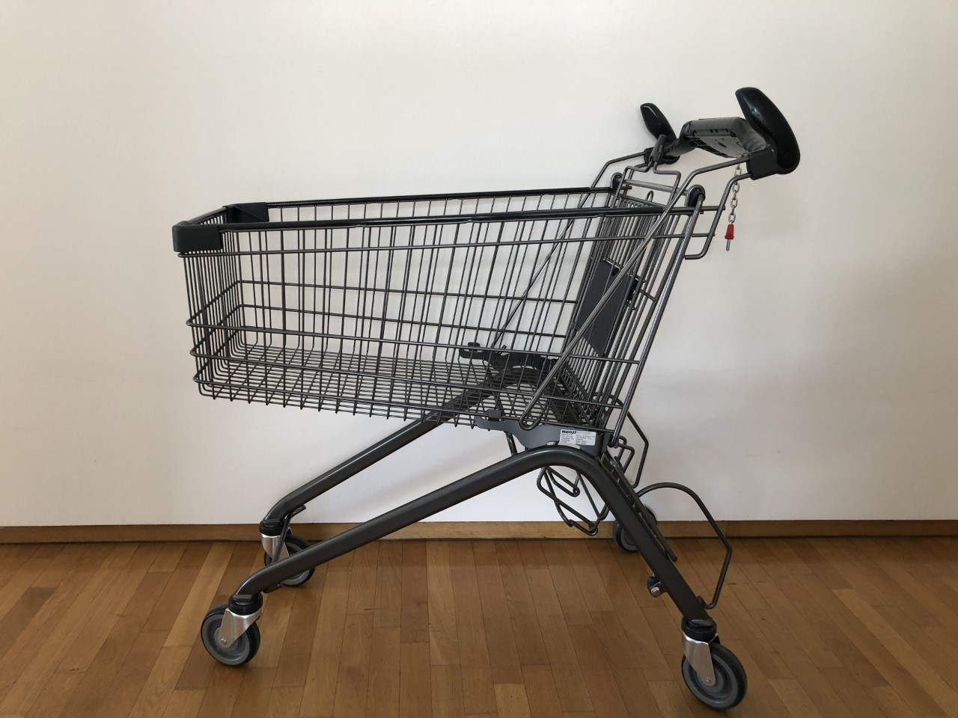
What does this mean for standard shopping carts?
horizontal
vertical
Slide 7/23

Slide 8
Zoom: Anatomy and Physiology of Shopping Carts
To move a standard cart forward one needs to activate the extensor muscle (Trizeps; Di Domizio and Keir 2010).
Extension
Why? Because the force of the arm needs to be induced in perpendicular ways
Slide 8/23

Slide 9
Zoom: Anatomy and Physiology of Shopping Carts
How about the vertical horns?
Extension
Slide 9/23

Slide 10
Zoom: Anatomy and Physiology of Shopping Carts
Standard Shopping Carts enact triceps activity which is associated with rejection, avoidance…!
What if shoppers had a cart that activates the biceps muscle?
Slide 10/23

Slide 11
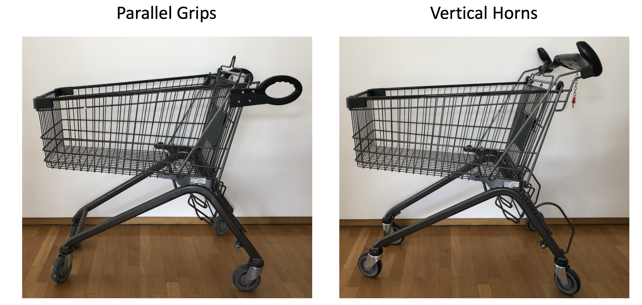
Prototyping (Estes and Streicher 2022)
Grips inspired by the idea of a rollator (or wheelborrow)
90 cm
Slide 11/23

Slide 12
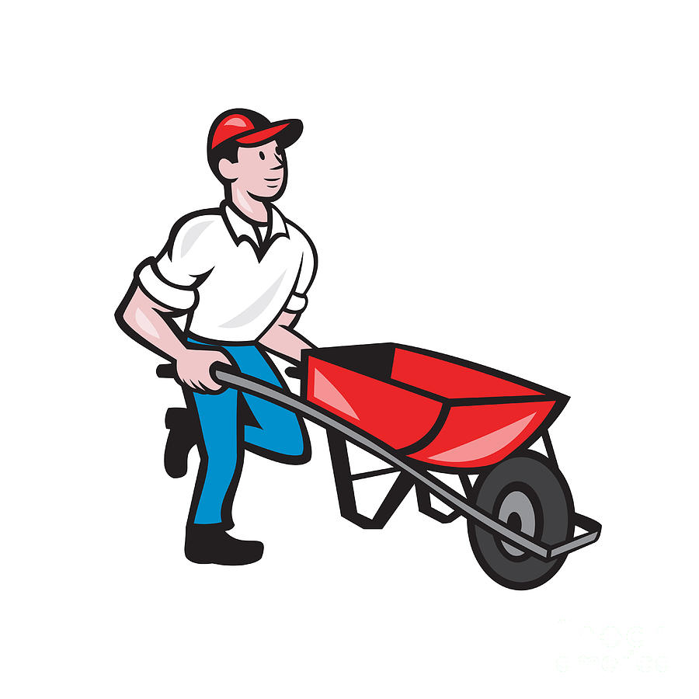
FLEXION
= stimulates consumption (Streicher and Estes 2016, Förster 2003)

Slide 13
Hypothesis Development (Streicher and Estes 2022)
H₁: Perpendicular handles (e.g., horizontal, vertical) more strongly activate the extensor muscles, whereas parallel handles more strongly activate the flexor muscles.
H₂: Relative to handles that activate extensor muscles (e.g., horizontal handles), parallel handles increase purchase quantity and spending.
Muscle Activation
Van den Bergh et al. (2011); Streicher and Estes (2016)
H1: EMG Study
Handle Orientation
H2: Lab & Field Study
Purchasing & Spending
Slide 13/23

Slide 14
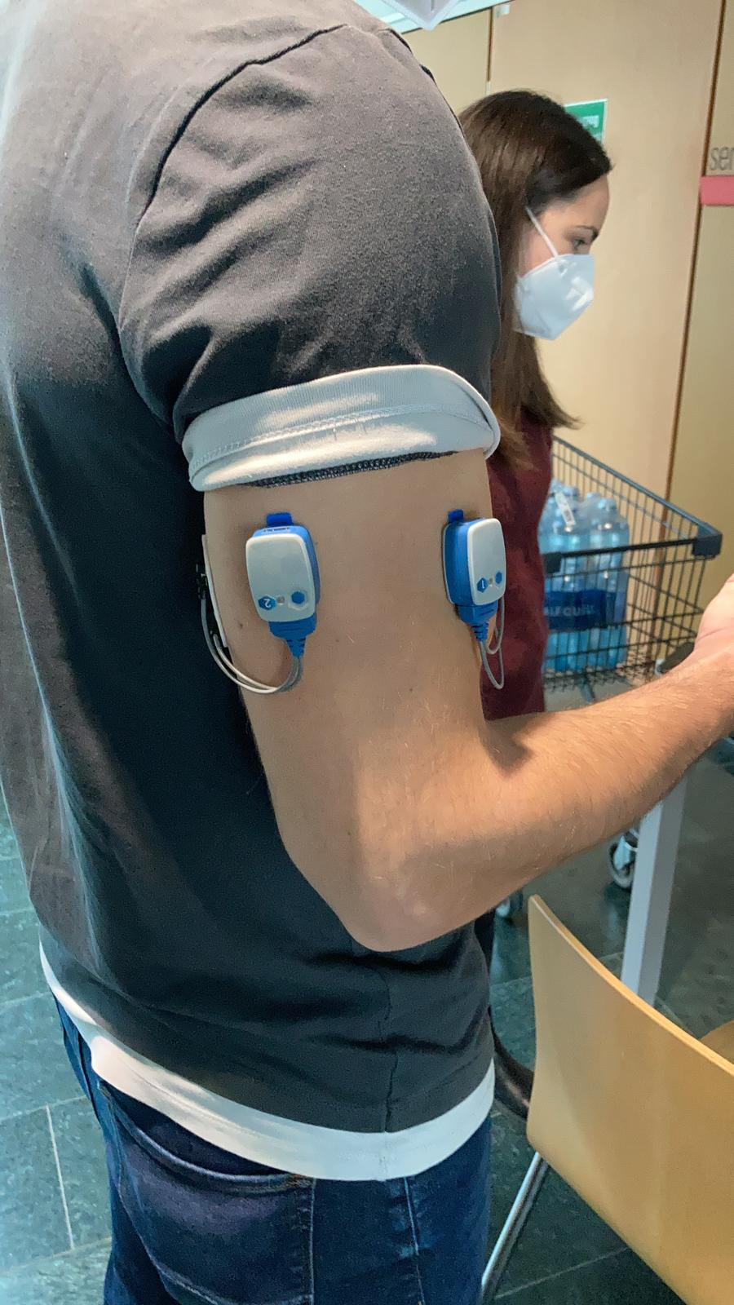
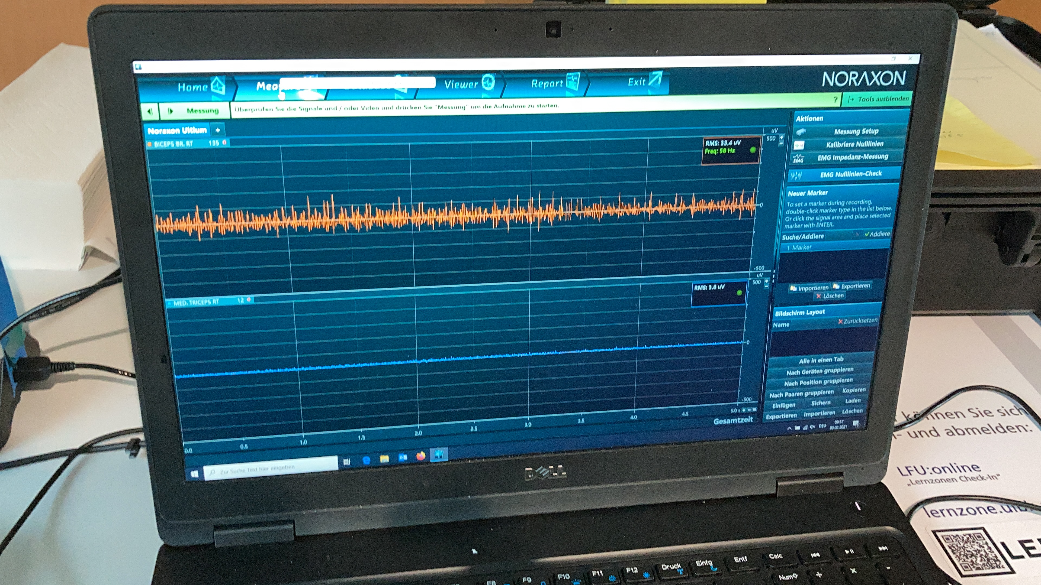
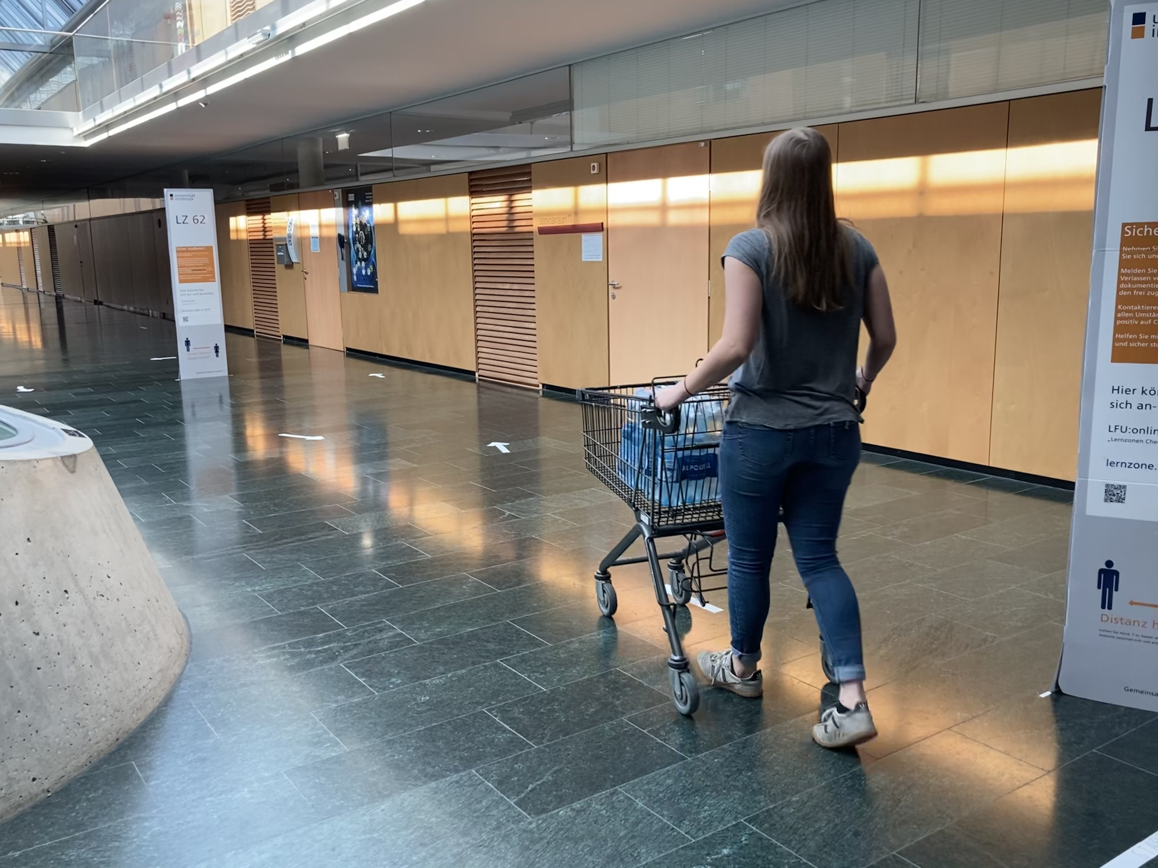
EMG Study (Streicher and Estes 2022)
N = 23 (44% female)
Within-design
Slide 14/23

Slide 15
Lab Study (Streicher and Estes 2022)
Methods
N = 141 students (lab)
Design: One-factorial between-Ps (horizontal, vertical, or parallel)
Stimuli: 44 common supermarket products in 7 categories (e.g., beverages, snacks), with discounted prices, presented across 12 displays
Procedure: Ps gently pushed the shopping cart against a wall while viewing the product displays on a computer, and indicated how many of each product they would like to purchase at the given price
DVs: purchase quantity*,variety, spending
Controls: grip force, push force, mood, gender, age
Extreme Outliers: windsorized (replacement by nearest non-extreme value). Outliers were rare, and their inclusion or exclusion had no effect on the significance of our main results
Covariates: if control measure differed between condition, then included as covariate. If not, then not.
Slide 15/23

Slide 16
Field Study (Streicher and Estes 2022)
Design & Procedure
Setting: 9am – 5pm on 3 consecutive weekdays in a 1000 m² supermarket
N = 388 shoppers (194 per group)
Design: one-factorial between design: horizontal vs. parallel handle
Procedure: Participating shoppers were randomly assigned to one of the two carts in alternating order (pseudo-random) to ensure equal distribution of the carts across day-time
Unbeknownst to the shoppers, at the time of checkout, the cashier scanned a special card to indicate whether the shopper had a parallel cart or a horizontal cart
DVs: purchase quantity, variety, and spending
Controls: time of day
Extreme Outliers: windsorized (replacement by nearest non-extreme value). Extreme Outliers were rare, and their inclusion or exclusion had no effect on the significance of our main results
Slide 16/23

Slide 17
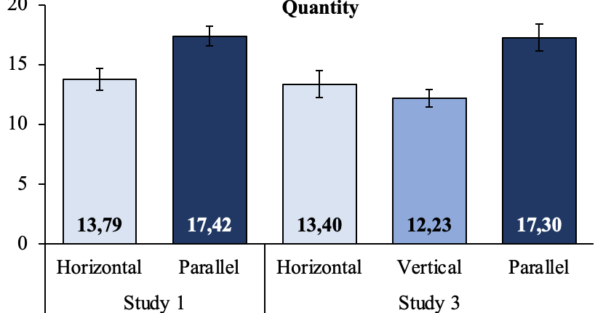
Overall Study Results
Field
Lab
Slide 17/23

Slide 18
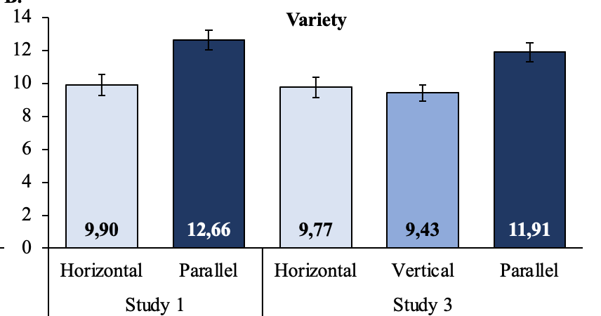
Overall Study Results
Field
Lab
Slide 18/23

Slide 19
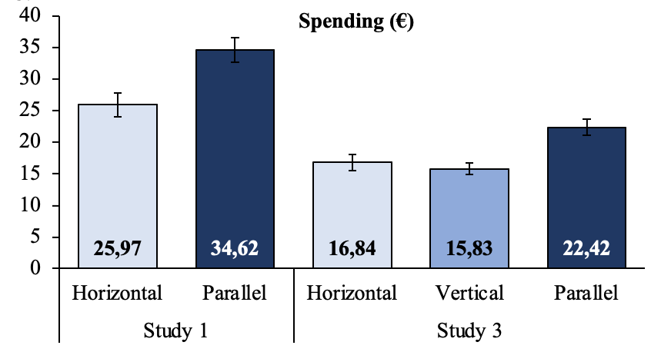
Overall Study Results
Field
Lab
Slide 19/23

Slide 20
Discussion
Academic contributions: Prior research has investigated how smart shopping carts can influence spending by providing real-time feedback about total costs (Van Ittersum et al. 2013). The present project is the first to examine the physical properties of the shopping cart itself as factor for shopping & spending.
Consumer Welfare: For the majority of shoppers, who face a constant battle against over-spending and over-consumption, the standard shopping carts may act as a welcome and unexpected restraint on buying and spending. For shoppers, who wish to make purchases in order to generate happiness (“retail therapy, see Atalay and Meloy 2011) or for shoppers who wish to stock up their needs in order to minimize smaller fill-in trips common carts in the marketplace may act as unwelcomed restriction. Lastly, parallel handles, such as those on rollators for the mobility-impaired, reduce leg muscle exertion and can improve stability while walking (Suica et al. 2016). Hence, parallel-handle cart could be beneficial for such consumers.
Managerial Implications: Currently retailers focus more on aesthetic/ergonomic aspects when designing applications used in retail environments. We demonstrate that such a focus can come at the cost of profits.
Thank you for your attention!
Slide 20/23

Slide 21
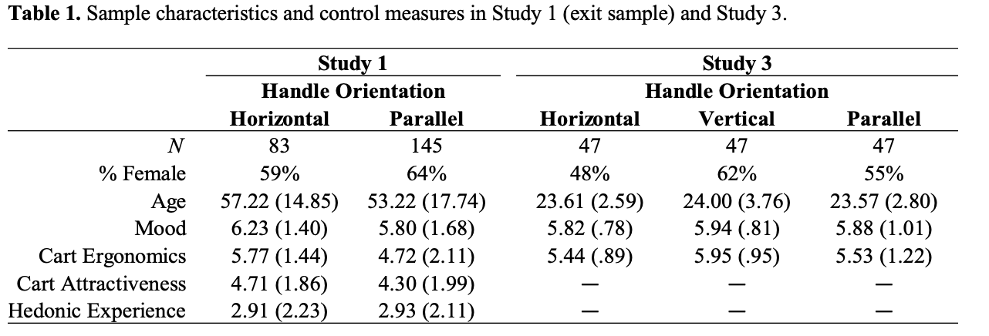
Back-up: Controls for lab & field study
Field Study
Lab Study
Slide 21

Slide 22
Media
Unsurprisingly they have found a sensational topic for Black Friday and Christmas…
Use of standard shopping trolleys can help shoppers to save money
Got a handle on your supermarket spending: A new trolley design could
loosen your grip
How putting side handles on a shopping trolley could make you spend more money (and it's all to do with the science of wheelbarrows)
Slide 22/23

Slide 23
Managers
Key Insights:
New handle could be a potential point of differentiation and source of brand equity
Handle designs are mostly based on ergonomics and aesthetics
Parallel handles as ours have never been considered
All interviewed stakeholders expressed their surprise that handle orientation could influence shopping behavior
the parallel handles are novel and their predicted effect on sales was non-obvious.
Do not only focus on aesthetics or ergonomics in designing physical contact points with consumers
Consider psychological knowledge
Head of Corporate Innovation Head Product Manager
Owner/CEO
Slide 23/23

Slide 24
Thank you for your attention!
Atalay, A. Selin, and Margaret G. Meloy (2011), "Retail therapy: A strategic effort to improve mood," Psychology & Marketing, 28 (6), 638-659.
Barsalou, L. W. (2009). Simulation, situated conceptualization, and prediction. Philosophical Transactions of the Royal Society B: Biological Sciences, 364(1521), 1281-1289.
Chen, M., & Bargh, J. A. (1999). Consequences of automatic evaluation: Immediate behavioral predispositions to approach or avoid the stimulus. Personality and social psychology bulletin, 25(2), 215-224.
Di Domizio, Jennifer, and Peter J. Keir (2010), “Forearm posture and grip effects during push and pull tasks,” Ergonomics, 53 (3), 336-343.
Elder, R. S., & Krishna, A. (2012). The “visual depiction effect” in advertising: Facilitating embodied mental simulation through product orientation. Journal of Consumer Research, 38(6), 988-1003.
Förster, J. (2003). The influence of approach and avoidance motor actions on food intake. European Journal of Social Psychology, 33(3), 339-350.
Gibson, J. J. (1979), The Ecological Approach to Visual Perception, Boston, MA: Houghton, Mifflin, and Company.
Glenberg, A. M., & Kaschak, M. P. (2002). Grounding language in action. Psychonomic bulletin & review, 9(3), 558-565.
Lin, J. H., McGorry, R. W., & Chang, C. C. (2012). Effects of handle orientation and between-handle distance on bi-manual isometric push strength. Applied ergonomics, 43(4), 664-670.
Roman-Liu, D., & Tokarski, T. (2005). Upper limb strength in relation to upper limb posture. International Journal of Industrial Ergonomics, 35(1), 19-31.
Suica, Zorica, Jacqueline Romkes, Amir Tal, and Clare Maguire (2016), "Walking with a four wheeled walker (rollator) significantly reduces EMG lower-limb muscle activity in healthy subjects," Journal of bodywork and movement therapies, 20 (1), 65-73.
Solarz, A. K. (1960). Latency of instrumental responses as a function of compatibility with the meaning of eliciting verbal signs. Journal of experimental psychology, 59(4), 239.
Streicher, M. C. and Estes, Z. (2016). Shopping to and fro: Ideomotor compatibility of arm posture and product choice.
Journal of Consumer Psychology, 26(3), 325-336.
Tucker, M., & Ellis, R. (1998). On the relations between seen objects and components of potential actions. Journal of Experimental Psychology: Human perception and performance, 24(3), 830.
Van den Bergh, Bram, Julien Schmitt, and Luk Warlop (2011), "Embodied myopia," Journal of Marketing Research, 48 (December), 1033-1044.
Van Ittersum, Koert, Brian Wansink, Joost ME Pennings, and Daniel Sheehan (2013), "Smart shopping carts: How real-time feedback influences spending," Journal of Marketing, 77 (November), 21-36.
Slide 24

