Slide 1
Shape preservation of evolution equations
András Bátkai, ELTE Budapest
A. Bobrowski (Lublin)
TexPoint fonts used in EMF.
Read the TexPoint manual before you delete this box.: AAAAAAA

Slide 2
What is shape? What is shape preservation? Examples:
Positivity preservation:
Monotonicity preservation:
Convexity/concavity preservation:
More involved:

Slide 4
Monotonicity:
Convexity:
Wentzell boundary conditions
Negative Convexity:
Convexity:

Slide 5
Some more references:
convexity preservation of general nonlocal Wentzell b.c.

Slide 6
Theorem:

Slide 7
Theorem:
(Miyadera-Voigt perturbation)
(generalization of Arendt-Rhandi)

Slide 8
Delay-equations
Reference:
Semigroups for Delay Equations
(with S. Piazzera)
A K Peters, 2005

Slide 9
TexPoint fonts used in EMF.
Read the TexPoint manual before you delete this box.: AAAAA

Slide 10
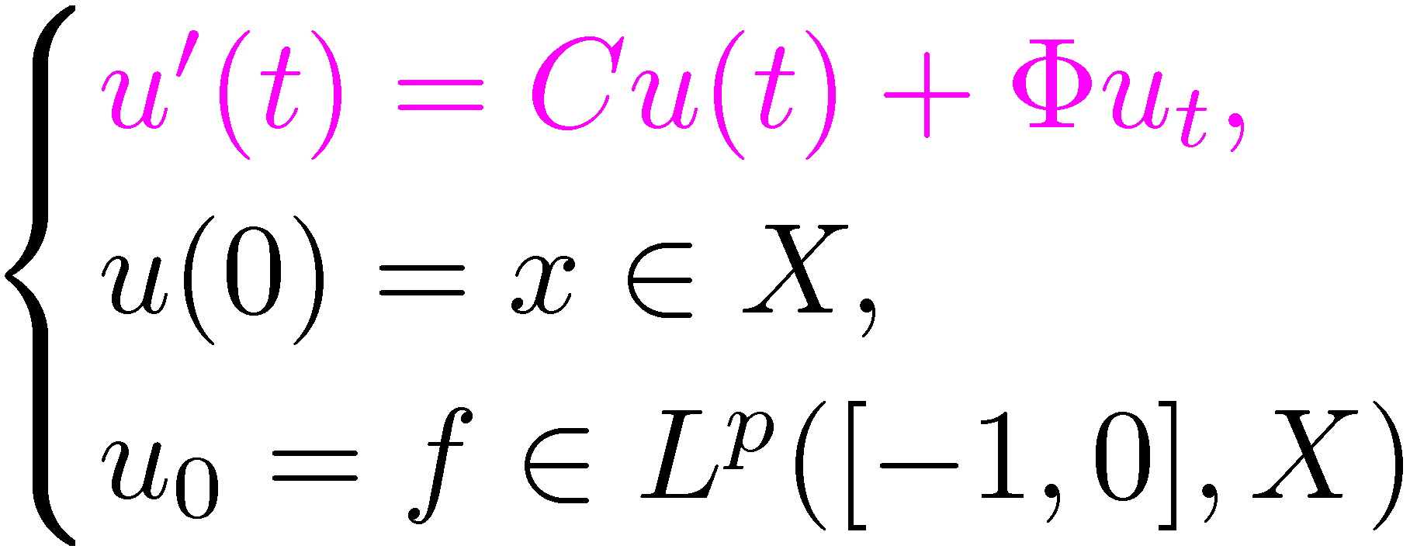
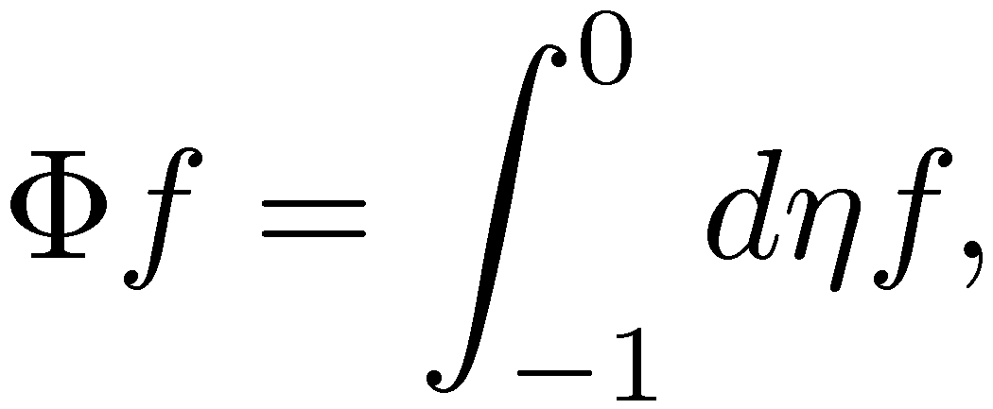

Slide 11
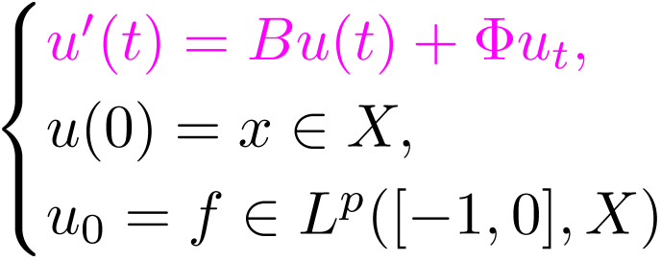
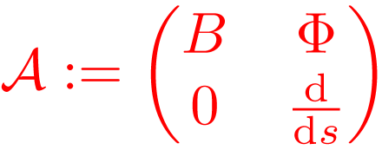

Slide 12
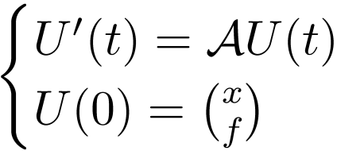

Slide 13
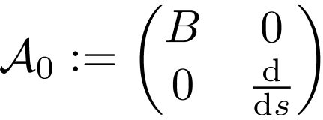
Miyadera-Voigt perturbation

Slide 14
monotonicity preservation
convexity preservation

