Slide 1
A 3D-Modell as Means to Store Written and Pictorial Historical Sources
Richard Kurdiovsky (ÖAW) Julia Forster (TU Wien)
Andreas Voigt (TU Wien) Christoph Hoffmann (ÖAW-ACDH)
Herbert Wittine Elmar Schmidinger
Gabriel Wurzer (TU Wien)

Slide 2
Sources and Concept
Viewer & Intended Use
The architecture
Outlook – Next Steps

Slide 3
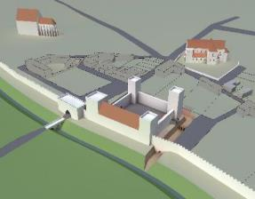
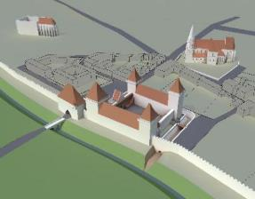
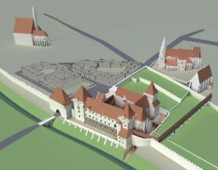
A 3D – Modell for analogue use
original 3D – modell(s) created for rendering images in print publications
ca. 1300
ca. 1380
ca. 1500

Slide 4
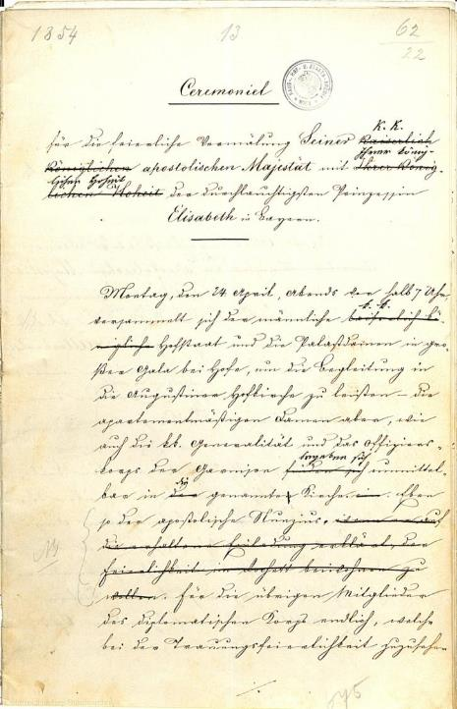
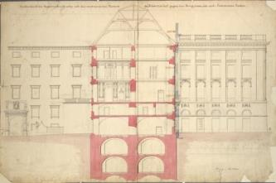
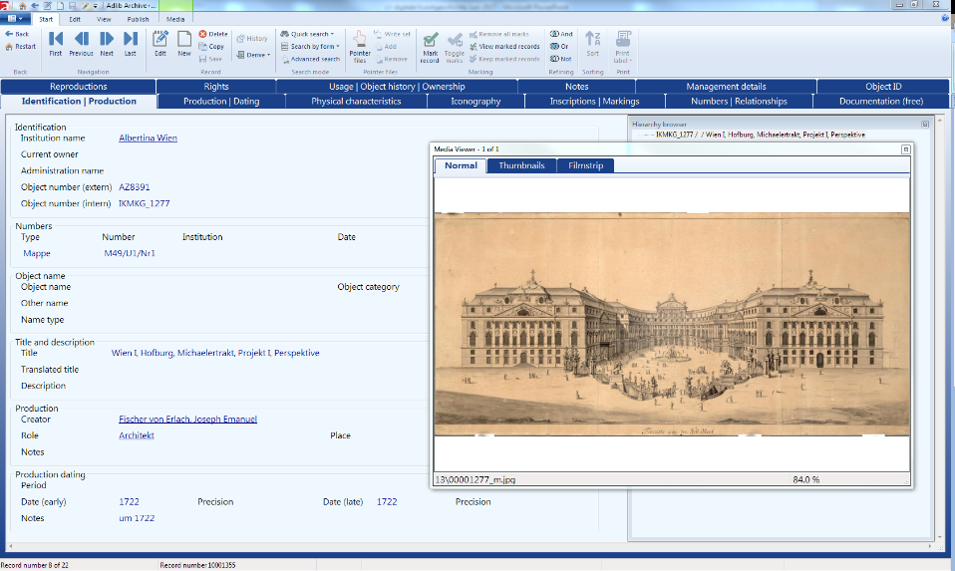
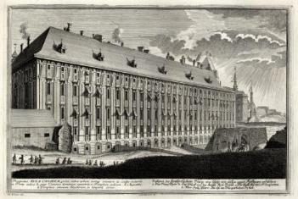
Classical Archival Resources
Digital assets catalogued in ISAD(G) in Adlib

Slide 5
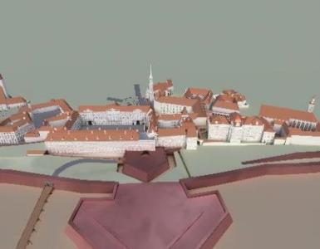
Spatial Discovery & Assisted Navigation

Slide 6
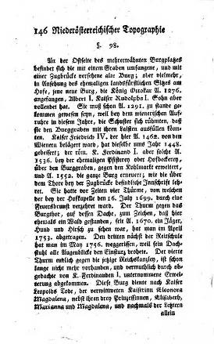
Diachronic Views
ca. 1740
ca. 1792

Slide 7
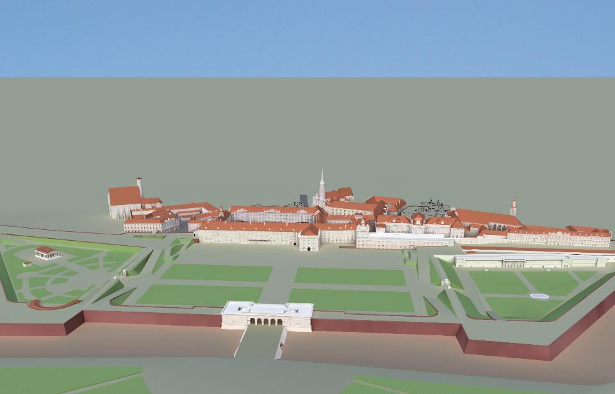
The Viewer – Spatial Discovery
View Level 0
+
Schweizertrakt
Stallburg
-
Augustinerkirche
Amalienburg
Reichskanzleitrakt
2D | 3D
HOF-
BURG
Trakte
Gebäudeteile
Geschoß
Räume
Schriftquellen (30.000)
Bildquellen (10.000)
myNotes (12)
Amalienburg
Reichskanzleitrakt
Schweizerhof
Stallburg
Augustinerkirche
1300
1835
2017

Slide 8
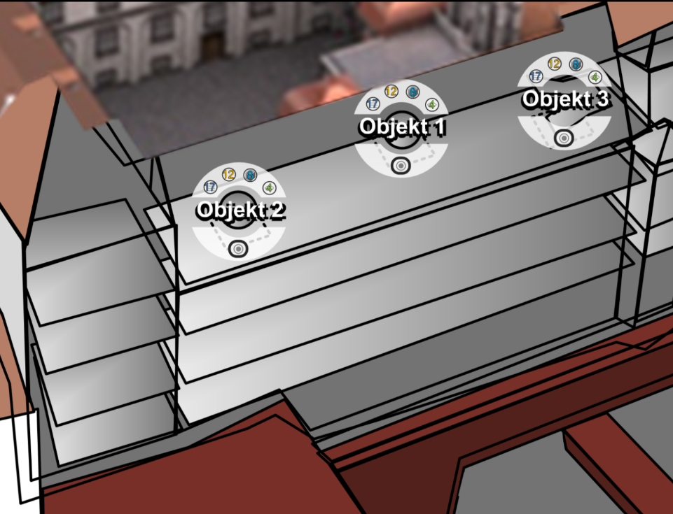
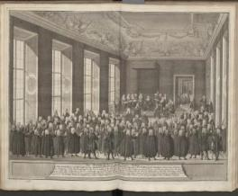
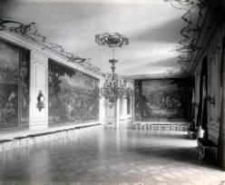
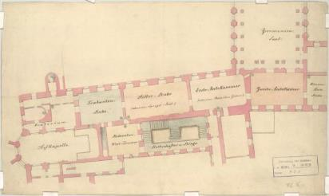
View Level 4

Slide 9
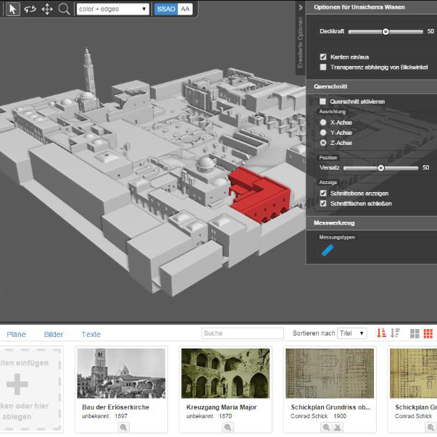
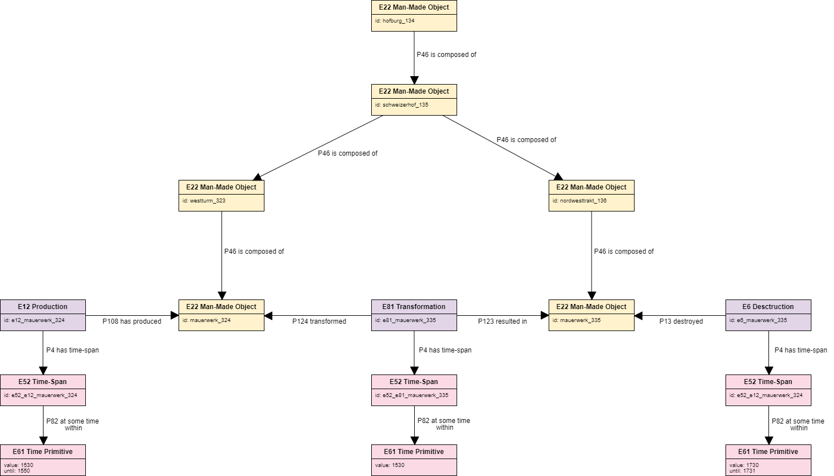
DokuVis als Basis
Geschrieben von Jonas Bruschke HTW Dresden
https://github.com/Brakebein/DokuVis

Slide 10
Proposed Architecture
Dokuvis/
Backend
Dokuvis/
Frontend
Source
Databases

Slide 11
Next Steps – Help?
Convert partonomy to CIDOC (?)
Test APIs of Source DBs for performance

