Slide 1
Institute for the Sociology of Law and Criminology (IRKS)

Slide 2
Institute for the Sociology of Law and Criminology (IRKS)
Background:
Founded 1973: non-university research institution addressing current social and legal challenges
Since March 2021: part of the Faculty of Social and Political Sciences at the University of Innsbruck
Members:
14
Interdisciplinary research:
Sociology, Law, Political Science, Criminology, Cultural and Social Anthropology, Social History, Psychology
Currently running third-party funded projects:
9
Website:
https://www.uibk.ac.at/irks/

Slide 3
Members: Mag. Dr. Mayrhofer Hemma Dr. iur. Hammerschick Walter Mag. Dr. Hofinger Veronika Mag. Dr. Fritsche Andrea Mag. Hager Isa MMag. Koller Martina BA Neuburg Florian Dr. Pelikan Christa BA Pflegerl Philipp Univ. Doz. Dr. Pilgram Arno MA Sahin Ufuk MA Steigmann Felix Mag. Dr. Tzanetakis Meropi MA Walter Rebecca
Institute for the Sociology of Law and Criminology

Slide 4
Main Topics Research Methods
Security
Crime
Violence and extremism
Legal norms
Social control
Social work
Mixed methods, focus on qualitative methods
Surveys and quantitative data analysis
Analysis of judicial files and crime statistics
Digital ethnography
Web scraping

Slide 5
Aims
- Scientific basis for evidence-based practice in politics and society
- Implementation of measures and laws
- Effects of social and legal interventions
- Strengthening the rule of law, social security and the social participation of multiple stakeholder groups

Slide 6
Three research focuses
Security Reseach
Criminology
Sociology of Law

Slide 7
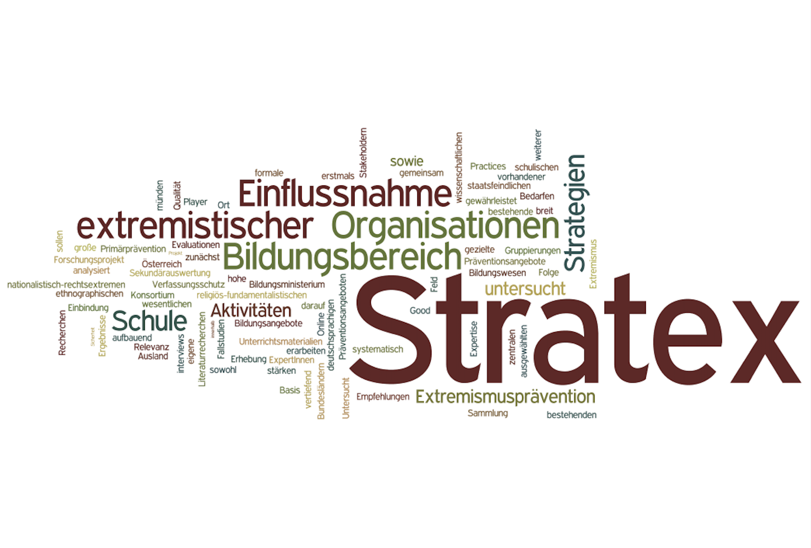
Security Reseach - Exemplary Research Project
Stratex –
Strategies of extremist organisations in the education sector
Aim: Analyses of the objectives, strategies, networks and the concrete approaches of extremist organisations
Provision of information necessary for primary prevention against extremism in Austria
Methods: Online survey, expert interviews, document analysis; in-depth case studies: (digital) ethnography
Funding: Austrian Security Research Programme KIRAS
Notes:
Analyses of the objectives, strategies, networks and the concrete approaches of extremist organisations (nationalist/right-wing extremist, religious fundamentalist and anti-state/esoteric movement) in the education sector in order to inform primary prevention against extremism in Austria.

Slide 8
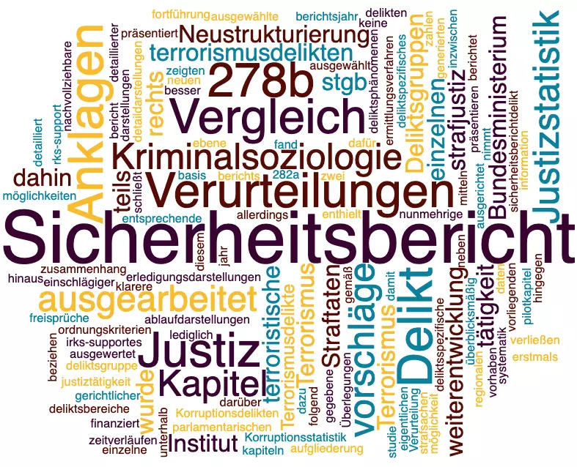
Criminology - Exemplary Research Project
Security Report –
Report on the Activities of the Criminal Justice System
Aim: Better understanding judiciary completion patterns for terrorism offenses under sections 278b to g and 282a of the Criminal Code
Data: Judicial statistics on terrorism offenses, criminal court statistics on demographic characteristics of offenders, six-year observation period (2015 - 2020)
Funding: Austrian Federal Ministry of Justice

Slide 9
Sociology of Law - Exemplary Research Project
FRALTERNA - Evaluation of the practical application of restrictions on freedom and alternative measures in risk situations in nursing homes
Aim: Generating evidence-based knowledge concerning the application practice of physical and chemical restraints as well as alternatives in nursing homes.
Policy recommendations for action and implementation
Methods: Online-survey (care staff, residents’ representatives, judges), in-depth case studies (mixed methods), longitudinal secondary data analysis
Funding: Austrian Security Research Programme KIRAS
Notes:
Generating evidence-based knowledge on how restrictions on freedom in different types of care institutions are applied, monitored and controlled; gaining substantial knowledge on less invasive alternatives in the context of the “HeimAufG” (Nursing Home Residence Act); contributing to the highest possible protection of persons concerned by restraints while preventing them form severe endangerments

Slide 10
Thank you!
Institute for the Sociology of Law and Criminology (IRKS)
Mag. Dr. Hemma Mayrhofer, Head of Department
hemma.mayrhofer@uibk.ac.at
Mag. Dr. Meropi Tzanetakis, Senior Scientist
meropi.tzanetakis@uibk.ac.at, @MeropiTzanet
https://www.uibk.ac.at/irks/

